Slide 1
PARENTS’ ORIENTATION PROGRAM
2023 -24
Class-1
Zee HIGH SCHOOL
Hayathnagar

Slide 2
The function of education is to teach one to think intensively and to think critically. Intelligence plus character – that is the goal of true education.” – Martin Luther King

Slide 3


Slide 4
HIGHEST SCORE – SUBJECT WISE
SUBJECT | MARKS
ENGLISH | 98
2nd LANGUAGE (HINDI) | 97
2nd LANGUAGE (TELUGU) | 96
MATH | 100
G.SCIENCE | 97
SOCIAL SCIENCE | 97
INFORMATION TECHNOLOGY | 100

Slide 5


Slide 6


Slide 7
ENGLISH
II LANG T/H
III LANG TELUGU
III LANG HINDI
MATHS
EVS
IT
Academics

Slide 8
SUBJECT | CLASS I
English | Mrs G.Swapna Mrs K.Sirisha
II Lang. Hindi | Mrs Divya Sharma Mrs Mangla Gite
II Lang. Telugu | Mrs RamTulasi Mrs Sujatha
III Lang Hindi | Mrs ManglaGite Mrs Sangeetha Tiwari
III Lang Telugu | Mrs RamaTulasi Mrs Pooja Mrs Sujatha
Math | Mrs Akhila Reddy Mrs Lavanya
EVS | Mrs Vijayalaxmi Mrs P.Sunitha Reddy
IT | Mrs Karuna

Slide 9
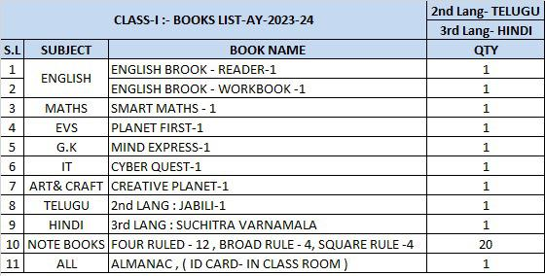
CLASS -1
BOOKS LIST

Slide 10
SUBJECT WISE MAINTENANCE OF NOTEBOOKS BY THE STUDENTS FOR THE ACADEMIC YEAR 2023-24
CLASS-1
SUBJECT | TYPE OF BOOK | CLASSWORK BOOK | SLIP TEST BOOK
ENGLISH | Four Ruled Book | 2 | 1
II LANG [TELUGU] | Broad Rule | 1 or 2 | 1
II LANG [HINDI] | Broad Rule | 1 or 2 | 1
III LANG [TELUGU] | Broad Rule | 1 or 2 | 1
III LANG [HINDI] | Broad Rule | 1 or 2 | 1
MATH | Square Rule | 2 | 1
EVS | Four Ruled Book | 2 | 1
IT | Four Ruled Book | 1 | 1

Slide 11
ASSESSMENT STRUCTURE
Grade -I
P T 1 | P T 2 | PT Scale To | Note Book | SEA | Term 1 | TOTAL
25M | 25M | 10M | 5M | 5M | 60M (scaled to 30) | 50M (10+5+5+30=50M)
PT 3 | PT 4 | PT Scale To | Note Book | SEA | Term 2 | TOTAL
25M | 25M | 10 M | 5M | 5M | 60 M (scaled to 30) | 50 M (10+5+5+30=50M)
TERM 1 + TERM 2 = 100M

Slide 12
CLASS -1
Term 1 & 2 Exam(100M)
Written Exam for 60 Marks (scaled to 30)

Slide 13
Weekly Assessment Schedule
From Monday to Friday
Spell check: Between 8.30 & 9.00 a.m
Weekly test will be given in almanac and conducted by the subject teachers

Slide 14
HOMEWORK Schedule
Day | Class I
Monday | MATH | ENGLISH | EVS
Tuesday | MATH | ENGLISH | II LANG
Wednesday | Math | EVS | II Lang
Thursday | MATH | ENGlish | II LANG
Friday | MATH | ENGLISH | EVS
SATURday | G.K | COMPUTERS | EVS / II LANG

Slide 15
WEEKLY ASSESSMENT Schedule
Day | Class I
Monday | -------------------
Tuesday | MATH
Wednesday | ENGLISH
Thursday | II LANG
Friday | EVS

Slide 16

PARENT APP POWERED BY Edmatix
.Username : Admision number
.Password : DOB of ward
https://itunes.apple.com/in/app/edmatix-parents-app/id1460578434?mt=8

Slide 17
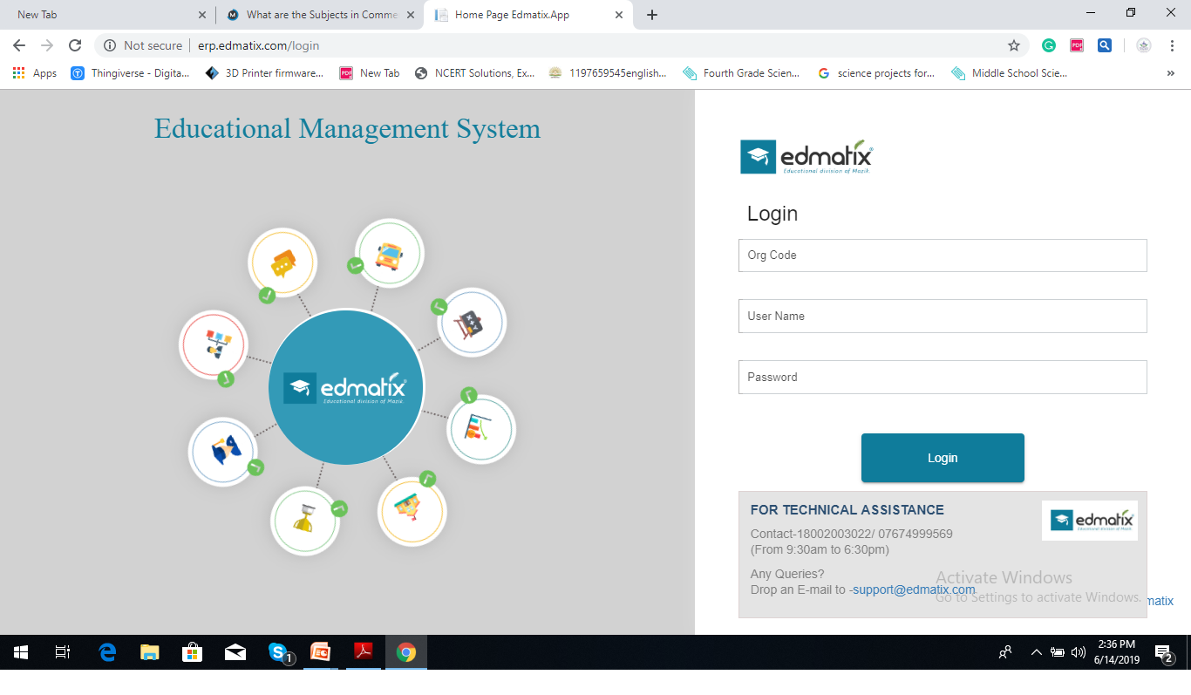
Contact:Nikita-9000835242

Slide 18
Co –scholastics Activities
Art Education
Visual
&
Performing Art
Physical Education
Assessed on a 5 point grading scale.

Slide 19
Physical Education
Karate
General Games

Slide 20
Art Education
PERFORMING ARTS
Music
DANCE

Slide 21
Art Education
Visual Arts
Drawing
&
Painting
Craft

Slide 22
Regularity
Punctuality
Dress Code
Discipline
A process of
controlling
one's behavior
and actions,
either through
self-motivation
or through teaching
Assessed on a 5 point grading scale.

Slide 23
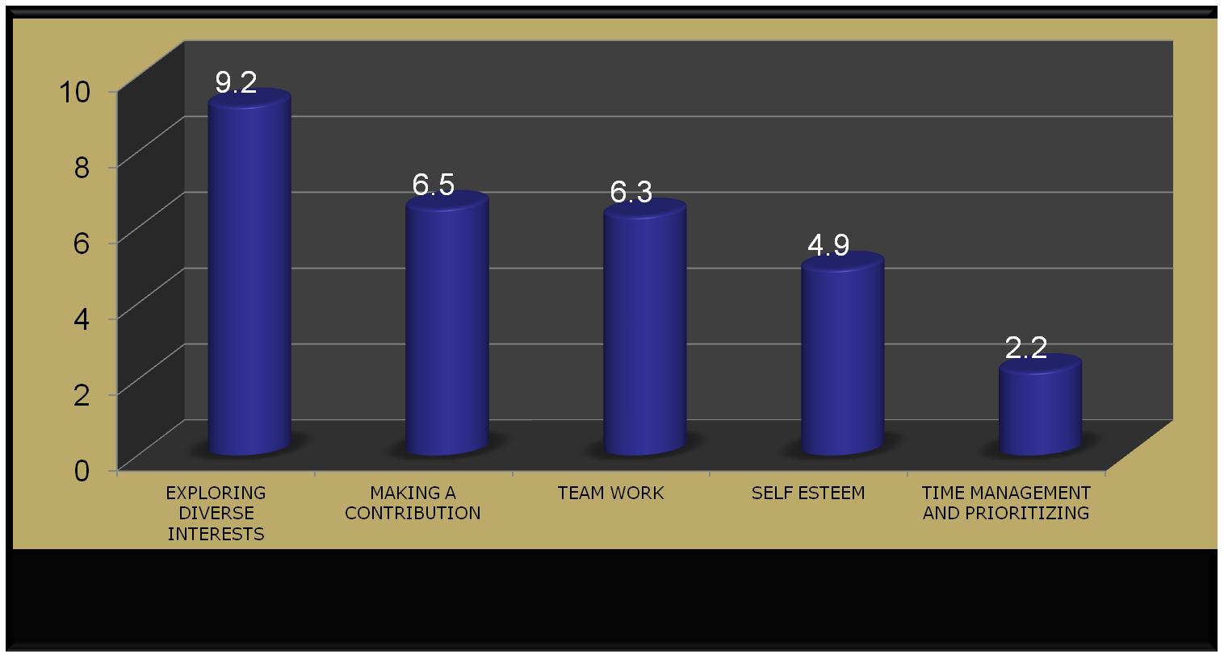
“Competition is always a good thing. It forces us to do our best. A monopoly renders people complacent and satisfied with mediocrity.”

Slide 24
Inter House Competitions
SPORTS
ENGLISH
SCIENCE
CLUBS
SOCIAL
Art & Craft
MATHS

Slide 25
External Competitions
Development of
Competitive Spirit
SOF Olympiads
  NCO
  NSO
  IEO
  ISKO
  IMO
Interschool Competitions
AVANTIKA
BALOTSAV

Slide 26

At the end of the day, the most overwhelming key to a child's success is the positive involvement of parents.

Slide 27


Slide 28
LEVEL | CO-ORDINATOR | INCHARGE | CONTACT NUMBERS
Pre-Primary | RAJEENA |  | 8466861216
I | G.SWAPNA | VIJAYRANI | 7730901242
II | C.SWATHI | VIJAYRANI | 9347976835
III | KEERTHI | VIJAYRANI | 9652608914
IV | KAVITHA | VIJAYRANI | 7730901666
V | ARUNA | VIJAYRANI | 9063608914
VI | NAGA POORNIMA |  | 8919767840
VII | SRIVENI |  | 9347823052
VIII | BHAVYA |  | 9398182919
IX | KONDA MADHURI |  | 9398568778
X | KAVITHA SRIPATHI |  | 9347792582
XI&XII | RAGHUNATH RAO |  | 7730901222

Slide 29
AREA | INCHARGE | CONTACT NUMBERS
TRANSPORT | Mr. PRABHAKAR | 7997131415
ACCOUNTS | Mr.SATYANARAYANA Mr. SURESH | 9010105106
MAINTENANCE | Mr. FAZAL | 9849408877
ADMIN | Mr. SRIDHAR REDDY Mrs. NIKITHA | 9966028284 9000835242
FRONT OFFICE | Mrs MOUNIKA Mrs BHAVANI REDDY | 7730872621
SPORTS DEPT. | Mr. SUDHAKAR | 9963887998

Slide 30



“The education of a child involves three major components: Teacher, Student and Parent.”
Student
Teacher
Parent

Slide 31
YOUR SUPPORT
BE INVOLVED:
Please check the almanac regularly and acknowledge.
Please check their books regularly and keep us informed. In case of long absence , send a note through almanac so that teacher with your support can get the work completed by the child.
Parent app powered by Edmatix.
If any concern kindly communicate through almanac.
SUPPORT: SCHOOL RULES AND GOALS

Slide 32
COMMUNICATION
Website
whatsapp
Edmatix

Slide 33
SPORTS COACHING
FOOTBALL
VOLLEYBALL
BASKETBALL
CRICKET
SKATING
BADMINTON
KARATE

Slide 34


Slide 35

Fees
Tuition
Transport

Slide 36


Slide 37


Slide 38

INCHARGE -A day with Parents
VISIT
VIJAYARANI MAM :
WEDNESDAY
Between
10 a.m
&
3.00 p.m

Slide 39
Thank You

