Slide 1
Parents’ Orientation
program
2023 -24
clasS 3
Zee HIGH SCHOOL
Hayathnagar

Slide 2
The function of education is to teach one to think intensively and to think critically. Intelligence plus character – that is the goal of true education.” – Martin Luther King

Slide 4
HIGHEST SCORE – SUBJECT WISE
SUBJECT | MARKS
ENGLISH | 98
2nd LANGUAGE (HINDI) | 97
2nd LANGUAGE (TELUGU) | 96
MATH | 100
G.SCIENCE | 97
SOCIAL SCIENCE | 97
INFORMATION TECHNOLOGY | 100

Slide 7
ENGLISH
II LANG T/H
III LANG T/H
MATHS
GENERALSCIENCE
SOCIAL SCIENCE
IT
Academics

Slide 8
Subject wise maintainance of note books By the students for the academic year 2023-24

Slide 9
SUBJECT | CLASS Iii
English | Mrs Farinaaz Ms Hari Priya
II Lang. Hindi | Mrs Mangala Gite Mrs Divya Sharma
II Lang. Telugu | Mrs Tulasi Mrs Sujatha
III Lang Hindi | Mrs Mangala Gite Mrs Sangeetha
III Lang Telugu | Mrs Sarada Mrs Pooja
Math | Mrs Sarada Mrs Lavanya
G.Science | Mrs Keerthi
Social Science | Mrs Prasanna
IT | Mrs Shwetha

Slide 10
ASSESSMENT STRUCTURE
Grade III
P T 1 | P T 2 | PT Scale To | Note Book | SEA | Term 1 | TOTAL
25M | 25M | 10M | 5M | 5M | 60 M (scale to 30M) | 50 M (10+5+5+30=50M)
PT 3 | PT 4 | PT Scale To | Note Book | SEA | Term 2 | TOTAL
25M | 25M | 10 M | 5M | 5M | 60 M (scale to 30 M) | 50 M (10+5+5+30=50M)
Final Result TERM 1 + TERM 2 = 100M

Slide 11
Weekly Assessment Schedule
From Monday to Friday
Spell check between 8:30 am to 9:00 am
Weekly test portion will be given in almanac by the subject teacher.
Test will be conducted by the subject teacher in their period.

Slide 12
Spell check schedule
Day | ClassES Iii
Monday | English
Tuesday | Science
Wednesday | Assembly
Thursday | Social
Friday | II LANG
Saturday | It

Slide 13
Weekly Assessment Schedule
Day | ClassES Iii
Monday | MATH
Tuesday | SOCIAL
Wednesday | SCIENCE
Thursday | ENGLISH
Friday | II LANG

Slide 14
Home assignment Schedule
Monday | Math | SOCIAL | ENGLISH
Tuesday | math | SCIENCE | Ii langUAGE
Wednesday | Math | SOCIAL | ENGLISH
Thursday | Math | SCIENCE | II LANGUAGE
Friday | Math | SOCIAL | ENGLISH
saturday | math | SCIENCE | II LANGUAGE

Slide 15
PARENT APP POWERED BY Edmatix
https://itunes.apple.com/in/app/edmatix-parents-app/id1460578434?mt=8

Slide 16
Contact:Nikita-9000835242

Slide 17
Co –scholastics Activities
Art Education
Visual
&
Performing Art
Physical Education
Assessed on a 5 point grading scale.

Slide 18
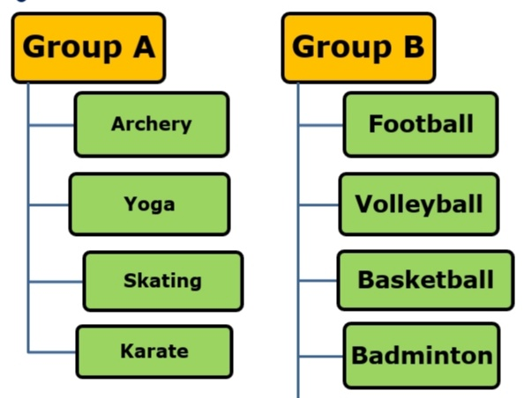
Physical Education

Slide 19
Art EducatioN
Performing Arts
pERFORMING ARTS
Dance
VOCAL MUSIC

Slide 20
Art Education
Visual Arts
Drawing
&
Painting
Craft

Slide 21
Regularity
Punctuality
Dress Code
Discipline
A process of
controlling
one's behavior
and actions,
either through
self-motivation
or through teaching
Assessed on a 5 point grading scale.

Slide 22
“Competition is always a good thing. It forces us to do our best. A monopoly renders people complacent and satisfied with mediocrity.”

Slide 23
Inter House Competitions
ENGLISH
SPORTS
SCIENCE
CLUBS
SOCIAL
Art & Craft
MATHS

Slide 24
External Competitions
Development of
Competitive Spirit
SOF Olympiads
NCO
NSO
IEO
ISKO
IMO
Interschool Competitions
AVANTIKA
BALOTSAV

Slide 25
At the end of the day, the most overwhelming key to a child's success is the positive involvement of parents.

Slide 27
LEVEL | CO-ORDINATOR | INCHARGE | CONTACT NUMBERS
Pre-Primary | RAJEENA |  | 8466861216
I | G.SWAPNA | VIJAYRANI | 7730901242
II | C.SWATHI | VIJAYRANI | 9347976835
III | KEERTHI | VIJAYRANI | 9652608914
IV | KAVITHA | VIJAYRANI | 7730901666
V | ARUNA | VIJAYRANI | 9063608914
VI | NAGA POORNIMA |  | 8919767840
VII | SRIVENI |  | 9347823052
VIII | BHAVYA |  | 9398182919
IX | KONDA MADHURI |  | 9398568778
X | KAVITHA SRIPATHI |  | 9347792582
XI&XII | RAGHUNATH RAO |  | 7730901222

Slide 28
AREA | INCHARGE | CONTACT NUMBERS
TRANSPORT | Mr. PRABHAKAR | 7997131415
ACCOUNTS | Mr.SATYANARAYANA Mr. SURESH | 9010105106
MAINTENANCE | Mr. FAZAL | 9849408877
ADMIN | Mr. SRIDHAR REDDY Mrs. NIKITHA | 9966028284 9000835242
FRONT OFFICE | Mrs MOUNIKA Mrs BHAVANI REDDY | 7730872621
SPORTS DEPT. | Mr. SUDHAKAR | 9963887998

Slide 29
“The education of a child involves three major components: Teacher, Student and Parent.”
Student
Teacher
Parent

Slide 30
YOUR SUPPORT
BE INVOLVED:
Please check the almanac regularly and acknowledge.
Please check their books regularly and keep us informed. In case of long absence , send a note through almanac so that teacher with your support can get the work completed by the child.
Parent app powered by Edmatix software.
If any concern kindly communicate through almanac.
SUPPORT: SCHOOL RULES AND GOALS

Slide 31
COMMUNICATION
Website
whatsapp
Edmatix

Slide 32
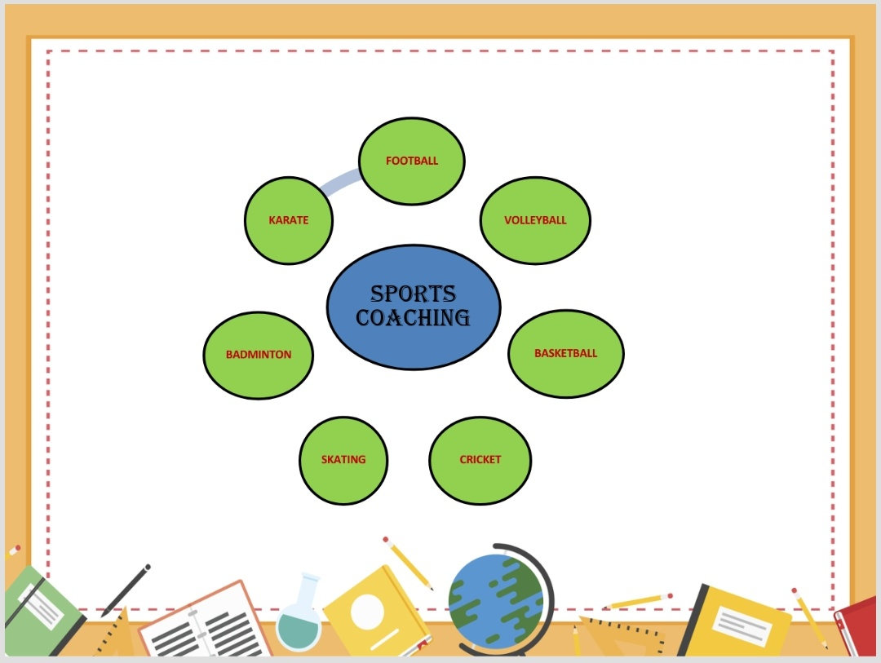
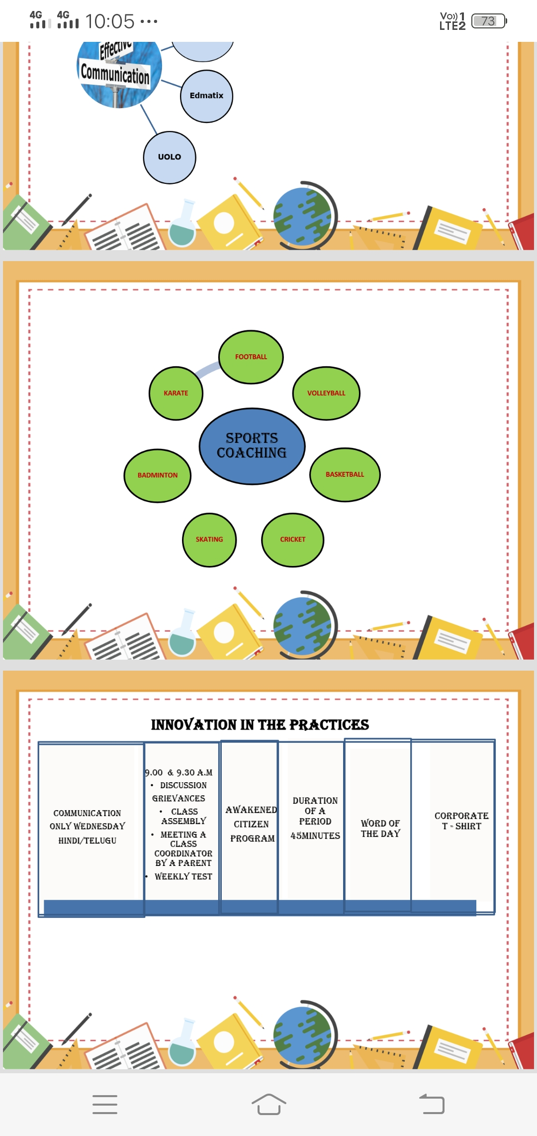
SPORTS COACHING
FOOTBALL
VOLLEYBALL
BASKETBALL
SKATING
BADMINTON
KARATE
C

Slide 33
INNOVATION IN THE PRACTICES
COMMUNICATION Only Wednesday Hindi/Telugu | 8.30 & 9.00 a.m Discussion Grievance Class Assembly | Duration of a period 45minutes | Word of THE DAY | Corporate T - Shirt

Slide 35
Fees
Tuition
Transport

Slide 38
Academic incharge-A day with Parents

Slide 39
Thank You

