Slide 1
PARENTS’ Orientation PROGRAM
2023 -24
class 5
Zee HIGH SCHOOL
Hayathnagar

Slide 2
The function of education is to teach one to think intensively and to think critically. Intelligence plus character – that is the goal of true education.” – Martin Luther King

Slide 4
HIGHEST SCORE – SUBJECT WISE
SUBJECT | MARKS
ENGLISH | 98
2nd LANGUAGE (HINDI) | 97
2nd LANGUAGE (TELUGU) | 96
MATH | 100
G.SCIENCE | 97
SOCIAL SCIENCE | 97
INFORMATION TECHNOLOGY | 100

Slide 7
ENGLISH
II LANG T/H
III LANG T/H
MATHS
GENERALSCIENCE
SOCIAL SCIENCE
IT
Academics

Slide 8
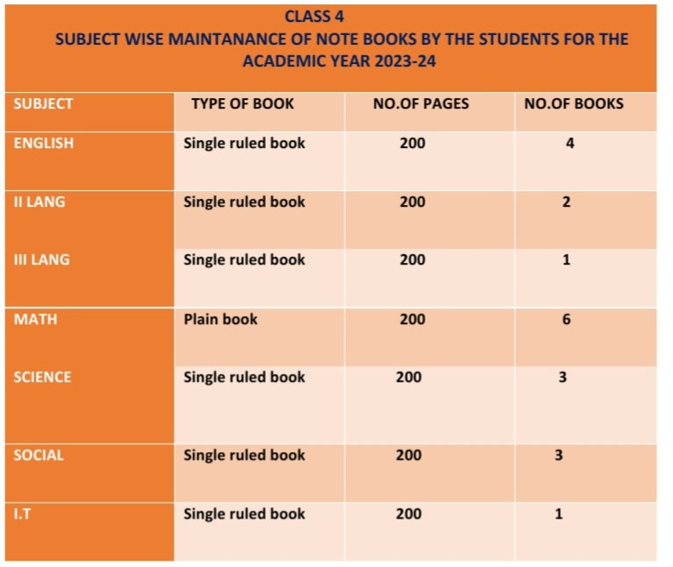

Slide 9
SUBJECT | CLASS V
English | Mrs Masarrath Mrs Sirisha
II Lang. Hindi | Mrs Thamkin Mrs Kausar Mrs Divya
II Lang. Telugu | Mrs Jayalakshmi Mrs Uma Maheshwari
III Lang Hindi | Mrs Keya Mrs Sangeetha
III Lang Telugu | Mrs Tulasi Mrs Sujatha Mrs Pooja
Math | Mrs Padmavati Mrs Vinitha
G.Science | Mrs Ashwini Mrs Aruna
Social Science | Mrs Nagalaxmi Mrs Rajeshwari
IT | Mrs Shwetha, Mrs Kalpana

Slide 10
ASSESSMENT STRUCTURE
Grade V
P T 1 | P T 2 | PT Scale To | Note Book | SEA | Term 1 | TOTAL
25M | 25M | 10M | 5M | 5M | 80M | 100M
PT 3 | PT 4 | PT Scale To | Note Book | SEA | Term 2 | TOTAL
25M | 25M | 10 M | 5M | 5M | 80 M | 100 M
FINAL RESULT: TERM 1 + TERM 2 = 200M SCALE TO = 100 M

Slide 11
Weekly Assessment Schedule
From Monday to Friday
Schedule with portion will be forwarded every weekend
Tests will be conducted by Subject teachers
in their respective periods
Practice of spell check between 8:30 to 9:30
Result will be released every fortnight
Check Parent app powered by Edmatix for the same using the credentials
Username: Admission Number
Password: DOB of ward

Slide 12
Weekly Assessment Schedule
Day | ClassES V
Monday | MATH
Tuesday | SOCIAL
Wednesday | SCIENCE
Thursday | ENGLISH
Friday | II LANG

Slide 13
Home assignment Schedule
Monday | Math | SOCIAL | ENGLISH
Tuesday | math | SCIENCE | Ii lang
Wednesday | Math | SOCIAL | ENGLISH
Thursday | Math | SCIENCE | II LANG
Friday | Math, | SOCIAL | ENGLISH
saturday | math | SCIENCE | II LANG

Slide 14
PARENT APP POWERED BY Edmatix
https://itunes.apple.com/in/app/edmatix-parents-app/id1460578434?mt=8

Slide 15
Contact:Nikita-9000835242

Slide 16
Co –scholastics Activities
Art Education
Visual
&
Performing Art
Physical Education
Assessed on a 5 point grading scale.

Slide 17
Physical Education
Group A
Archery
Yoga
Skating
Group B
Football
Volleyball
Basketball
Cricket
Kho Kho
Badminton
Karate
Kabaddi

Slide 18
Art Education
Performing Arts
Group C
Performing Arts
Vocal Music
Instrumental Music
Dance
Dramatics
Zumba Dance

Slide 19
Art Education
Visual Arts
Drawing
&
Painting
Craft

Slide 20
Regularity
Punctuality
Dress Code
Discipline
A process of
controlling
one's behavior
and actions,
either through
self-motivation
or through teaching
Assessed on a 5 point grading scale.

Slide 21
“Competition is always a good thing. It forces us to do our best. A monopoly renders people complacent and satisfied with mediocrity.”

Slide 22
Inter House Competitions
ENGLISH
SPORTS
SCIENCE
CLUBS
Art & Craft
SOCIAL
MATHS

Slide 23
External Competitions
Development of
Competitive Spirit
SOF Olympiads
NCO
NSO
IEO
ISKO
IMO
Interschool Competitions
AVANTIKA
BALOTSAV

Slide 24
At the end of the day, the most overwhelming key to a child's success is the positive involvement of parents.

Slide 26
LEVEL | CO-ORDINATOR | INCHARGE | CONTACT NUMBERS
Pre-Primary | RAJEENA |  | 8466861216
I | G.SWAPNA | VIJAYRANI | 7730901242
II | C.SWATHI | VIJAYRANI | 9347976835
III | KEERTHI | VIJAYRANI | 9652608914
IV | KAVITHA | VIJAYRANI | 7730901666
V | ARUNA | VIJAYRANI | 9063608914
VI | NAGA POORNIMA |  | 8919767840
VII | SRIVENI |  | 9347823052
VIII | BHAVYA |  | 9398182919
IX | KONDA MADHURI |  | 9398568778
X | KAVITHA SRIPATHI |  | 9347792582
XI&XII | RAGHUNATH RAO |  | 7730901222

Slide 27
AREA | INCHARGE | CONTACT NUMBERS
TRANSPORT | Mr. PRABHAKAR | 7997131415
ACCOUNTS | Mr.SATYANARAYANA Mr. SURESH | 9010105106
MAINTENANCE | Mr. FAZAL | 9849408877
ADMIN | Mr. SRIDHAR REDDY Mrs. NIKITHA | 9966028284 9000835242
FRONT OFFICE | Mrs MOUNIKA Mrs BHAVANI REDDY | 7730872621
SPORTS DEPT. | Mr. SUDHAKAR | 9963887998

Slide 28
“The education of a child involves three major components: Teacher, Student and Parent.”
Student
Teacher
Parent

Slide 29
YOUR SUPPORT
BE INVOLVED:
Please check the almanac regularly and acknowledge.
Please check their books regularly and keep us informed. In case of long absence , send a note through almanac so that teacher with your support can get the work completed by the child.
Edmatix Parent app.
If any concern kindly communicate through almanac.
SUPPORT: SCHOOL RULES AND GOALS

Slide 30
COMMUNICATION
Website
whatsapp
Edmatix

Slide 31
SPORTS COACHING
FOOTBALL
VOLLEYBALL
BASKETBALL
CRICKET
SKATING
BADMINTON
KARATE

Slide 32
INNOVATION IN THE PRACTICES
COMMUNICATION Only Wednesday Hindi/Telugu | 8.30 & 9.00 a.m Discussion Grievance Class Assembly | Duration of a period 45minutes | Word of THE DAY | Corporate T - Shirt

Slide 34
Fees
Tuition
Transport

Slide 37
ACADEMIC INCHARGE-A day with Parents
WEDNESDAY
Between
10 a.m
&
3.00 p.m
For prior appointment
contact
Front Office

Slide 38
Thank You

