Slide 1
Orientation
2023 -24
pre-primary
Zee HIGH SCHOOL
Hayathnagar

Slide 2
The function of education is to teach one to think intensively and to think critically. Intelligence plus character – that is the goal of true education.” – Martin Luther King

Slide 3


Slide 4
LITERACY SKILLS
NUMERACY SKILLS
GENERAL AWARENESS
RHYMES
STORY TELLING
ART AND CRAFT
Academics
NURSERY

Slide 5
LITERACY SKILLS
NUMERACY SKILLS
GENERAL AWARENESS
RHYMES
STORY TELLING
ART AND CRAFT
Academics
LKG

Slide 6
LITERACY SKILLS
NUMERACY SKILLS
GENERAL AWARENESS
II LANGUAGE (HINDI/TELUGU)
STORY TELLING
ART AND CRAFT
RHYMES
Academics
UKG

Slide 7
INSTRUCTIONS TO THE PARENTS
Monday till Thursday child should come in school uniform
Every Friday child should come in civil dress according to the monthly color.
Extra pair of dress in a bag pack.
No valuable items are allowed.
calling time for co- ordinator 8:30 am to 4:30pm.

Slide 8
Term 1 Exam(50M)
Written Exam for 50 Marks with syllabus coverage as below:
Classes Nursery ,LKG , UKG: Term I syllabus

Slide 9
ACTIVITIES
SEASON ACTIVITY
GANESH CLAY MODELING
TRANSPORT
ACTIVITY
VEG. CARVING
COMMUNITY HELPERS
CRAFT
SHARING AND CARING

Slide 10
FESTIVALS
KRISHNA ASHTAMI
DUSSEHRA
CHRISTMAS
RAMADAN
HOLI
SANKRANTHI
RAKHI
DIWALI

Slide 11
CompetitiON
  TOY TALK
  RHYMES RECITATION
  STORY TELLING
  JAM SESSION
  SPELL BEE
FANCY DRESS COMPETITION
COLOURING AND COLLAGE WORK

Slide 12
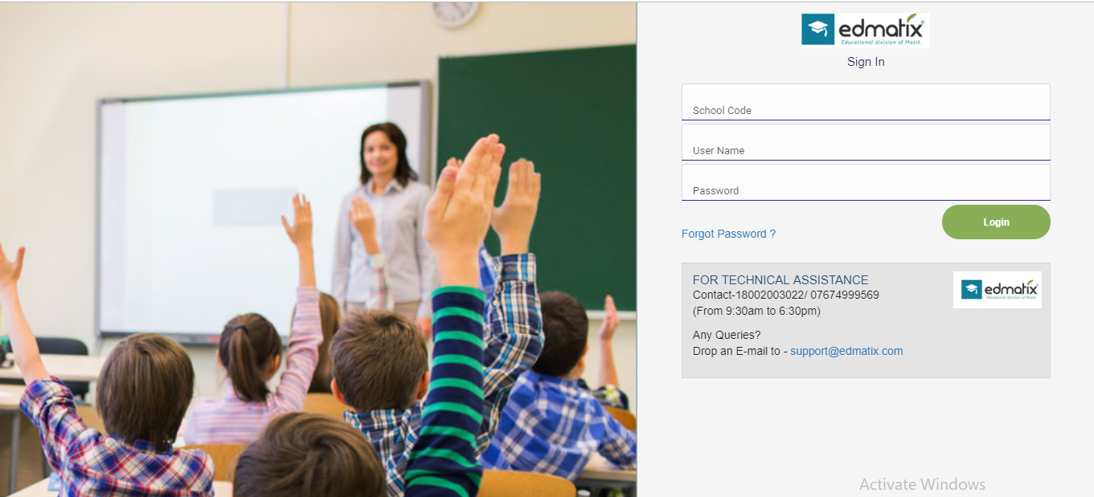
Edmatix Software
https://itunes.apple.com/in/app/edmatix-parents-app/id1460578434?mt=8

Slide 13
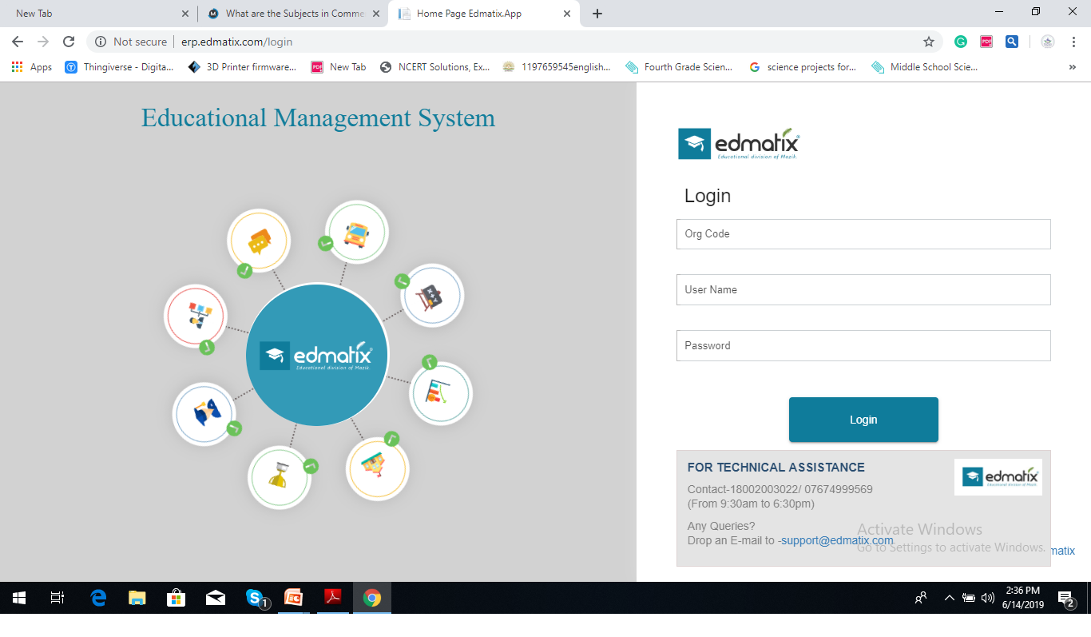
Contact:Nikita-9000835242

Slide 14
Regularity
Punctuality
Dress Code
Discipline
A process of
controlling
one's behavior
and actions,
either through
self-motivation
or through teaching
Assessed on a 5 point grading scale.

Slide 15
“Competition is always a good thing. It forces us to do our best. A monopoly renders people complacent and satisfied with mediocrity.”

Slide 16

At the end of the day, the most overwhelming key to a child's success is the positive involvement of parents.

Slide 17


Slide 18



“The education of a child involves three major components: Teacher, Student and Parent.”
Student
Teacher
Parent

Slide 19
LEVEL | CO-ORDINATOR | INCHARGE | CONTACT NUMBERS
Pre-Primary | RAJEENA THOMAS |  | 8466861216
I | G.SWAPNA | VIJAYRANI | 7730901242
II | C.SWATHI | VIJAYRANI | 9347976835
III | KEERTHI | VIJAYRANI | 9652608914
IV | KAVITHA | VIJAYRANI | 7730901666
V | ARUNA | VIJAYRANI | 9063608914
VI | NAGA POORNIMA |  | 8919767840
VII | SRIVENI |  | 9347823052
VIII | BHAVYA |  | 9398182919
IX | KONDA MADHURI |  | 9398568778
X | KAVITHA SRIPATHI |  | 9347792582
XI&XII | RAGHUNATH RAO |  | 7730901222

Slide 20
AREA | INCHARGE | CONTACT NUMBERS
TRANSPORT | Mr. PRABHAKAR | 7997131415
ACCOUNTS | Mr.SATYANARAYANA Mr. SURESH | 9010105106
MAINTENANCE | Mr. FAZAL | 9849408877
ADMIN | Mr. SRIDHAR REDDY Mrs. NIKITHA | 9966028284 9000835242
FRONT OFFICE | Mrs MOUNIKA Mrs BHAVANI REDDY | 7730872621
SPORTS DEPT. | Mr. SUDHAKAR | 9963887998

Slide 21
YOUR SUPPORT
BE INVOLVED:
Please check the almanac regularly and acknowledge.
Please check their books regularly and keep us informed. In case of long absence , send a note through almanac so that teacher with your support can get the work completed by the child.
Edmatix Parent app.
If any concern kindly communicate through almanac.
SUPPORT: SCHOOL RULES AND GOALS

Slide 22
COMMUNICATION
Website
whatsapp
UOLO
Edmatix

Slide 23

Fees
Tuition
Transport

Slide 24


Slide 25


Slide 26

Principal-A day with Parents
WEDNESDAY
Between
10 a.m
&
3.00 p.m
For prior appointment
contact
Front Office

Slide 27
Thank You

Slide 32
Weekly Assessment Schedule
From Monday to Friday
Between 8.30 & 9.00 a.m
Schedule with portion will be forwarded every weekend
Result will be result every fortnight
Check Edmatix for the same using the credentials
Username: Admission Number
Password: DOB of ward

Slide 33
Weekly Assessment Schedule
Day | Class VI | Class VII | Class VIII
Monday | II Lang | Social | Social
Tuesday | Social | II Lang | Math
Wednesday | Math | Math | II Lang
Thursday | Science | Science | Science
Friday | English | English | English
Key Note: After every Periodic test
GALAXY EXAM (Competitive Based Exam)
will be conducted to improve
competence amongst the students.

Slide 34
Home assignment Schedule
Day | Class VI | Class VII | Class VIII
Monday | Math Social | Math Social | Math Social
Tuesday | math Ii lang | math Ii lang | math Ii lang
Wednesday | Math Science | Math Science | Math Science
Thursday | Math English | Math English | Math English
Friday | Math, Science | Math, Science | Math, Science
saturday | math Ii lang | Math Social | Math Social

Slide 35
CELEBRATIONS
OPENING DAY
GRAND PARENTS DAY
SPORTS DAY
CHILDREN’S DAY
TEACHER’S DAY
BIRTHDAY
ANNUAL DAY
GRADUATION DAY

Slide 36
Art Education
Performing Arts
Group C
Performing Arts
Vocal Music
Instrumental Music
Dance
Dramatics
Zumba Dance

Slide 37
Art Education
Visual Arts
Drawing
&
Painting
Craft

Slide 38
Inter House Competitions
SPORTS
ENGLISH
SCIENCE
CLUBS
SOCIAL
Art & Craft
MATHS

Slide 39
SPORTS COACHING
FOOTBALL
VOLLEYBALL
BASKETBALL
CRICKET
SKATING
BADMINTON
KARATE

Slide 40
INNOVATION IN THE PRACTICES
COMMUNICATION
Only Wednesday
Hindi/Telugu
9.00 & 9.30 a.m
Discussion
Grievances
Class Assembly
Meeting a Class Coordinator by a parent
Weekly Test
Awakened
Citizen
Program
Duration of a period
45minutes
Corporate T - Shirt
Word of the Day

