Slide 1
ZEE HIGH SCHOOL
Hayathnagar
Parents’
Orientation Programme
2024 -25
Class III
Notes:
1

Slide 2
"In the pursuit of academic excellence, there is no substitute for hard work, perseverance, and a willingness to go the extra mile. Success belongs to those who are willing to put in the effort."
Notes:
2

Slide 3
Grade X – 2014-15 to 2023-24
Ten Batches 100% Result
Notes:
3

Slide 4
Notes:
4

Slide 5
Grade XII – 2017-18 to 2023-24
Six Batches 100% Result
Notes:
5

Slide 6
Notes:
6

Slide 7
Academics
English
II Lang T/H
III Lang T/H
Mathematics
General Science
Social Studies
IT
11/06/24

Slide 8
Subject | Class III
English | Mrs.Massrath Mrs.Arshiya Mrs.B.Sowmya
II Lang.Hindi | Mrs.Divya Sharma Mrs.Nisha Tiwari Mrs.Kousar
II Lang. Telugu | Mrs.Sujatha Mrs.Tulasi
III Lang. Hindi | Mrs.Nisha Tiwari Mrs.Divya Sharma
III Lang.Telugu | Mrs.Tulasi Mrs.Uma
Math | Mrs.Swathi Mrs.Vinitha Mrs.Vijaya Lakshmi
General Science | Mrs.Rajeshwari Mrs.Keerthi Mrs.Lavanya
Social Studies | Mrs.Saritha Mrs.Kavitha Mrs.Naga Lakshmi Mrs.Prasanna
IT | Mrs.Swetha
Notes:
8

Slide 9
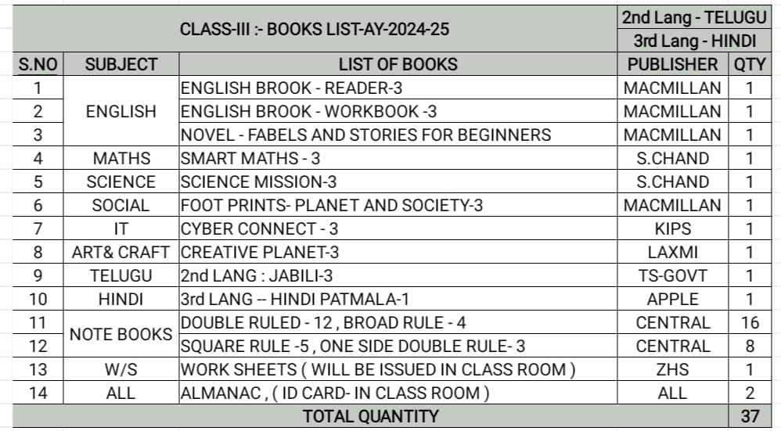
Notes:
9

Slide 10
SUBJECT WISE MAINTENANCE OF NOTEBOOKS BY THE STUDENTS FOR THE ACADEMIC YEAR 2024-25
Subject | Type of Book | Classwork Book | Slip test Book
ENGLISH | Double ruled | 3 | 1
MATHEMATICS | Square ruled | Class work-3 Practice book -1 | 1
GENERAL SCIENCE | One side double ruled and Double ruled | Class work-3(one side double ruled) Practice Book-1 | 1(double ruled)
SOCIAL STUDIES | Double ruled | 3 | 1
II LANGUAGE | Broad ruled | 2 | 1
III LANGUAGE | Broad ruled | 1 | -
IT | Double ruled | 1 | -
MUSIC | Double ruled | 1 | -

Slide 11
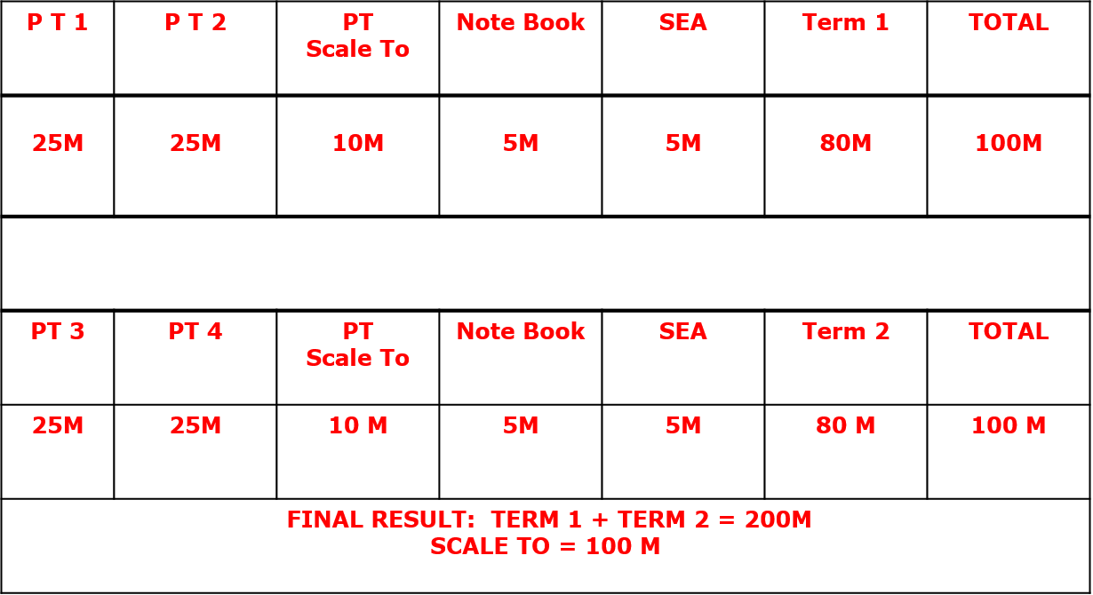
ASSESSMENT STRUCTURE
Grade III
FINAL RESULT: BEST OF TERMS
Notes:
11

Slide 12
Weekly Assessment Schedule
From Monday to Friday
Weekly test portion will be given in almanac by the subject teacher.
Assessment will be conducted in their respective periods.
Notes:
12

Slide 13
Weekly assessment Schedule
Day | Subject
Monday | Math
Tuesday | Social
Wednesday | Science
Thursday | English
Friday | II Language
Notes:
13

Slide 14
Home Assignment Schedule
MONDAY | MATH | SOCIAL | ENGLISH
TUESDAY | MATH | SCIENCE | II LANGUAGE
WEDNESDAY | MATH | SOCIAL | ENGLISH
THURSDAY | MATH | SCIENCE | II LANGUAGE
FRIDAY | MATH | SOCIAL | ENGLISH
SATURDAY | MATH | SCIENCE | II LANGUAGE
Notes:
14

Slide 15
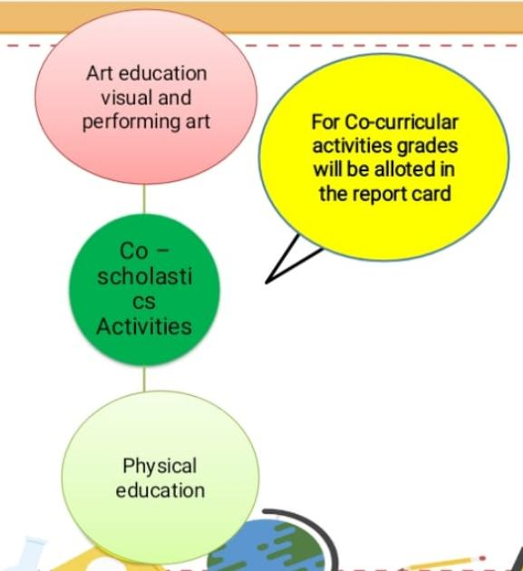
Assessed on a 5 point grading scale.
Notes:
15

Slide 16
Physical Education
Group A
Group B
Archery
Football
Yoga
Volleyball
Skating
Basketball
Karate
Badminton
Notes:
16

Slide 17
Art Education
Performing Arts
Performing Arts
Vocal Music
Dance

Slide 18
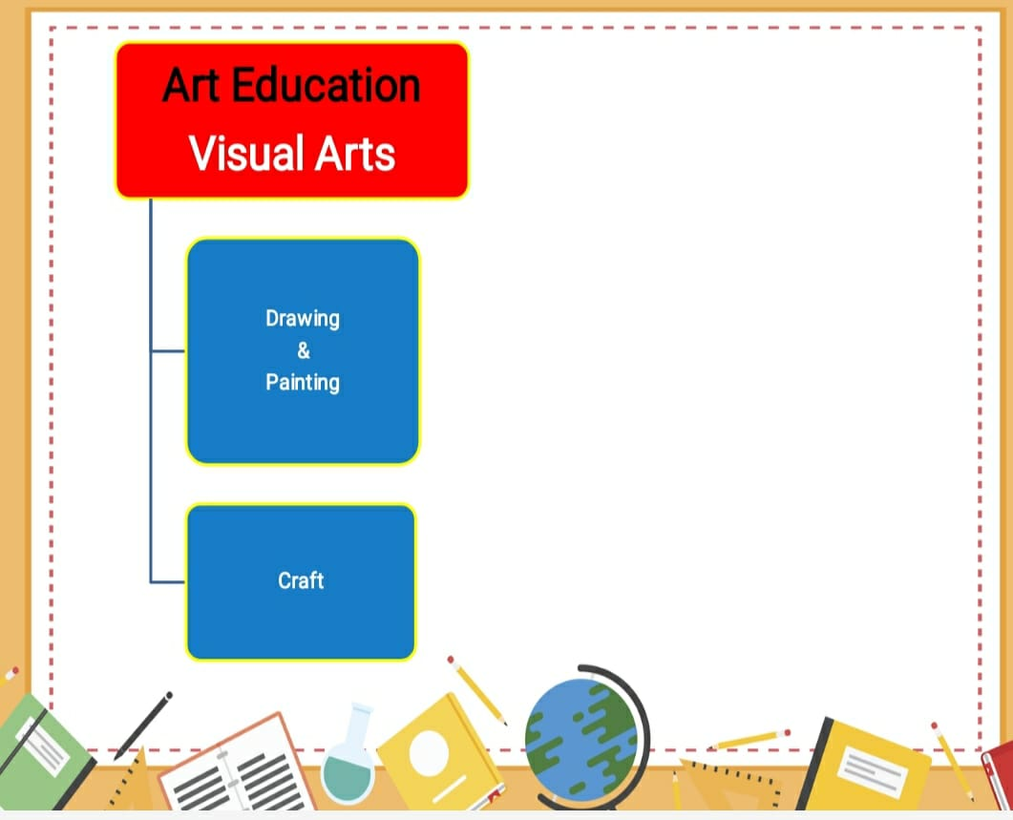
Notes:
18

Slide 19
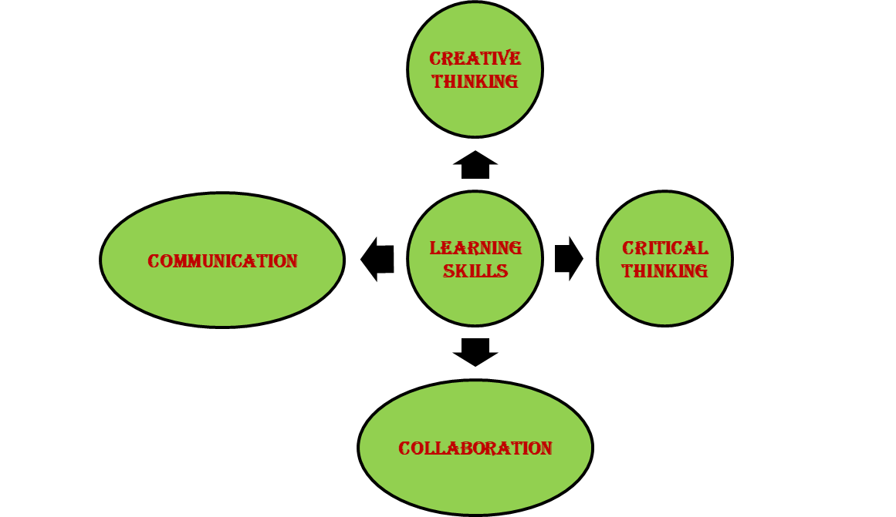
LEARNING SKILLS-4C’s

Slide 20
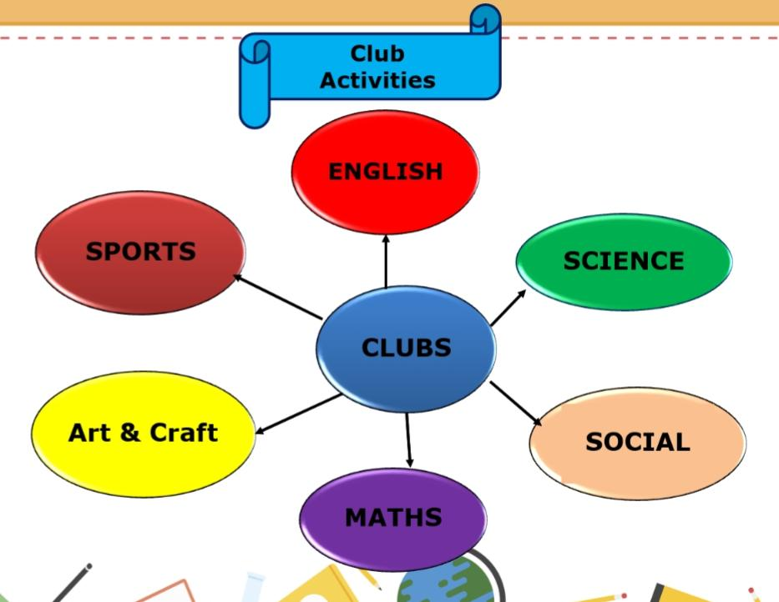
Active participation is mandatory for all the students for their overall
Development.
Subject-wise club will be conducted and prior information will be
given in Almanac
Notes:
20

Slide 21
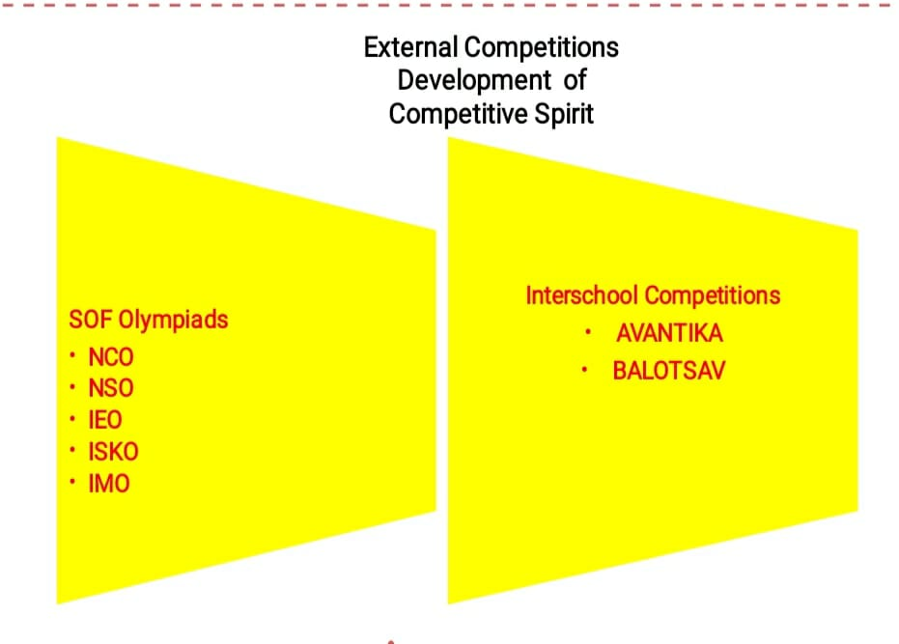
Science Olympiad Foundation(SOF)
National Cyber Olympiad(NCO)
National Science Olympiad(NSO)
International English Olympiad(IEO)
International Society for Knowledge Organization(ISKO)
International Mathematics Olympiad(IMO)
s

Slide 22
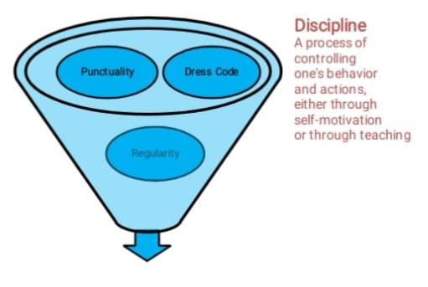
Notes:
22

Slide 23
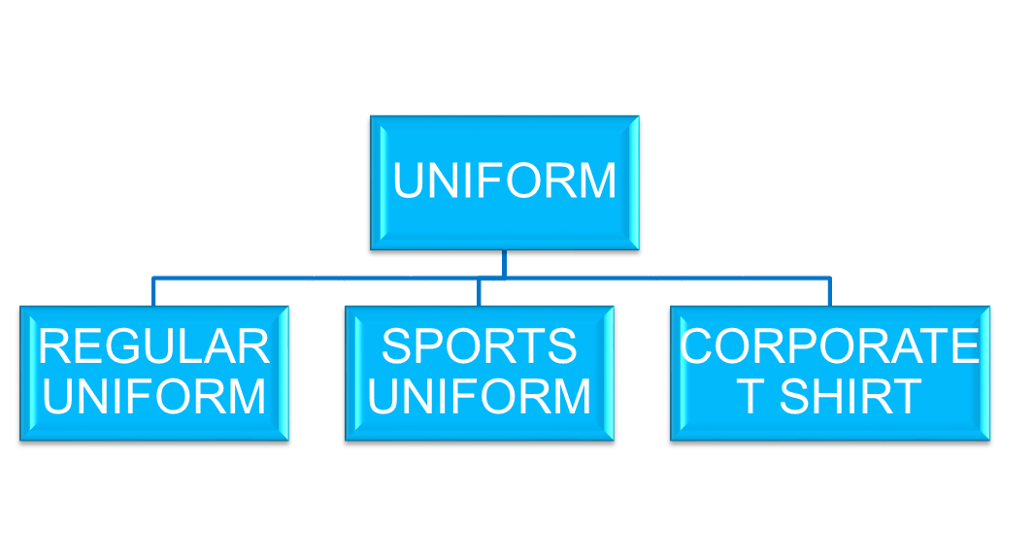
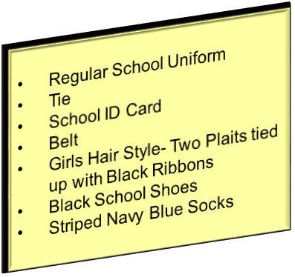
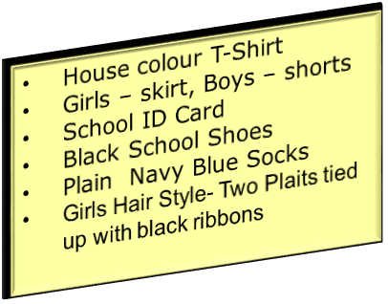
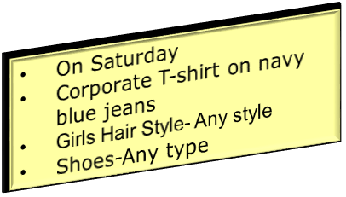

Slide 24
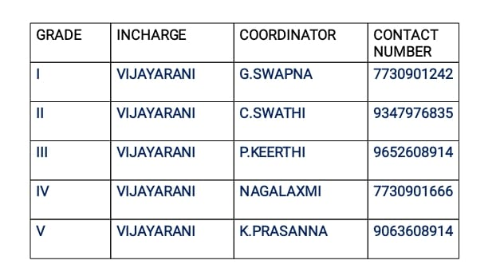

Slide 25
AREA
INCHARGE
CONTACT NUMBERS
TRANSPORT
Mr. PRABHAKAR
7997131415
ACCOUNTS
Mr. SURESH
Mrs KAVITHA
Mrs SHYAMALEE
9010105106
MAINTENANCE
Mr. FAZAL
9849408877
ADMIN
Mr. SRIDHAR REDDY
Mrs. BHAVANI
9966028284
9000835242
FRONT OFFICE
Mrs MOUNIKA
Mrs DEEPIKA
7730872621
SPORTS DEPT.
Mr. SUDHAKAR
9963887998
Notes:
25

Slide 27
ZEE HIGH SCHool APP POWERED BY Edmatix
https://itunes.apple.com/in/app/edmatix-parents-app/id1460578434?mt=8

Slide 28
Fees
Tuition
Transport
Notes:
28

Slide 29
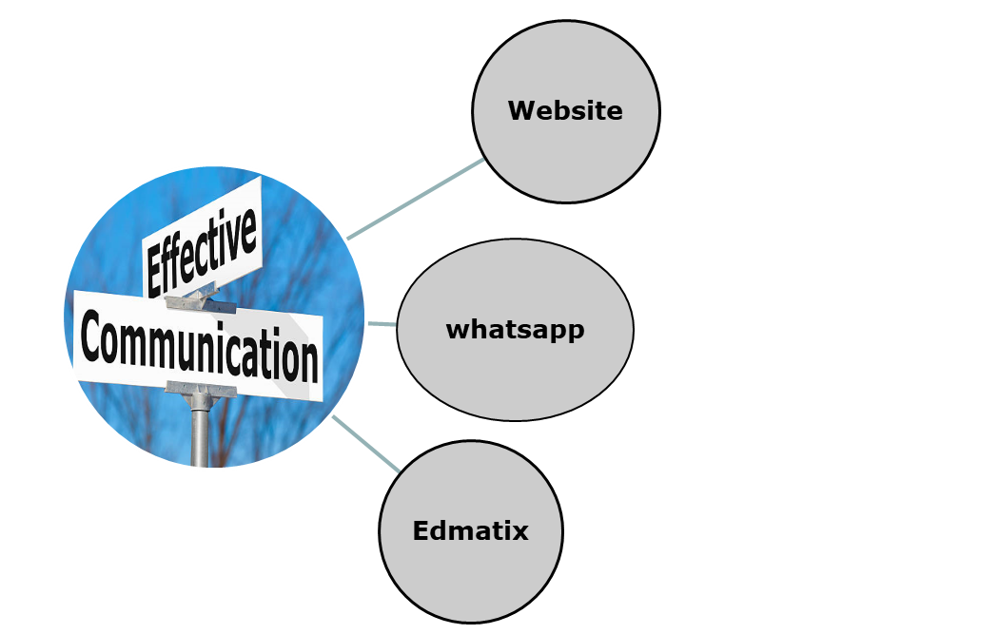
COMMUNICATION
Notes:
29

Slide 30
Incharge - A day with Parents
WEDNESDAY
&Saturday
Between
10 a.m
&
2.00 p.m
For prior appointment
contact
Front Office
Notes:
30

Slide 31
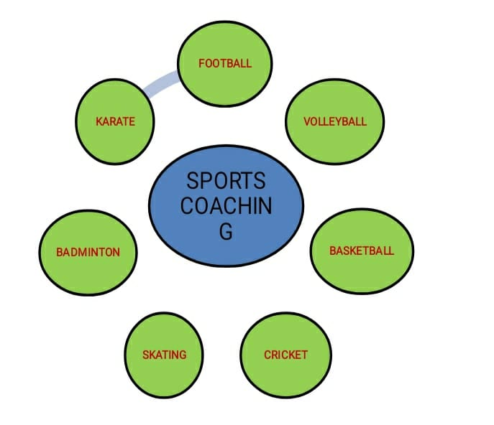
SPORTS COACHING
Notes:
31

Slide 32
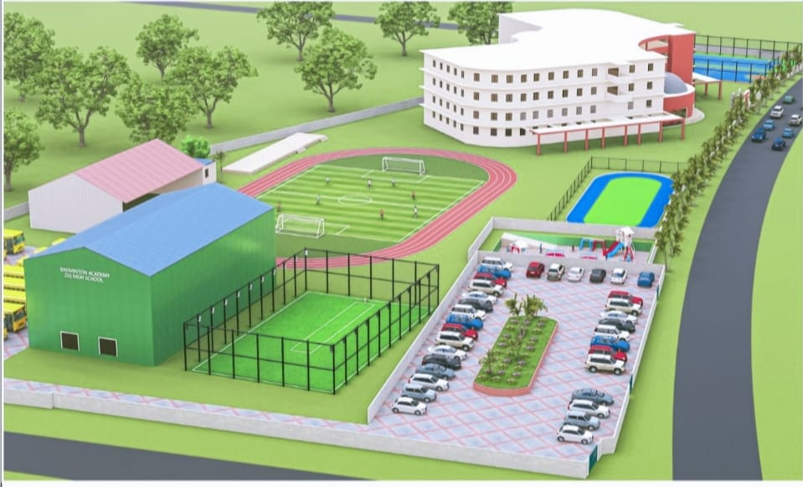

Slide 33
YOUR SUPPORT
BE INVOLVED:
Please check the almanac regularly and acknowledge.
Please check their books regularly and keep us informed. In case of long absence , send a note through almanac so that teacher with your support can get the work completed by the child.
Edmatix Parent app.
If any concern kindly communicate through almanac.
SUPPORT: SCHOOL RULES AND GOALS
Notes:
33

Slide 34
“The education of a child involves three major components: Teacher, Student and Parent.”
Notes:
34

Slide 35
Thank You
Notes:
35

