Slide 1
Zee HIGH SCHOOL
Hayathnagar
Parents’
Orientation Programme
2024 -25
class 4&5

Slide 6
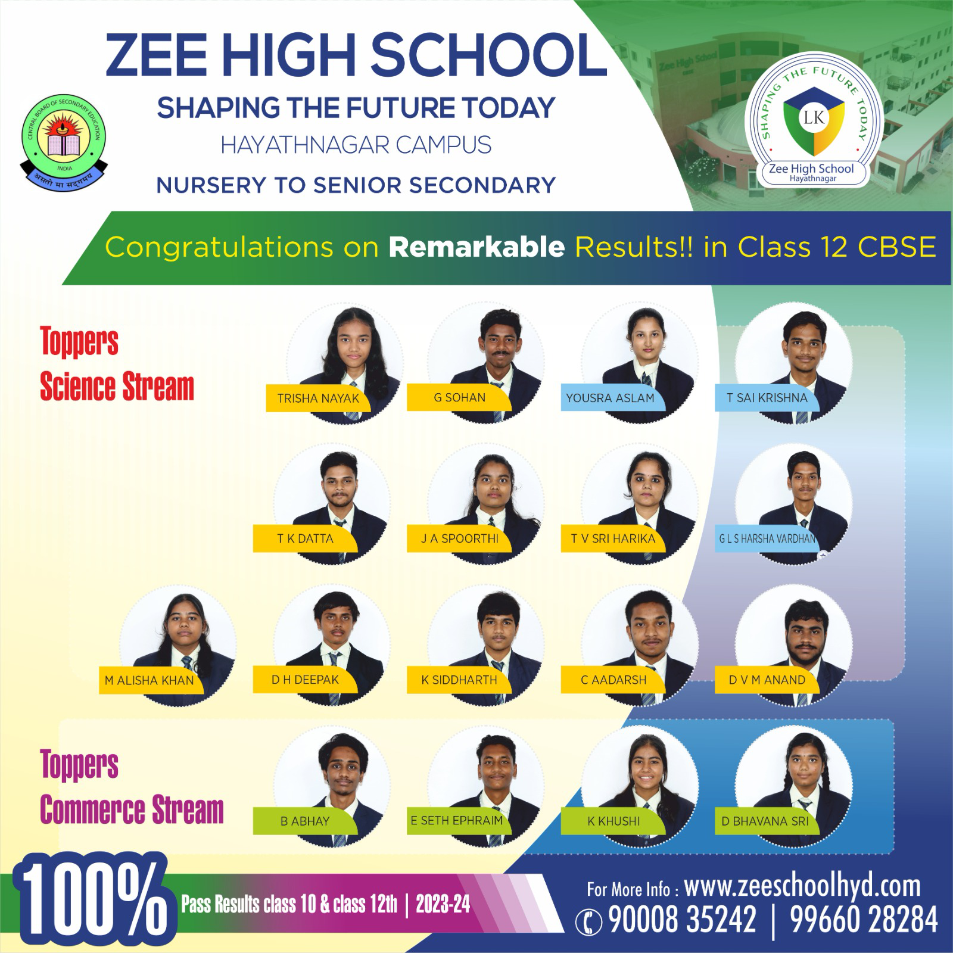
s

Slide 7
ENGLISH
II LANG T/H
III LANG T/H
MATHS
GENERALSCIENCE
SOCIAL SCIENCE
IT
Academics

Slide 8
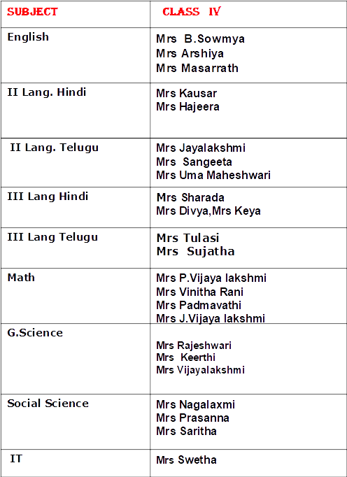

Slide 9
 | Class v
Subject | Teacher
ENGLISH | MRS MASARRATH,MRS ARSHIYA,MRS SWAPNA
II LANG TELUGU | MRS SANGEETHA ,MRS UMA MAHESHWARI MRS JAYA LAKSHMI
II LANG HINDI | MRS KAUSAR,MRS HAJERA
III LANG TELUGU | MRS TULASI,MRS UMA MAHESHWARI
III LANG HINDI | MRS SARADA MRS KEYA,MRS NISHA
MATHS | MRS PADMAVATHI,MRS J. VIJAYA LAKSHMI MRS VINITHA RANI
SCIENCE | MRS RAJESHWARI,MRS KEERTHI,MRS VIJAYALAKSHMI
SOCIAL | MRS P.NAGA LAXMI,MRS KAVITHA NAIDU,MRS PRASANNA
IT | SWETHA

Slide 10
CLASS-IV :- BOOKS LIST-AY-2024-25 |  |  | 2nd Lang - TELUGU
 |  |  | 3rd Lang - HINDI
S.NO | SUBJECT | LIST OF BOOKS | PUBLISHER | QTY
1 | ENGLISH | ENGLISH BROOK - READER-4 | MACMILLAN | 1
2 |  | ENGLISH BROOK - WORKBOOK -4 | MACMILLAN | 1
3 |  | NOVEL - SINDBAD THE SAILOR | MACMILLAN | 1
4 | MATHS | SMART MATHS - 4 | S.CHAND | 1
5 | SCIENCE | SCIENCE MISSION-4 | S.CHAND | 1
6 | SOCIAL | FOOT PRINTS-PLANET AND SOCIETY-4 | MACMILLAN | 1
7 | IT | CYBER CONNECT - 4 | KIPS | 1
8 | ART& CRAFT | CREATIVE PLANET-4 | LAXMI | 1
9 | TELUGU | 2nd Lang--JABILI-4 | TS-GOVT | 1
10 | HINDI | 3rd LANG -- HINDI PATMALA-2 | APPLE | 1
11 | NOTE BOOKS | MATHS PLANE - 5 , BROAD RULE - 3 | CENTRAL | 8
12 |  | SINGLE RULE -9 , ONE SIDE RULE- 3 | CENTRAL | 12
13 | W/S | WORK SHEETS ( WILL BE ISSUED IN CLASS ROOM ) | ZHS | 1
14 | ALL | ALMANAC , ( ID CARD- IN CLASS ROOM ) | ALL | 2
TOTAL QUANTITY |  |  |  | 33

Slide 11
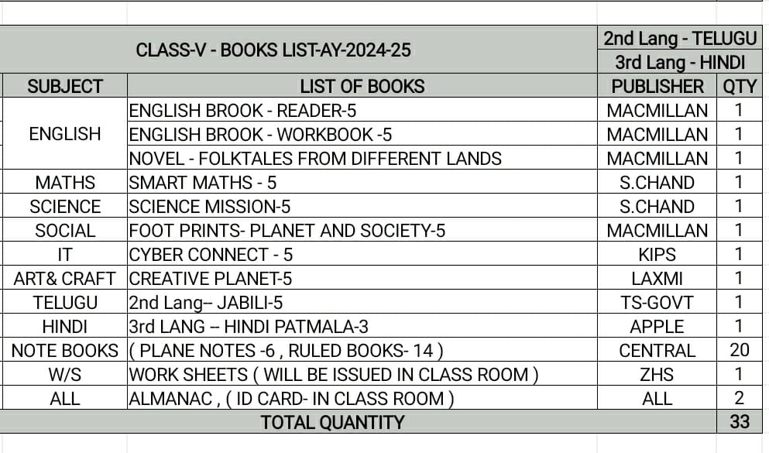

Slide 12
Class 4
Subject wise maintenance of Notebooks by the students for the
Academic year 2024-25
SUBJECT | TYPE OF BOOK | NO.OF BOOKS
ENGLISH | Single ruled | 3
MATH | Plain | 5
SCIENCE | One side single ruled | 3
SOCIAL | Single ruled | 3
2L TELUGU/HINDI 3L HINDI/TELUGU | Broad ruled Single ruled | 3 1
IT | Single ruled | 1

Slide 13
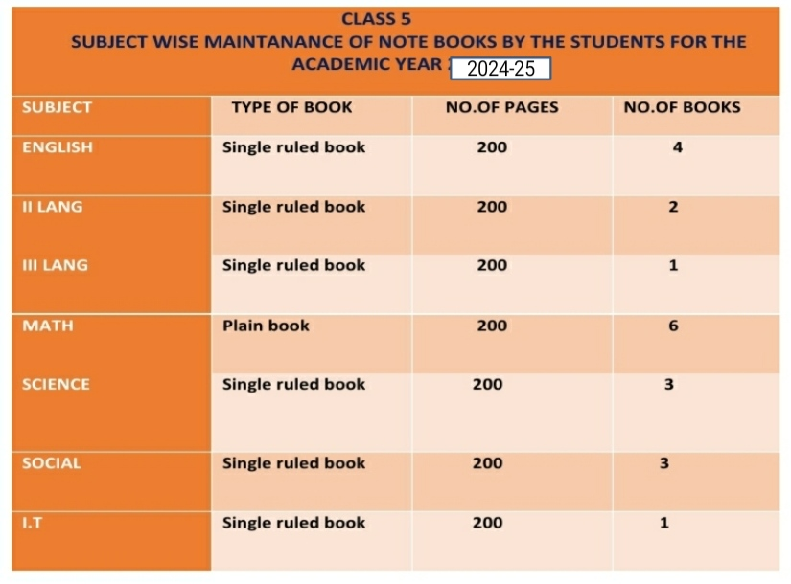

Slide 14
ASSESSMENT STRUCTURE
Grade IV & V
P T 1 | P T 2 | PT Scale To | Note Book | SEA | Term 1 | TOTAL
25M | 25M | 10M | 5M | 5M | 80M | 100M
PT 3 | PT 4 | PT Scale To | Note Book | SEA | Term 2 | TOTAL
25M | 25M | 10 M | 5M | 5M | 80 M | 100 M
FINAL RESULT: Best of TERMS

Slide 15
Weekly Assessment Schedule
Day | Subject
Monday | MATH
Tuesday | SOCIAL
Wednesday | SCIENCE
Thursday | ENGLISH
Friday | II LANG

Slide 16
Weekly Assessment Schedule
From Monday to Friday
Schedule with portion will be forwarded every weekend
Tests will be conducted by Subject teachers
in their respective periods
Practice of spell check in Zero hour
Result will be released every fortnight
Check Parent app powered by Edmatix for the same using the credentials
Username: Admission Number
Password: DOB of ward

Slide 17
Home assignment Schedule
Monday | Math | SOCIAL | ENGLISH
Tuesday | Math | SCIENCE | II LANG
Wednesday | Math | SOCIAL | ENGLISH
Thursday | Math | SCIENCE | II LANG
Friday | Math, | SOCIAL | ENGLISH
Saturday | Math | SCIENCE | II LANG

Slide 18
Co –scholastics Activities
Art Education
Visual
&amp;amp;amp;amp;amp;amp;amp;amp;amp;amp;amp;amp;amp;amp;amp;
Performing Art
Physical Education
Art education visual and performing art
For Co-curricular activities grades will be alloted in the report card
Assessed on a 5 point grading scale.
Physical education

Slide 19
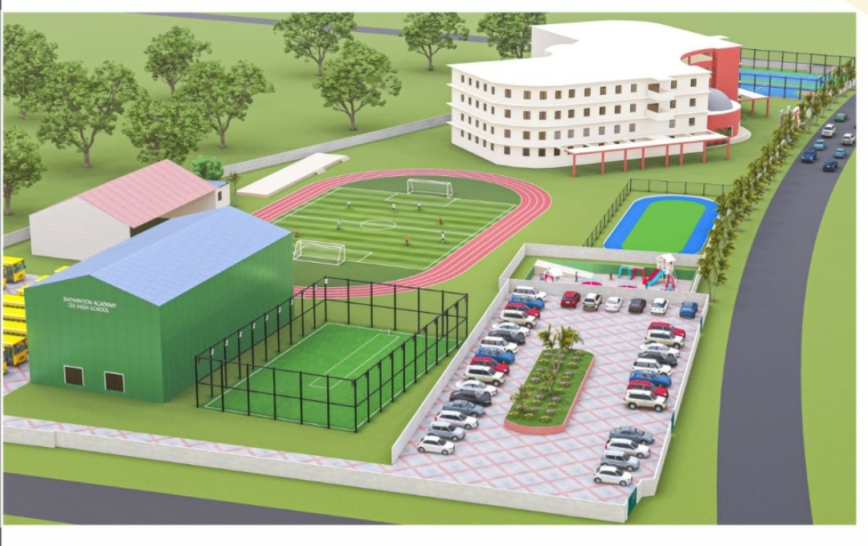

Slide 20
Physical Education
Group A
Archery
Yoga
Skating
Group B
Football
Volleyball
Basketball
Cricket
KhoKho
Badminton
Karate
Kabaddi

Slide 21
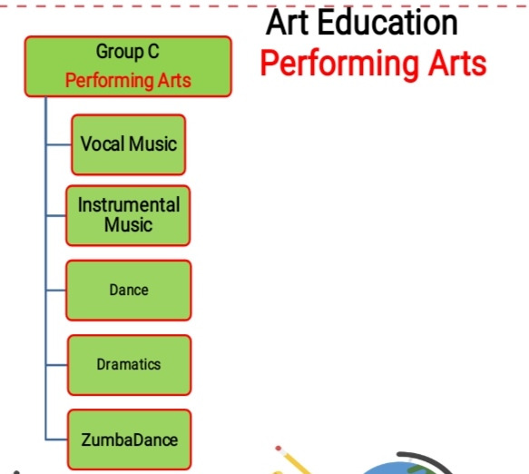

Slide 22
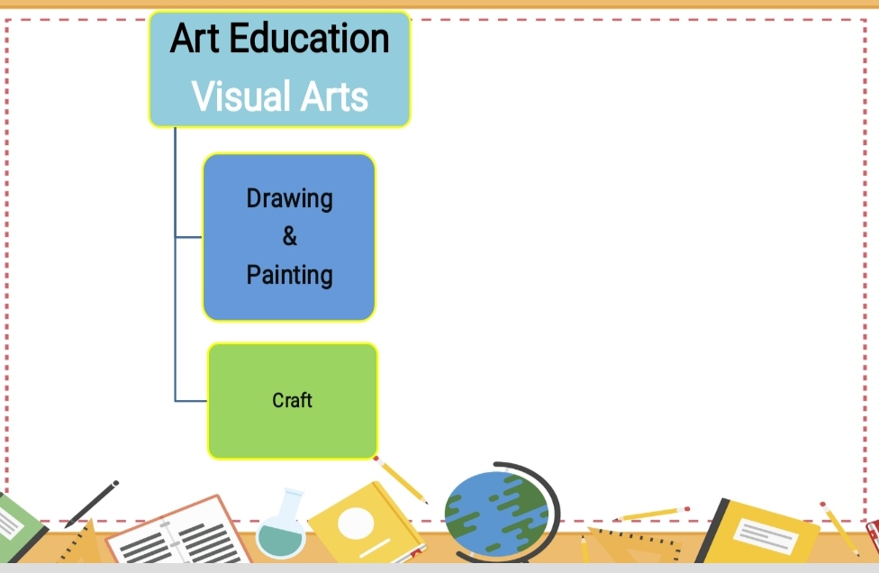

Slide 23
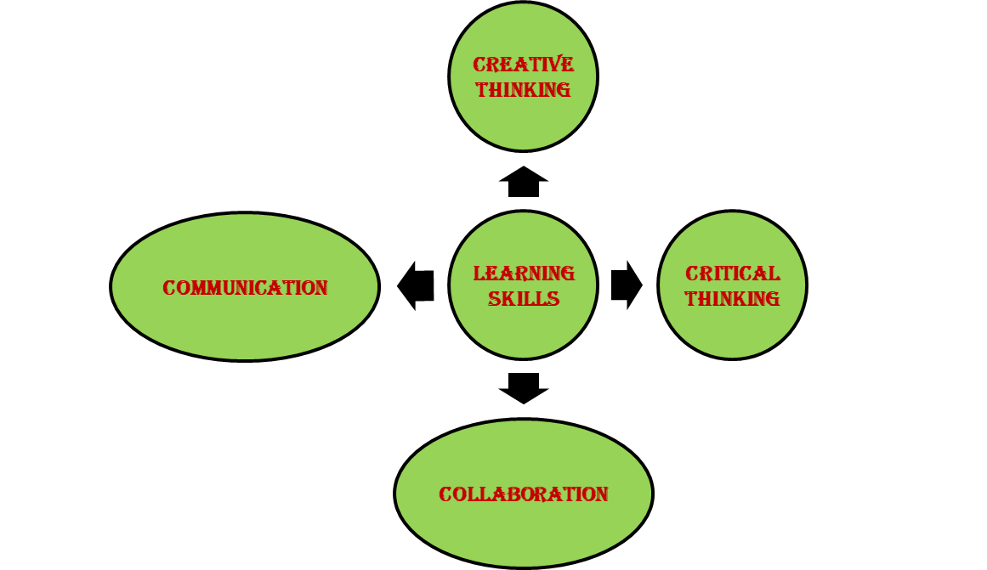
LEARNING SKILLS-4C’s

Slide 24
CLUB ACTIVITIES
ENGLISH
SPORTS
SCIENCE
CLUBS
Art & Craft
SOCIAL
MATHS

Slide 25
Active participation is mandatory for all the students for their overall development.
Subject wise club will be conducted and prior information will be given in the almanac.

Slide 26
External Competitions
for the Development of
Competitive Spirit
SOF Olympiads
NCO
NSO
IEO
ISKO
IMO
Interschool Competitions
AVANTIKA
BALOTSAV
Science Olympiad Foundation(SOF)
National Cyber Olympiad(NCO)
National Science Olympiad(NSO
International English Olympiad(IEO)
International Society for Knowledge Organization(ISKO)
International Mathematics Olympiad(IMO)

Slide 27
Regularity
Punctuality
Dress Code
Discipline
A process of
controlling
one's behavior
and actions,
either through
self-motivation
or through teaching

Slide 28
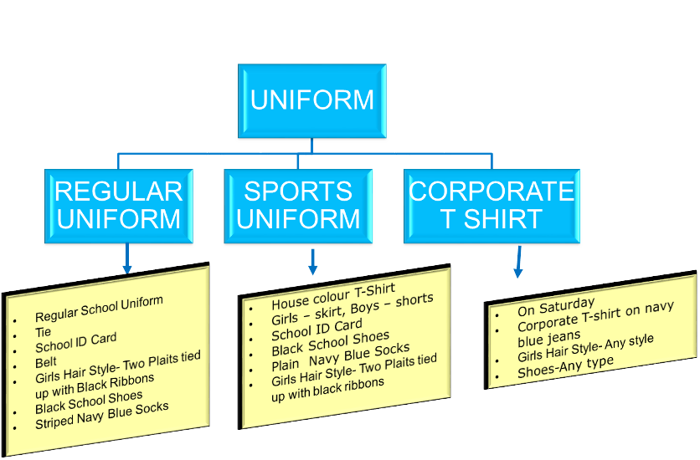

Slide 29
GRADE | INCHARGE | COORDINATOR | CONTACT NUMBER
I | VIJAYARANI | G.SWAPNA | 7730901242
II | VIJAYARANI | C.SWATHI | 9347976835
III | VIJAYARANI | P.KEERTHI | 9652608914
IV | VIJAYARANI | P. NAGALAXMI | 7730901666
V | VIJAYARANI | K.PRASANNA | 9063608914

Slide 30
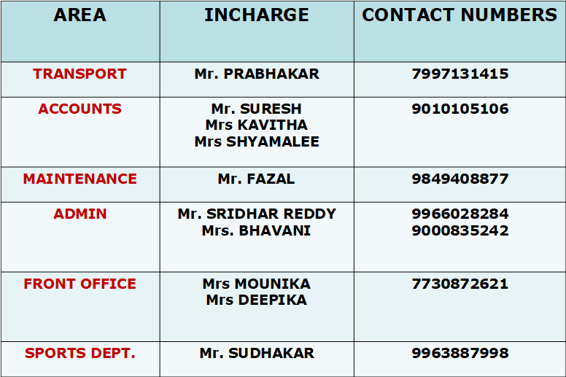

Slide 34
COMMUNICATION
Website
whatsapp
Edmatix

Slide 35
ACADEMIC INCHARGE-A day with Parents
WEDNESDAY
&
SATURDAY
Between 10 a.m &
2.00 p.m
For prior appointment
contact
Front Office

Slide 36
SPORTS COACHING
FOOTBALL
VOLLEYBALL
BASKETBALL
CRICKET
SKATING
BADMINTON
KARATE

Slide 37
YOUR SUPPORT
BE INVOLVED:
Please check the almanac regularly and acknowledge.
Please check their books regularly and keep us informed. In case of long absence , send a note through almanac so that teacher with your support can get the work completed by the child.
Edmatix Parent app.
If any concern kindly communicate through almanac.
SUPPORT: SCHOOL RULES AND GOALS

Slide 38
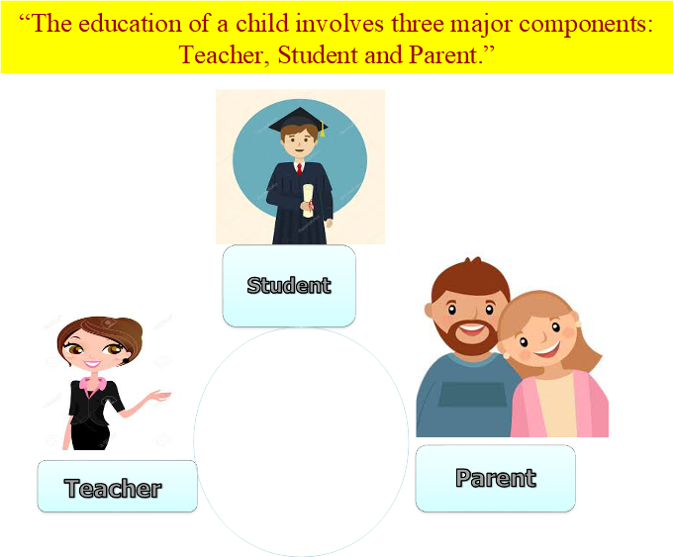

Slide 39
Thank You

