Slide 1


Parents
Orientation Program
2026 -27
Class - 11,12
Zee HIGH SCHOOL,Hayathnagar CAMPUS

Slide 2


Slide 3


Slide 4
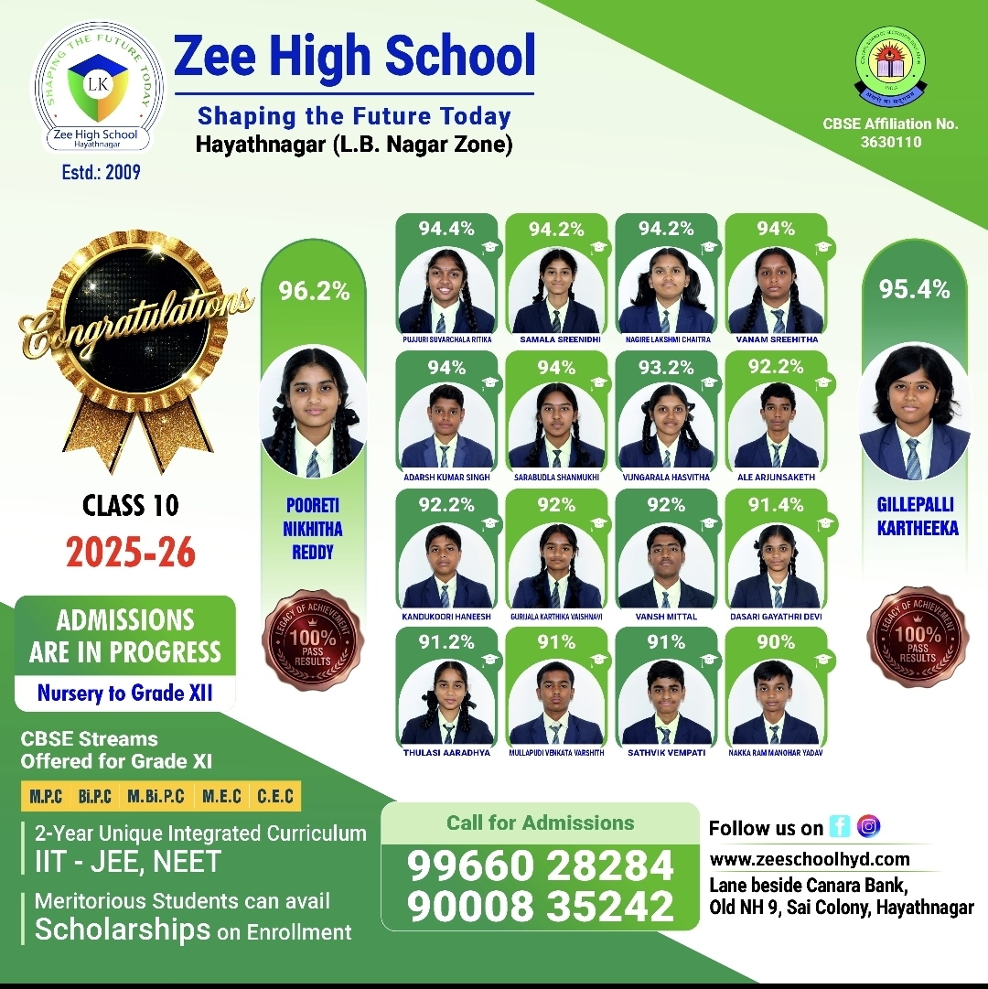

Slide 5
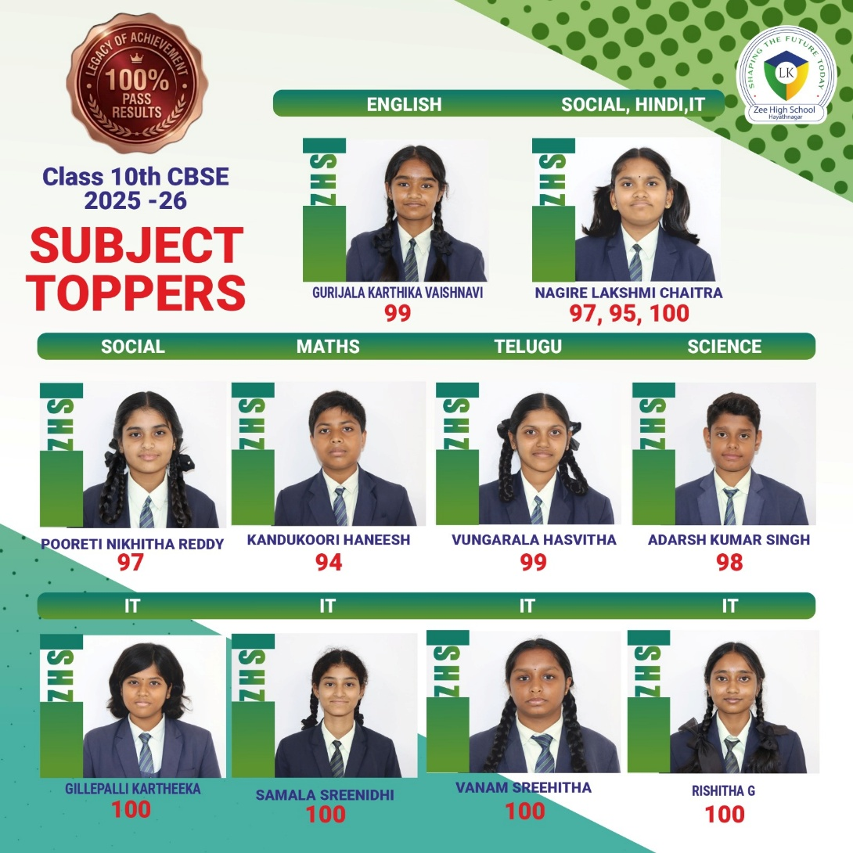

Slide 6


Slide 7
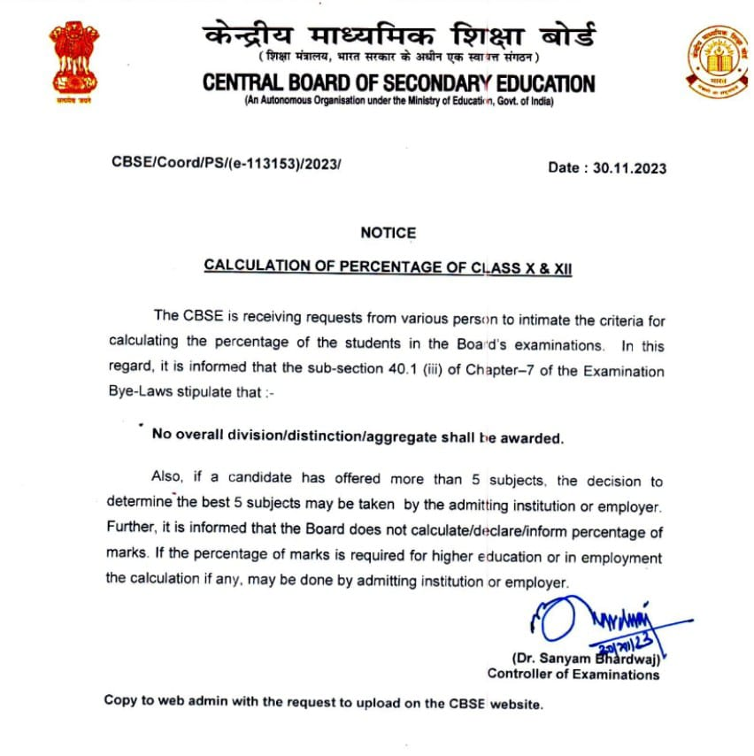

Slide 8
List of academic Subjects
  English
  Mathematics
  Physics
  Chemistry
  Biology
  Information Technology
  Physical Education
  Accountancy
  Business Studies
  Economics

Slide 9
SCIENCE STREAM
SUBJECT | MPC | BiPC | MBiPC
1 | ENGLISH | ENGLISH | ENGLISH
2 | MATH | BIOLOGY | MATH
3 | PHYSICS | PHYSICS | PHYSICS
4 | CHEMISTRY | CHEMISTRY | CHEMISTRY
5 | IT/PE | IT/PE | BIOLOGY
COMMERCE STREAM
SUBJECT | MEC | CEC
1 | ENGLISH | ENGLISH
2 | BUSINESS STUDIES | BUSINESS STUDIES
3 | ECONOMICS | ECONOMICS
4 | ACCOUNTANCY | ACCOUNTANCY
5 | MATH | IT/PE

Slide 10
SUBJECT | CLASS XI | CLASS XII
English | Mrs Mehnaaz | Mrs Mehnaaz
MATH | Mr Raghunath | Mr Raghunath
Physics | Mrs Sowmya | Mrs Sowmya
Chemistry | Mrs Anita | Mrs Anita
Biology | Mrs Dhanalakshmi | Mrs Dhanalakshmi
Accountancy | Mrs Bhargavi | Mrs Bhargavi
Business Studies | Mrs Bhargavi | Mr Mahender
Economics | Mr Mahender | Mr Mahender
IT | Mrs Pallavi | Mrs Pallavi
P E | Mr Sudhakar & Mrs srividya | Mr Sudhakar

Slide 11
ZEE HIGH SCHOOL, HAYATHNAGAR
Class : XI Year Plan 2026-27
Sub: Mathematics Teacher: Raghunath Rao
S.N | MONTH | Syllabus | IIT Syllabus
1 | June | Sets, Relations & Functions Complex Numbers | Sets, Relations , Complex Numbers
2 | July | Complex Numbers Limits Straight Lines | Limits, Complex numbers, Straight Lines
3 | August | Comic Sections Trignometry Derivatives | Comic, Trignometry, Limits (2)
4 | September | Derivatives Continuity & Differentiability | Derivatives, Continuity, Differentiability
5 | October | 3-D, 2-D | 3-D, 2-D
6 | November | Statistics, Sequences & Series Linear Equations in 2 Variables Straight lines ( 2nd Level ) | Statistics, Sequense & Series Linear Equations in 2 Variables Straight lines ( 2nd Level )
7 | December | Determinants Application of Derivatives, Probability | Determinants Application of Derivatives, Probability
8 | January | Revision
9 | February | Annual Exams

Slide 12
ZEE HIGH SCHOOL, HAYATHNAGAR
Class : XI Year Plan 2026-27
Sub: Physics Teacher: Sowmya Lakshmi
S.N | MONTH | Syllabus | IIT Syllabus
1 | June | Unit-I Physical Quantities and Measurements | Unit-I Physical Quantities and Measurements
2 | July | Unit-II Motion in a Straight Line Motion in a Plane | Unit-II Motion in a Straight Line Motion in a Plane
3 | August | Unit-III Laws of Motion Unit-IV Work, Power Energy | Unit-III Laws of Motion Unit-IV Work, Power Energy
4 | September | Unit- V Motion of System of Particles and Rigid Body Unit-VI Gravitation | Unit- V Motion of System of Particles and Rigid Body Unit-VI Gravitation
5 | October | Unit-VII Mechanical Properties of Solids & Fluids, Thermal Properties of Matter | Unit-VII Mechanical Properties of Solids & Fluids, Thermal Properties of Matter
6 | November | Unit-IX Behaviour of Gases & Kinetic Theory (Cont) | Unit-IX Behaviour of Gases & Kinetic Theory (Cont)
7 | December | Unit- X Oscillations, Unit-X Waves | Unit- X Oscillations, Unit-X Waves
8 | January | Revision
9 | February | Annual Exams

Slide 13
ZEE HIGH SCHOOL, HAYATHNAGAR
Class : XI Year Plan 2026-27
Sub: Chemistry Teacher: Anitha
S.N | MONTH | Syllabus | IIT Syllabus
1 | June | Some basic Concepts of Chemistry | Some basic Concepts of Chemistry
2 | July | Atomic Structure | Atomic Structure
3 | August | Classification of Elements and Periodicity in Properties | Classification of Elements and Periodicity in Properties
4 | September | Chemical Equilibrium and ionic equilibrium | Chemical Equilibrium and ionic equilibrium
5 | October | Thermodynamics | Thermodynamics
6 | November | Redox Reactions, S-Block Elements | Redox Reactions, S-Block Elements
7 | December | Basic Principles in Organic Chemistry Hydrocarbons | Basic Principles in Organic Chemistry Hydrocarbons
8 | January | Revision
9 | February | Annual Exams

Slide 14
ZEE HIGH SCHOOL, HAYATHNAGAR
Class : XI Year Plan 2026-27
Sub: B.S Teacher: Mrs. Bhargavi
S.N | MONTH | Syllabus
1 | June | Business, Trade and Commerce, Forms of Business Organization
2 | July | Private, Public, and Global Enterprises, Business Services
3 | August | Emerging Modes of Business, Social Responsibility of Business and Business Ethics
4 | September | Formation of a Company,
5 | October | Sources of Business Finance, MSME and Business Entrepreneurship
6 | November | Internal Trade
7 | December | International Business
8 | January | Revision
9 | February | Annual Exams

Slide 15
ZEE HIGH SCHOOL, HAYATHNAGAR
Class : XI Year Plan 2025-26
Sub: Economics Teacher: Mr. Mahendar
S.N | MONTH | Syllabus
1 | June | National Income and Related Aggregates, Monetary Policy
2 | July | Government Budget, Balance of Payments and Exchange Rate
3 | August | Microeconomics: Introduction, Consumer's Equilibrium and Demand
4 | September | Producer Behavior and Suppl, Forms of Market and Price Determination
5 | October | Statistics for Economics, National Income and Related Aggregates
6 | November | Money and Banking, Government Budget, Consumer Equilibrium
7 | December | Supply and Demand, Forms of Market
8 | January | Revision
9 | February | Annual Exams

Slide 16
ZEE HIGH SCHOOL, HAYATHNAGAR
Class : XI Year Plan 2025-26
Sub: Accountancy Teacher: Bhargavi
S.N | MONTH | Syllabus
1 | June | Financial Accounting, Theoretical Framework, Accounting Process
2 | July | Financial Accounting 2, Financial Statements of Sole Proprietorship,
3 | August | Computers in Accounting
4 | September | Project Work
5 | October | Introduction to Accounting, Basic Accounting Terms, Accounting Equation
6 | November | Accounting Standards, IFRS (International Financial Reporting Standards), Financial Statements
7 | December | Incomplete Records, Computers in Accounting
8 | January | Revision
9 | February | Annual Exams

Slide 17
ZEE HIGH SCHOOL, HAYATHNAGAR
Class : XI Year Plan 2025-26
Sub: Physical Education Teacher: Sudhakar & Srividya
S.N | MONTH | Syllabus
1 | June | Changing Trends & Career in Physical Education, Olympic Value Education, Yoga
2 | July | Physical Education & Sports for CWSN, Physical Fitness,
3 | August | Test, Measurements & Evaluation, Fundamentals of Anatomy and Physiology in Sports
4 | September | Fundamentals of Kinesiology and Biomechanics in Sports,
5 | October | Psychology and Sports
6 | November | Training & Doping in Sports:
7 | December | Wellness, and Lifestyle
8 | January | Revision
9 | February | Annual Exams

Slide 18
ZEE HIGH SCHOOL, HAYATHNAGAR
Class : XI Year Plan 2025-26
Sub: Computer Science Teacher: Pallavi
S.N | MONTH | Syllabus
1 | June | Basic Computer Organization, Types of Software, Operating Systems (OS)
2 | July | Boolean Logic and Number Systems, Encoding Schemes
3 | August | Computational Thinking and Programming, Introduction to Problem Solving, Python Programming
4 | September | Python Programming
5 | October | Society, Law, and Ethics, Data Protection, Cyber Crime
6 | November | Digital Footprints
7 | December | Digital Society and Netiquette
8 | January | Revision
9 | February | Annual Exams

Slide 19
ZEE HIGH SCHOOL, HAYATHNAGAR
Class : XI Year Plan 2025-26
Sub: English Teacher: Mehnaaz
S.N | MONTH | Syllabus
1 | June | Hornbill (Prose and Poetry), The Portrait of a Lady,
2 | July | A Photograph, We're Not Afraid to Die
3 | August | Discovering Tut: The Saga Continues
4 | September | Snapshots (Reader Book with Short Stories)
5 | October | Elective Course (Woven Words), Includes short stories, poetry, and essays
6 | November | Reading Skills
7 | December | Writing Skills, Grammar
8 | January | Revision
9 | February | Annual Exams

Slide 20
LIST OF SUBJECTS OFFERED BY CBSE
FOR
SENIOR SECONDARY SCHOOL
https://cbseacademic.nic.in/web_material/CurriculumMain26/SrSec/Curriculum_SrSec_2025-26.pdf

Slide 21
ADDITIONAL SUBJECT/
SKILL SUBJECT/6th SUBJECT
Skill education equips students with practical skills for specific trades or occupations.
The CBSE empowers students by offering a curriculum focused on life and employability skills, with 19 skill subjects at the secondary level and 39 at the senior secondary level.
This initiative helps students enhance their abilities and explore diverse career opportunities.
It also acts as a backup for a student who underperforms in one of their core subjects, the 6th subject can replace the lowest scoring marks.
Under Co-Scholastic activities, students opting skill subject shall be exempted from Work Education.
https://cbseacademic.nic.in/skill-education.html

Slide 22
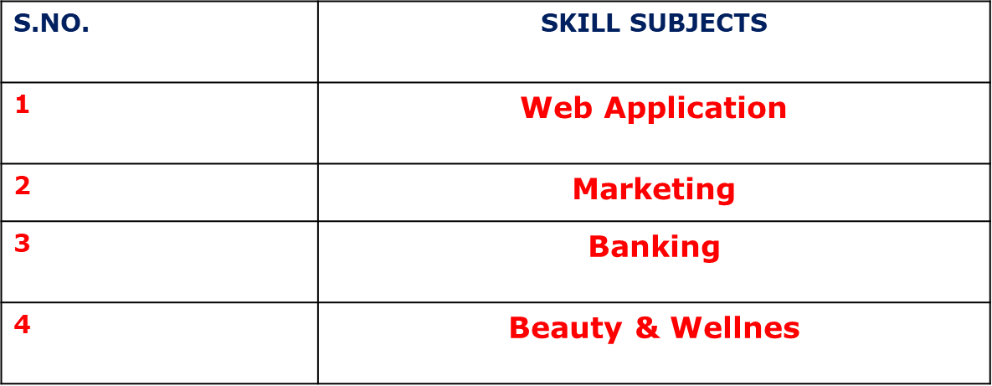
Skill Subjects As Under

Slide 23
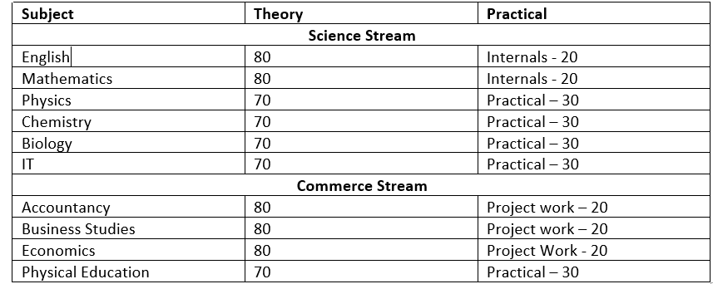
Marking Scheme

Slide 24
ASSESSMENT STRUCTURE
Grade XI
COMMERCE & SCIENCE STREAM
Unit Test 1 | 30 Marks
Unit Test 2 | 30 Marks
Unit Test 3 | 30 Marks
Term 1 | 20M(Practicals) + 80M (Theory)
Term 2 | 20M(Practicals) + 80M (Theory)
FINAL REPORT CARD
Quarterly Exam 100 M | Half Yearly Exam 100 M | Annual Exam 100M
Consolidation of 3 UT Marks of each subject | Term 1 Marks scored in each subject | Term 2 Marks scored in each subject

Slide 25
Integrated curriculum
An IIT-JEE and NEET integrated curriculum for Classes 11 and 12 combines school education with targeted preparation for JEE and NEET exams.
This approach builds a strong foundation in core subjects while preparing students for competitive exams.
At ZEE, we ensure students excel in both competitive exams and 12th Board Exams.
.

Slide 26
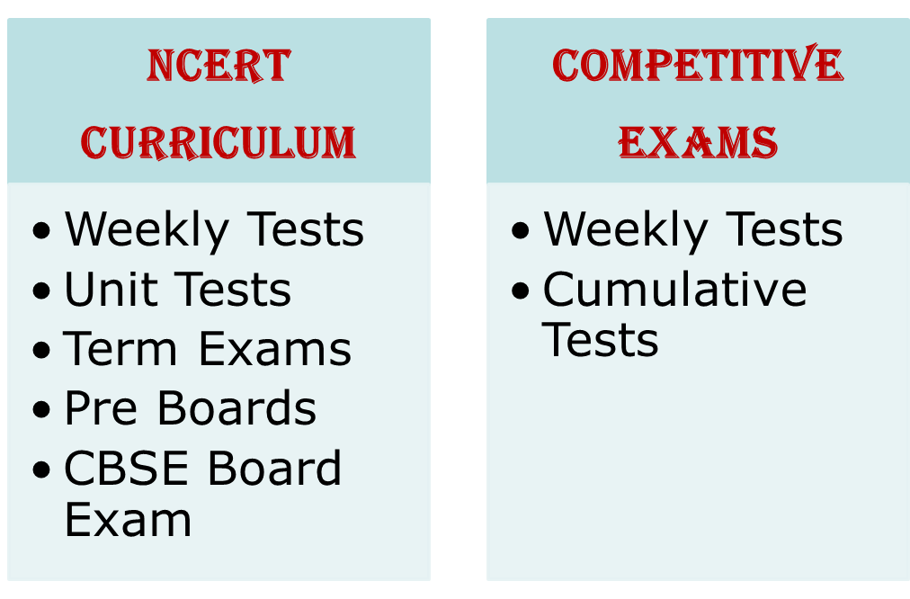
PROVISIONS

Slide 27
Weekly Assessment for classes 11 & 12
From Tuesday to Friday between 8.30 am & 9.00 a.m
A 20 M paper including MCQ & Subjective Questions
Schedule with portion will be forwarded every weekend
Result will be released every fortnight
Need to check Zee High School Parent App powered by Edmatix for the same using the credentials
Username: Admission Number
Password: DOB of your ward

Slide 28
CUMULATIVE ASSESSMENT FOR MATH And SCIENCES Of class 11 & 12
Will be held on Friday in the fourth week of a month.
For MPC & BiPC stream, the paper includes 25 MCQ each from Math/Biology, Physics, Chemistry. Thus the maximum marks allotted for the Cumulative Test is 75 with a duration of 1 & 1/2 hr.
For MBiPC stream, the paper includes 25 MCQ each from Math, Biology, Physics, Chemistry. Thus the maximum marks allotted for the Cumulative Test is 100 with a duration of 2 hrs
Schedule with portion will be forwarded
Result will be released in a week.
Need to check Zee High School Parent App powered by Edmatix for the same using the credentials
Username: Admission Number
Password: DOB of your ward

Slide 29
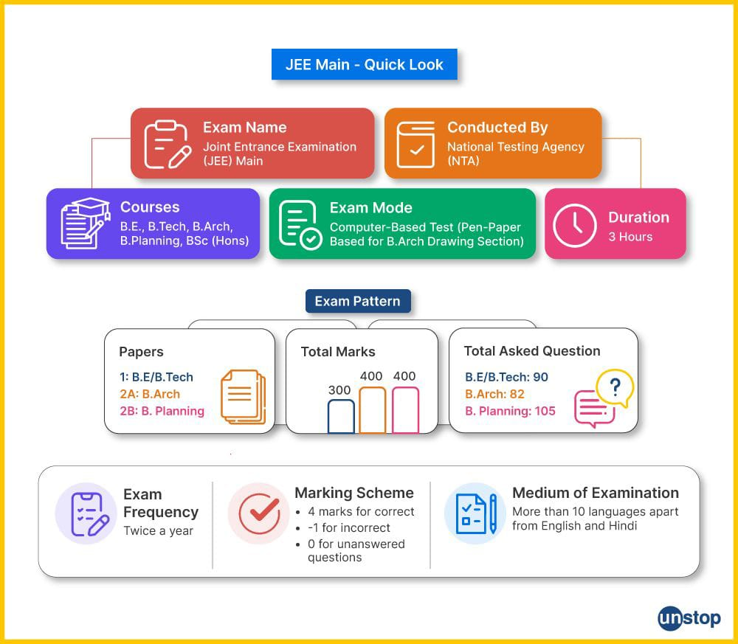
Integrated curriculum
An IIT-JEE and NEET integrated curriculum for Classes 11 and 12 combines school education with targeted preparation for JEE and NEET exams.
This approach builds a strong foundation in core subjects while preparing students for competitive exams.
At ZEE, we ensure students excel in both competitive exams and 12th Board Exams.
.

Slide 30
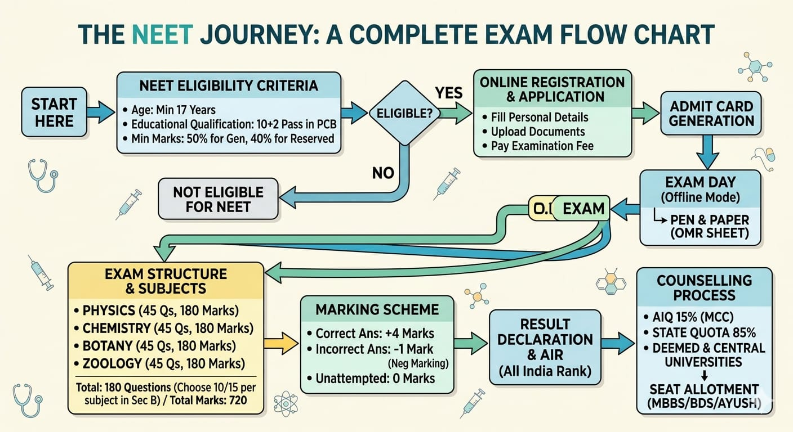

Slide 31
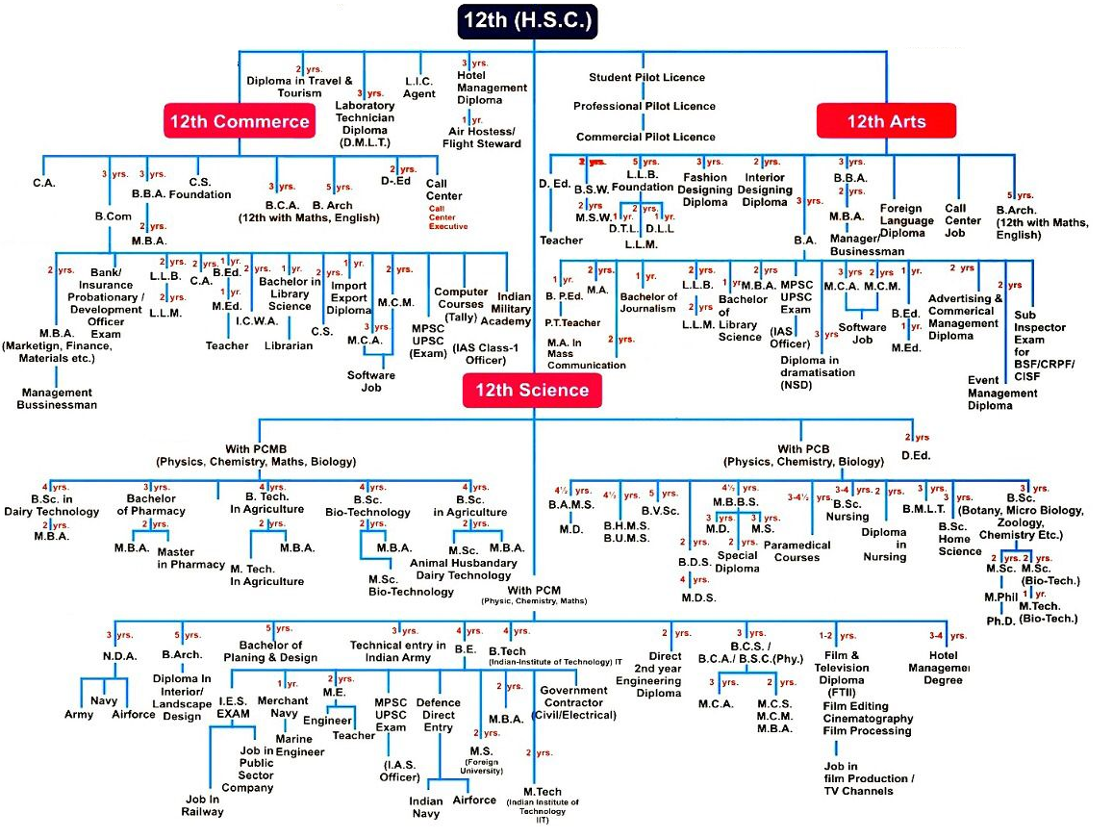

Slide 32
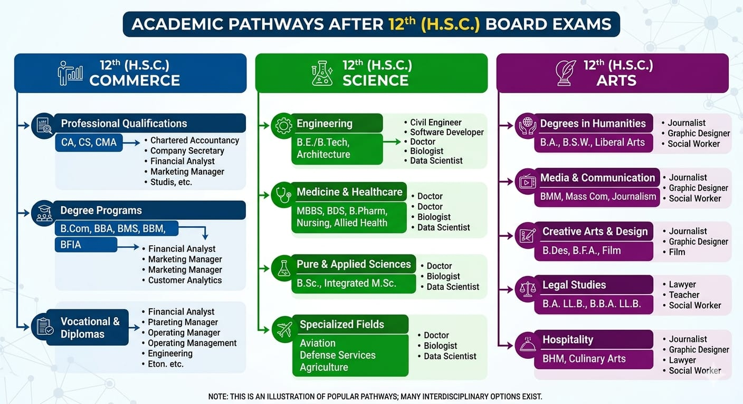

Slide 33
Career
https://cbseacademic.nic.in/web_material/skilledu/Compendium-2022.pdf

Slide 34
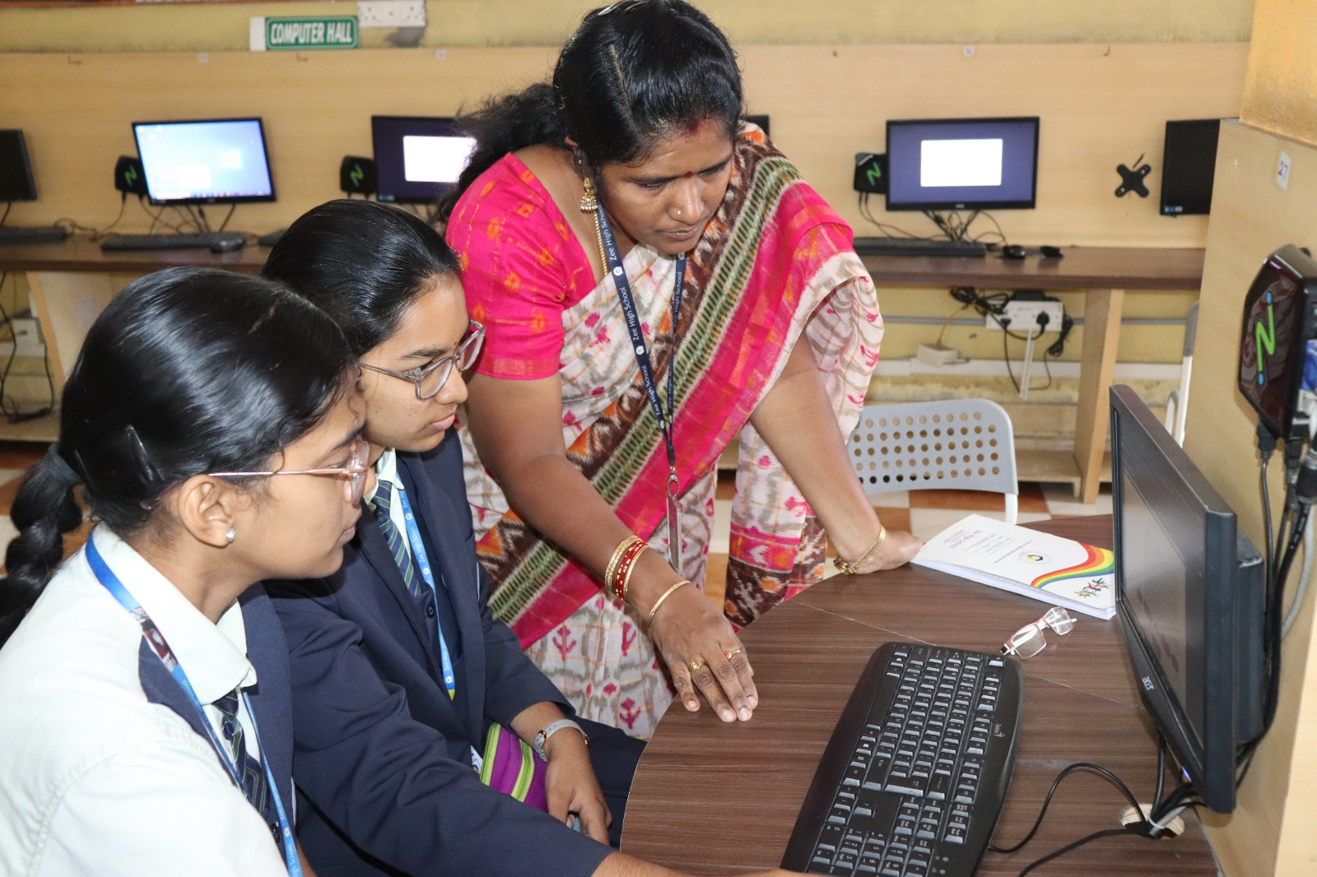
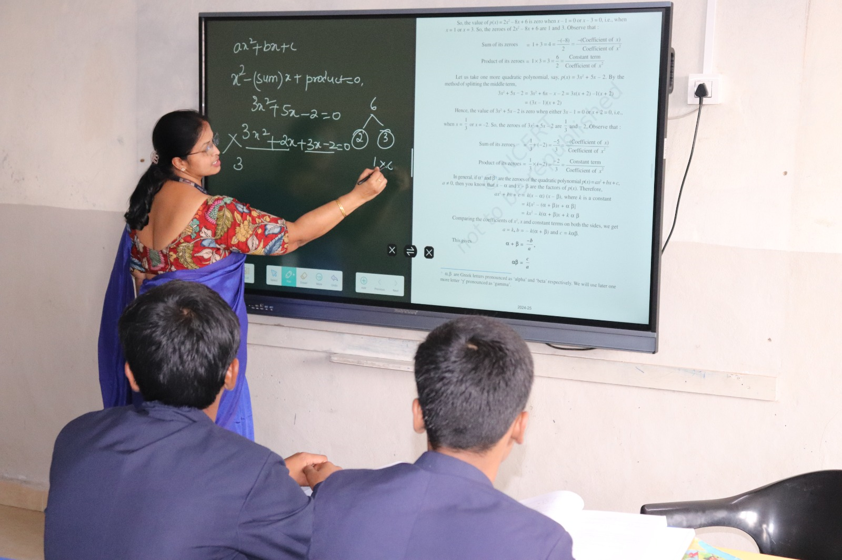
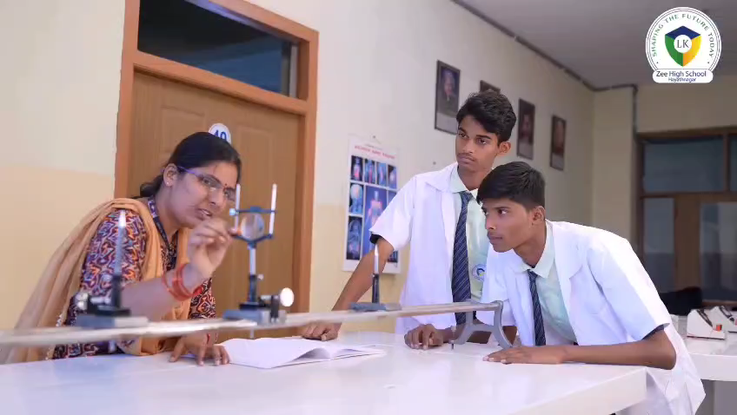
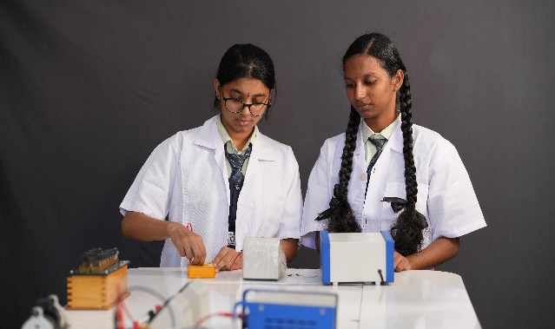
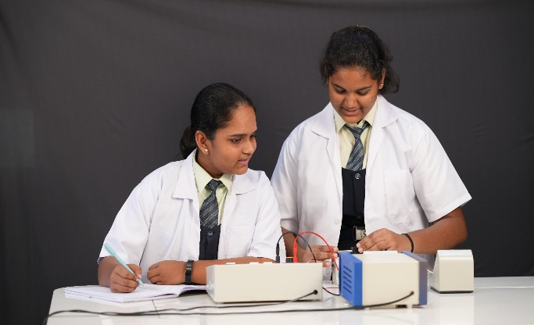
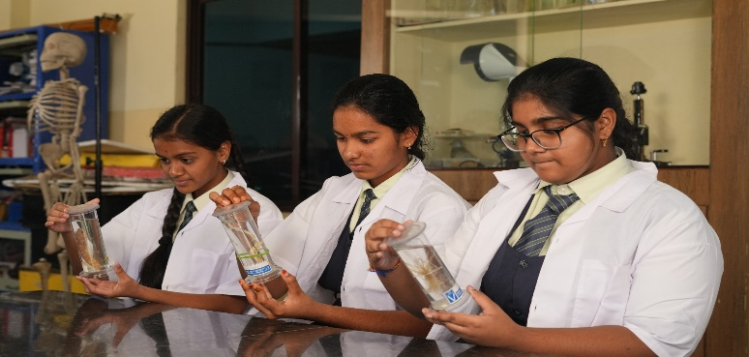
INFRA STRUCTURE - ACADEMICS

Slide 35
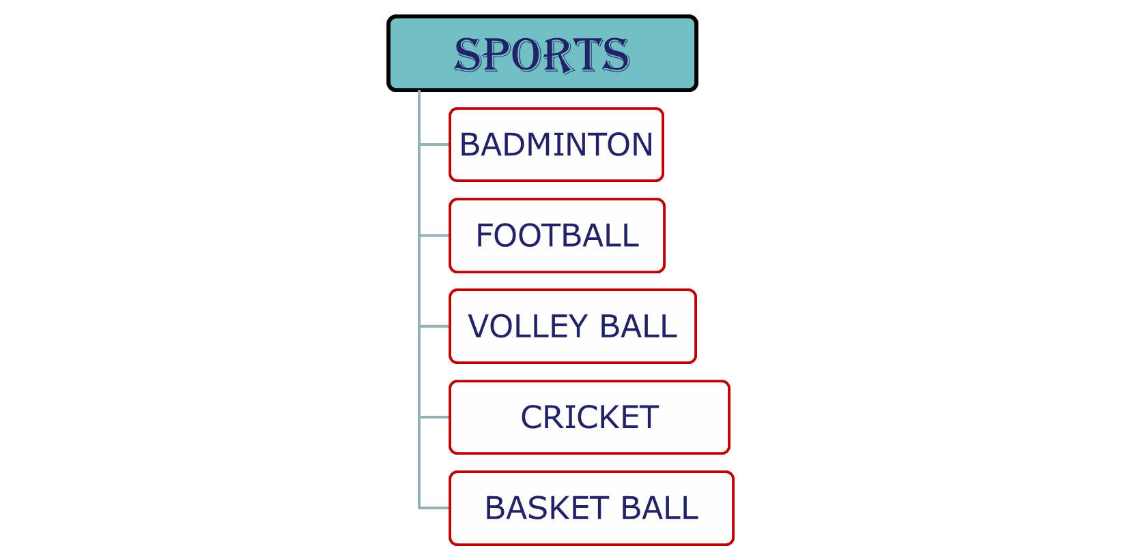
HEALTH AND PHYSICAL EDUCATION

Slide 36
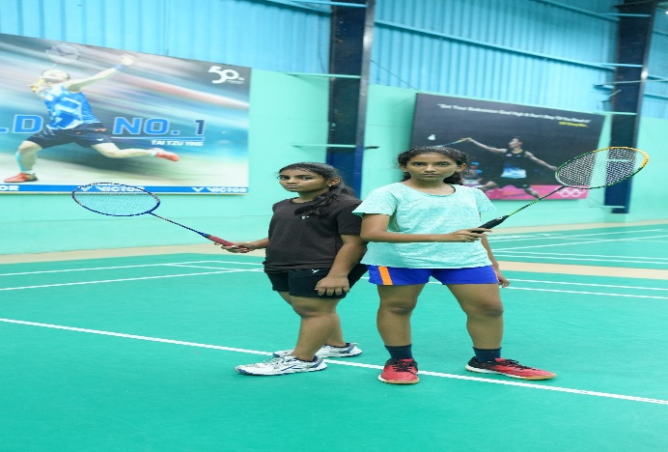
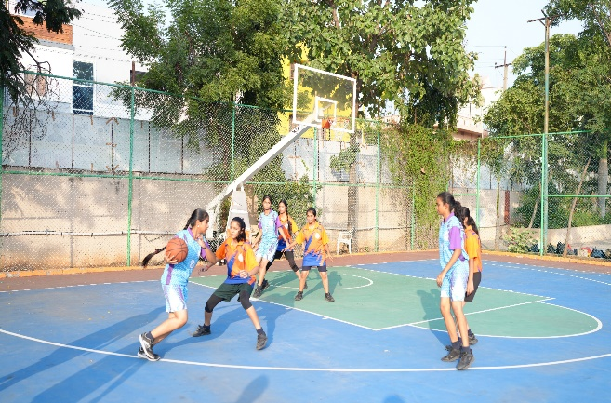
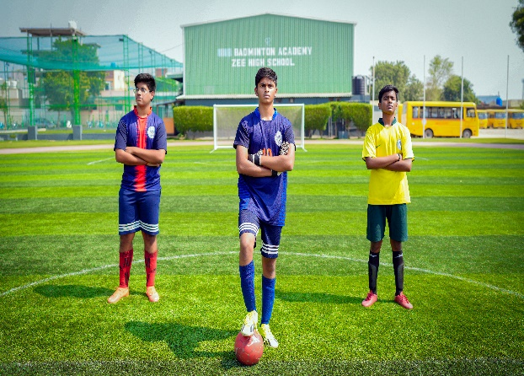
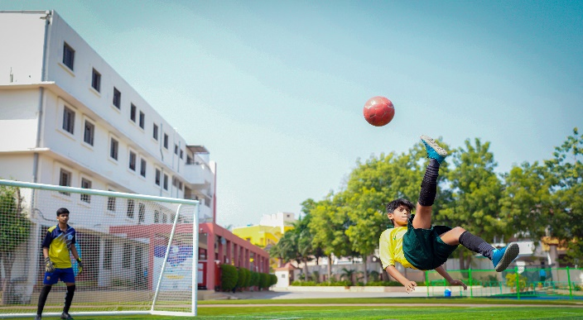
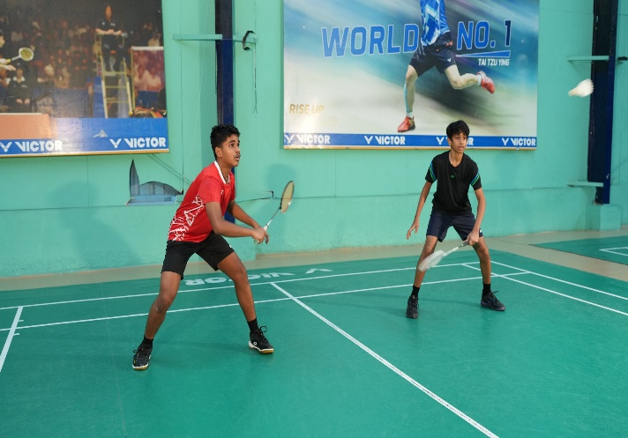
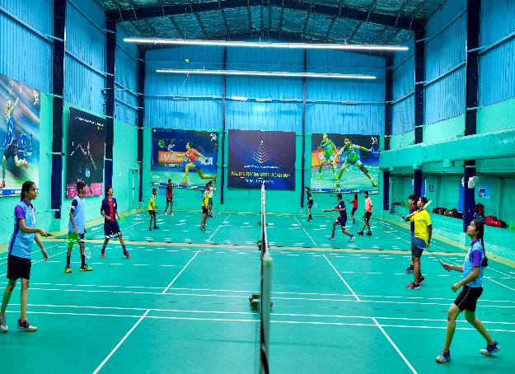
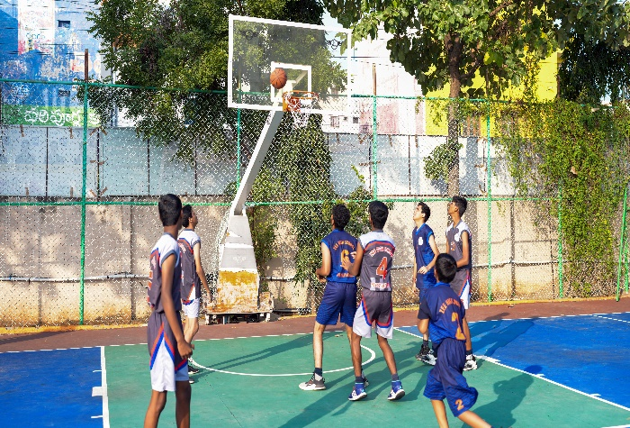
INFRASTRUCTURE - SPORTS

Slide 37
Regularity
Punctuality
Dress Code
Discipline
A process of
controlling
one's behavior
and actions,
either through
self-motivation
or through teaching
Assessed on a 5 point grading scale.

Slide 38

School Counsellor
We are dedicated to supporting students' academic, and personal-social development to help them reach their highest potential.
Name: Rajitha Chirra
Phone no:
9573767698

Slide 39
UNIFORM
REGULAR UNIFORM
SPORTS UNIFORM
CORPORATE T SHIRT
Regular School Uniform
School ID Card
Black School Shoes
Plain Navy Blue Socks
House colour T-Shirt
Girls – skirt,
Boys – shorts
School ID Card
Black School Shoes
Plain Navy Blue Socks
Girls Hair Style- Two Plaits tied up with black ribbons
On Saturday
Corporate T-shirt on navy blue jeans
Girls Hair Style- Any style
Shoes-Any type

Slide 40


Slide 41
XI&XII | RAGHUNATH RAO | 7730901222

Slide 42
AREA | INCHARGE | CONTACT NUMBERS
TRANSPORT | Mr. PRABHAKAR | 7997131415
ACCOUNTS | Mr. SURESH Mrs KAVITHA Mrs SABITHA | 9010105106
MAINTENANCE | Mr. FAZAL | 9849408877
ADMIN | Mr. SRIDHAR REDDY Mrs. BHAVANI | 9966028284 9000835242
FRONT OFFICE | Mrs MOUNIKA Mrs DEEPIKA | 7730872621
SPORTS DEPT. | Mr. SUDHAKAR | 9963887998

Slide 43
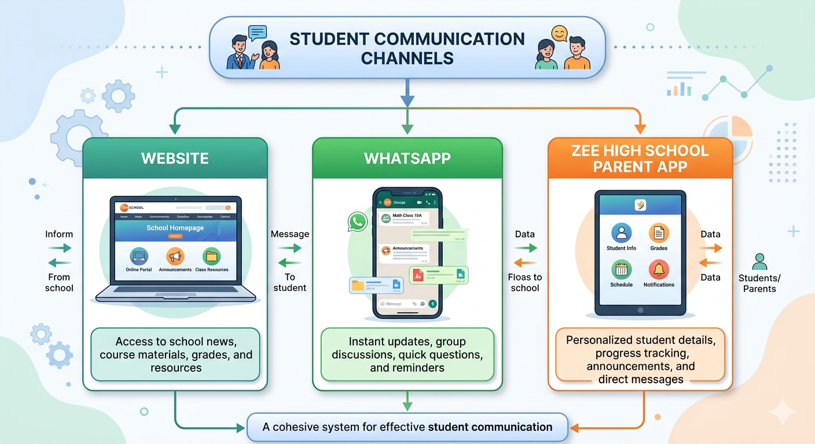

Slide 44
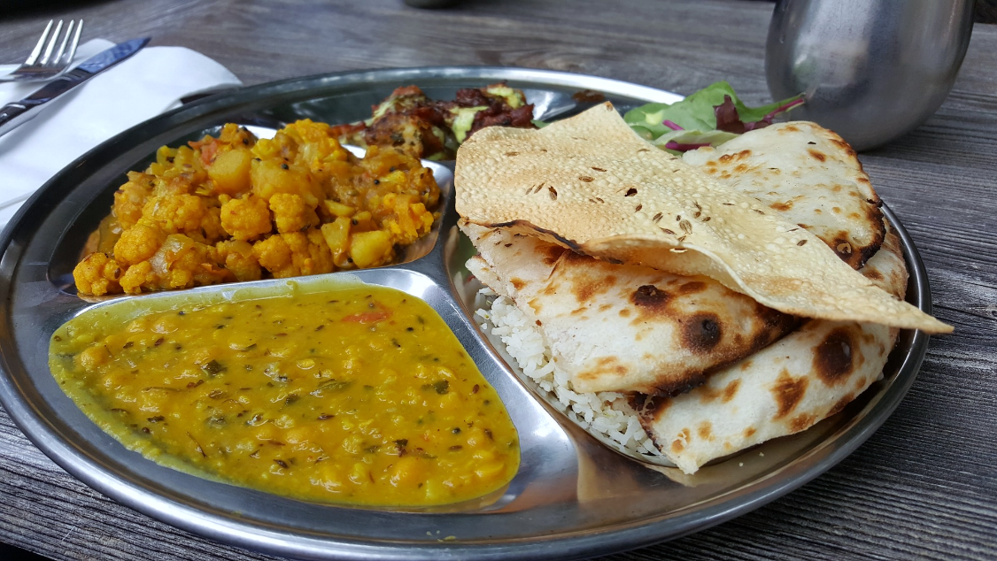
CANTEEN
Contact no: P. Vishnu Goud
9908996195
9398260903

Slide 45
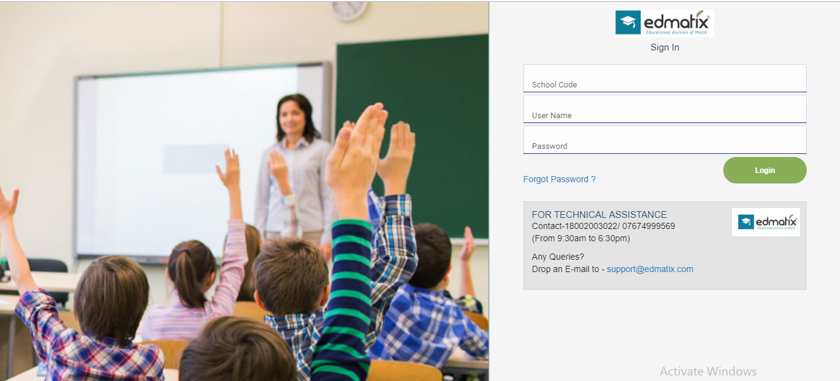
ZEE HIGH SCHOOL PARENT APP POWERED BY Edmatix
https://itunes.apple.com/in/app/edmatix-parents-app/id1460578434?mt=8
Contact:Bhavani-9000835242

Slide 46

Principal - A day with Parents
WEDNESDAY
Between
10 a.m
&
3.00 p.m
For prior appointment
contact
Front Office

Slide 47



“The education of a child involves three major components: Teacher, Student and Parent.”
Student
Teacher
Parent

Slide 48


