Slide 1


Zee HIGH SCHOOL
HAYATH NAGAR CAMPUS
Parents’
Orientation Program
2026 -27
class - 3

Slide 2
““Your potential to learn is a gift, your ability is a skill, and
your decision to keep learning is your greatest strength.”

Slide 3

Grade X – 2015 to 2026
twelve Batches 100% Result

Slide 4
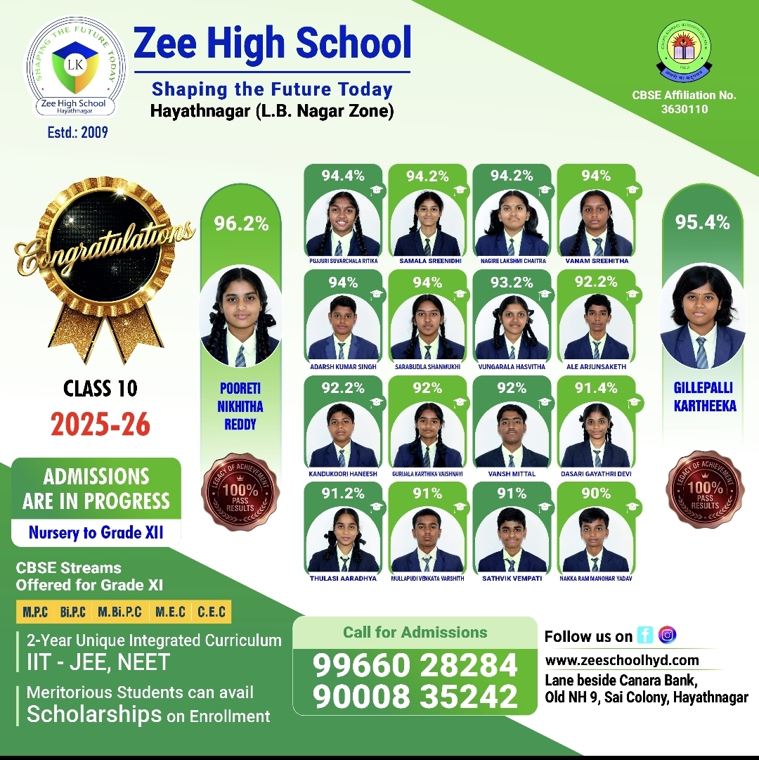

Slide 5
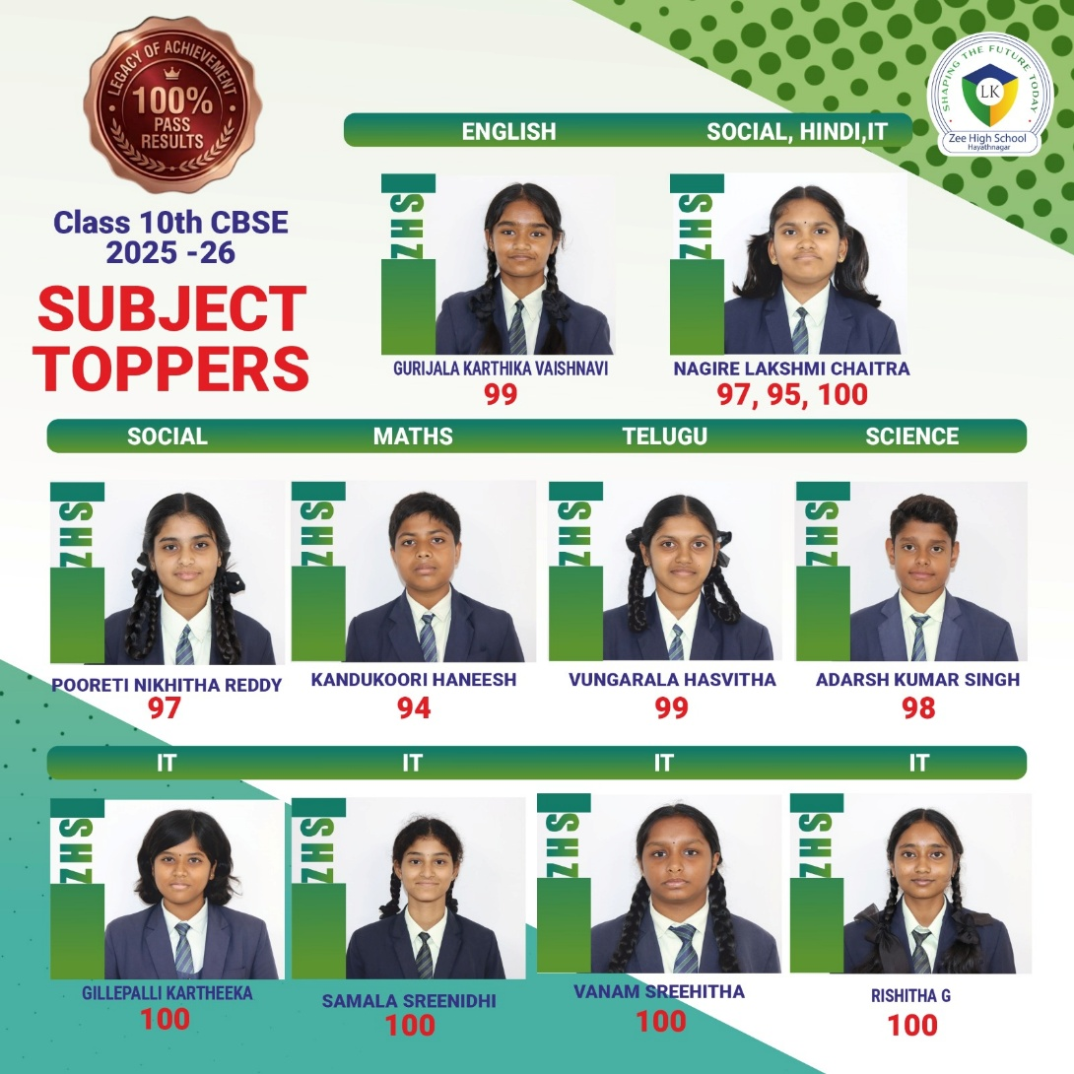

Slide 6
Subject Wise Highest Score
English
99
Mathematics
94
Science
96
Social Science
97
II Lang H/T
99
Information Technology
100

Slide 7
ENGLISH
II LANGUAGE Telugu/Hindi
III LANGUAGE Telugu/Hindi
MATHS
EVS
Information Technology
Academics

Slide 8
SUBJECT | CLASS III TEACHERS
English | Mrs Sowmya Mrs Masrrath Mrs Arshia
II Lang. Hindi | Mrs Annamma Mrs Hazera Mrs Divya
II Lang. Telugu | Mrs Sangeetha Mrs Rama Tulasamma
III Lang Hindi | Mrs Nisha Mrs Hazera
III Lang Telugu | Mrs Sunitha Mrs Sangeetha
Math | Mrs Swathi Mrs Srilatha Mrs Anusha
EVS | Mrs Keerthi Mrs Prasanna Mrs Vijaya Lakshmi
IT | Mrs Swetha

Slide 9
https://www.cbse.gov.in/

Slide 10
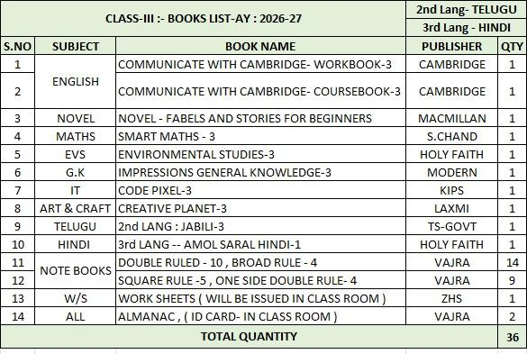

Slide 11
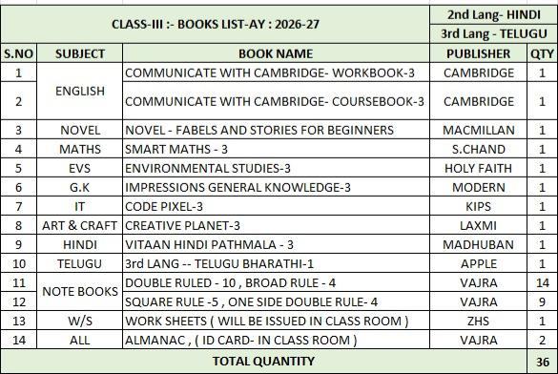
2025-26

Slide 12
SUBJECT WISE MAINTENANCE OF NOTE BOOKS BY THE STUDENTS FOR THE ACADEMIC YEAR 2026-27
SUBJECT | TYPE OF BOOK | CLASSWORK | SLIPTEST BOOK
English | Double ruled | 3 | 1
EVS | One side ruled book and double ruled book | 3 Practice book -1 | Double ruled -1
II Language | Broad ruled | 2 | 1
III Language | Broad ruled | 2
Mathematics | Square ruled | 3 Practice book -1 | 1
IT | Double ruled | 1
Music | Double ruled | 1
2025-26

Slide 13
ASSESSMENT STRUCTURE
Grade III
PT-1 |  | PT-2 | PT Scale To | Note Book | SEA | Term 1 | TOTAL
25M |  | 25M | 10M | 5M | 5M | 30M | 50M
PT-3 | PT-4 |  | PT Scale To | Note Book | SEA | Term 2 | TOTAL
25M | 25M |  | 10 M | 5M | 5M | 30 M | 50 M
Term 1&2 (written Exam-60M) TERM 1 + TERM 2 = 100M

Slide 14
Term Exams(60M)
Written Exam for 60 Marks with
the syllabus covered

Slide 15
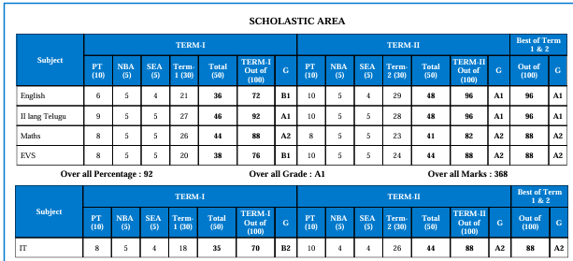
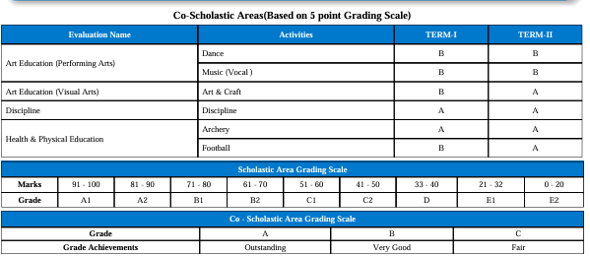
FINAL REPORT CARD

Slide 16
HPC(Holistic Progress Card)
HPC(Holistic Progress Card) is an alignment with NEP 2020.
HPC is strongly promoted under NEP 2020 which focuses on competency- based education and 360-degree progress tracking.
HPC aims to make assessments more inclusive ,equitable and student -centric.

Slide 17
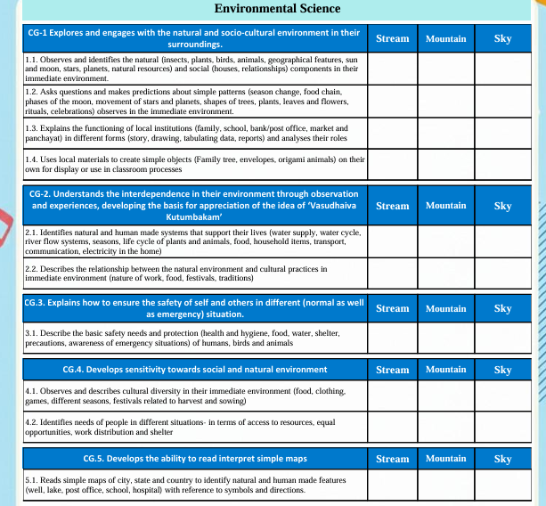

Slide 18
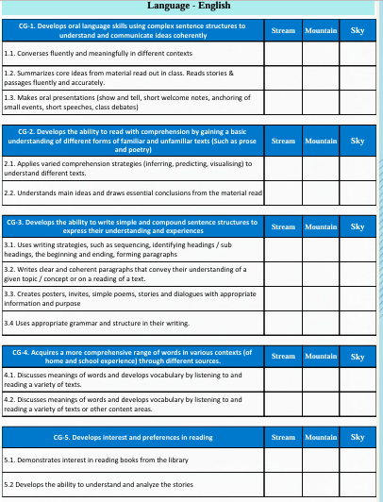
Holistic Report Card

Slide 19
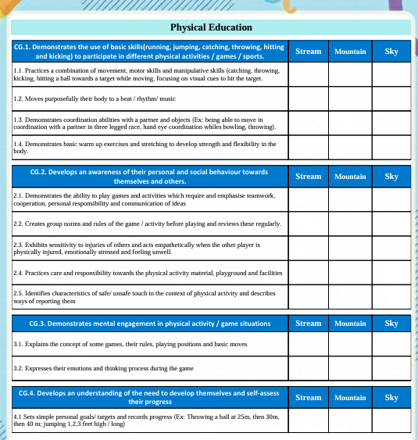

Slide 20
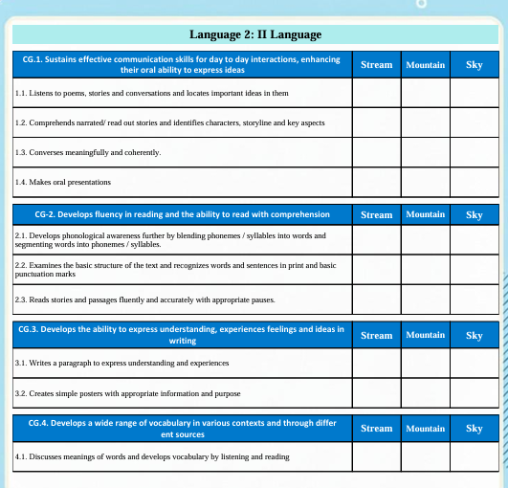

Slide 21
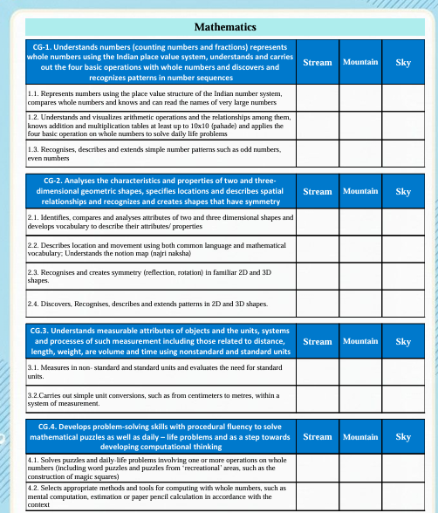

Slide 22
Interdisciplinary Project
LED will be conducted in the month of November which is an inter disciplinary project .
Grades will be allotted for LED presentations.

Slide 23

Inter Disciplinary Project
Student LED conference
Parameters:
Communication
Research
Confidence
Innovation
Collaboration

Slide 24

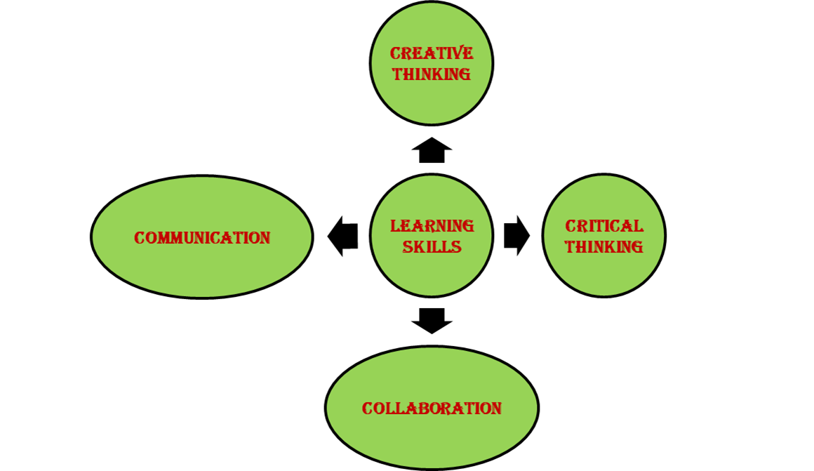

Slide 25
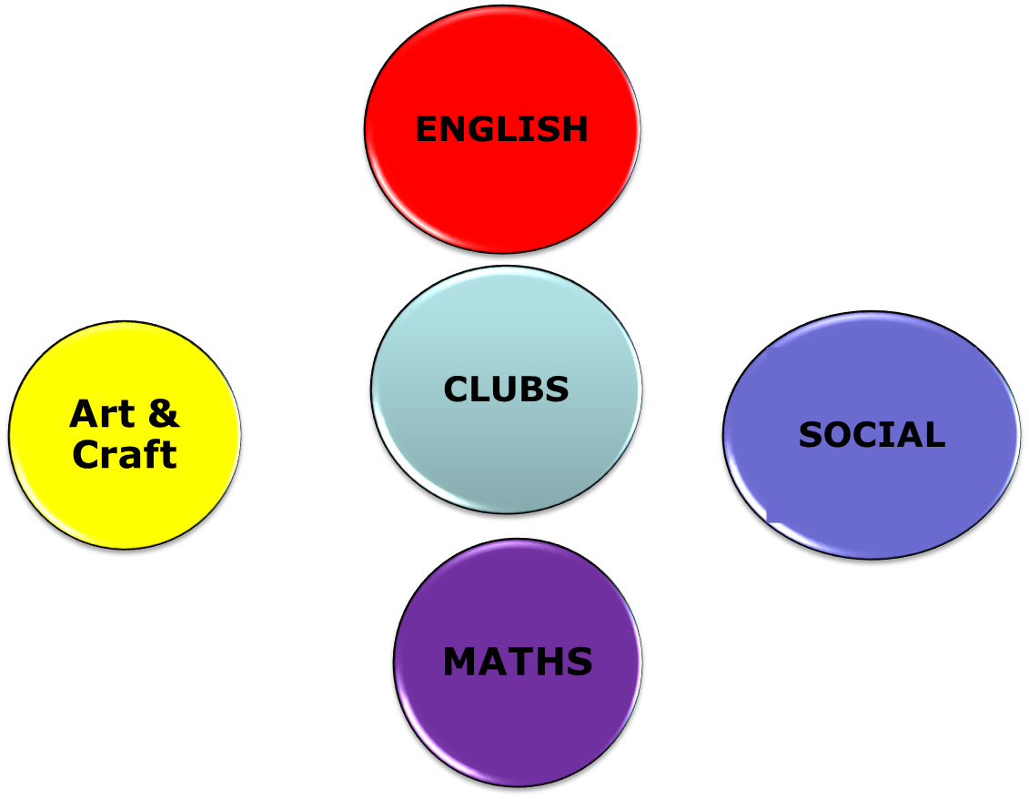


CLUB ACTIVITIES

Slide 26
Activities will be conducted in club periods every week except during PTs and examinations.
Active participation is mandatory for all the students for their overall development.
Subject wise club will be conducted and prior information will be given in the almanac.

Slide 27
Active participation is mandatory for all the students for their overall development.
Subject wise club will be conducted and prior information will be given in the almanac.

Slide 28
It involves continuous assessments rather than just term exams.
Assessment will be done through activities.
Note : Participation is mandatory in all the activities.

Slide 29
HOME ASSIGNMENT Schedule
DAY | SUBJECT
MONDAY | MATH | ENGLISH | EVS
TUESDAY | MATH | ENGLISH | II LANGUAGE
WEDNESDAY | MATH | EVS | II LANGUAGE
THURSDAY | MATH | ENGLISH | II LANGUAGE
FRIDAY | MATH | ENGLISH | EVS
SATURDAY | GK | EVS | II LANGUAGE

Slide 30
Weekly Assessment Schedule
DAY | SUBJECT
MONDAY | ----
TUESDAY | MATH
WEDNESDAY | ENGLISH
THURSDAY | EVS
FRIDAY | II LANGUAGE

Slide 31
Weekly Assessment Schedule
From Monday to Friday
Schedule with portion will be forwarded every weekend
Tests will be conducted by Subject teachers
in their respective periods

Slide 32
Zero Hour Schedule
Assembly - Monday to Wednesday
Spell check – Thursday and Friday

Slide 33
Co –scholastics Activities
Art Education
Visual
&
Performing Art
Physical Education
Assessed on a 5 point grading scale.

Slide 34
Physical Education
Group A
Archery
Yoga
Skating
Group B
Football
Volleyball
Basketball
Badminton
Karate
cricket

Slide 35
Art Education
Visual Arts
Drawing
&
Painting
Craft

Slide 36
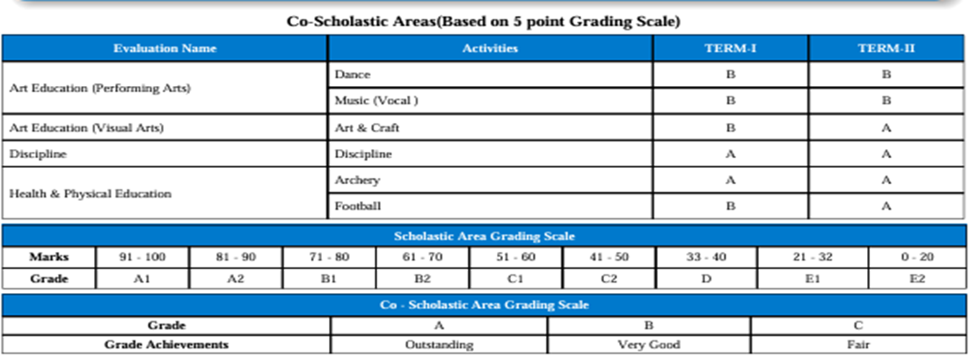

Slide 37
Regularity
Punctuality
Dress Code
Discipline
Assessed on a 5 point grading scale.

Slide 38
EXTERNAL COMPETITIONS FOR THE DEVELOPMENT OF COMPETITIVE SPIRIT
SOF OLYMPIADS
INTERNATIONAL GENERAL KNOWLEDGE OLYMPIAD (IGKO)
INTERNATIONAL ENGLISH OLYMPIAD (IEO)
NATIONAL SCIENCE OLYMPIAD (NSO)
INTERNATIONAL MATHEMATICS OLYMPIAD (IMO)
INTERNATIONAL COMPUTER SCIENCE OLYMPIAD (ICSO)
INTERNATIONAL SOCIAL STUDIES OLYMPIAD (ISSO)
INTERNATIONAL HINDI OLYMPIAD (IHO)

Slide 39
UNIFORM
REGULAR UNIFORM
SPORTS UNIFORM
CORPORATE T SHIRT
Regular School Uniform
School ID Card
Belt
Girls Hair Style- Two Plaits tied up with Black Ribbons
Black School Shoes
White Socks
House colour T-Shirt
Girls – skirt, Boys – shorts
School ID Card
Black School Shoes
Plain Navy Blue Socks
Girls Hair Style- Two Plaits tied up with black ribbons
On Saturday
Corporate T-shirt on navy blue jeans
Girls Hair Style- Any style
Shoes-Any type

Slide 40
LEVEL | INCHARGE | CO-ORDINATOR | CONTACT NUMBERS
I | VIJAYA RANI | SWAPNA | 7730901242
II | VIJAYA RANI | SWATHI | 9347976835
III | VIJAYA RANI | KEERTHI | 9652608914
IV | VIJAYA RANI | NAGA LAXMI | 7730901666
V | VIJAYA RANI | PRASANNA | 9063608914

Slide 41
AREA | INCHARGE | CONTACT NUMBERS
TRANSPORT | Mr. PRABHAKAR | 7997131415
ACCOUNTS | Mr. SURESH Mrs KAVITHA Mrs SABITHA | 9010105106
MAINTENANCE | Mr. FAZAL | 9849408877
ADMIN | Mr. SRIDHAR REDDY Mrs. BHAVANI | 9966028284 9000835242
FRONT OFFICE | Mrs MOUNIKA Mrs DEEPIKA | 7730872621
SPORTS DEPT. | Mr. SUDHAKAR | 9963887998

Slide 42


Slide 43
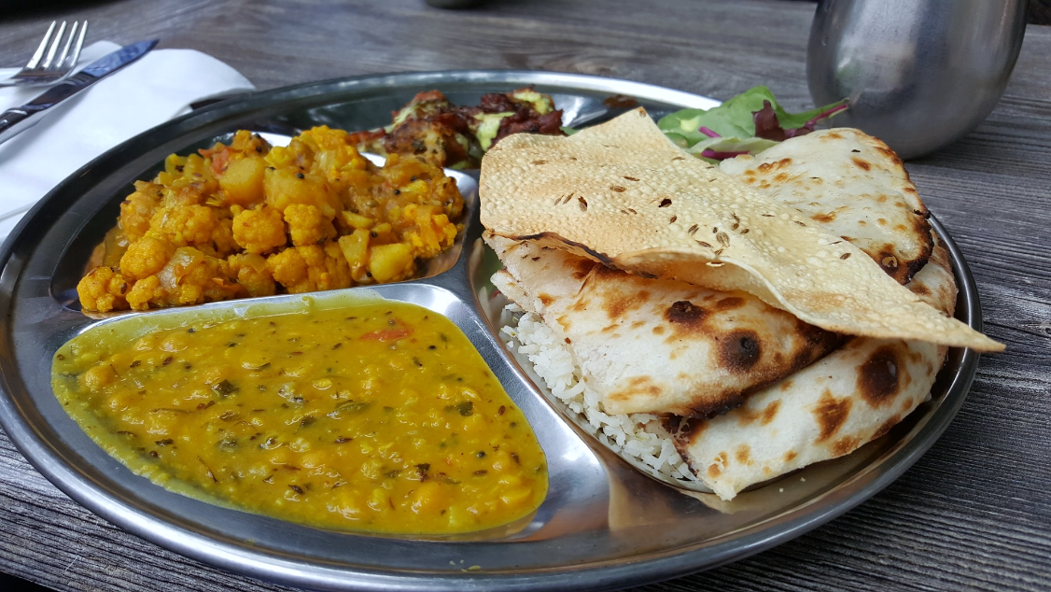
CANTEEN
Contact no: P. Vishnu Goud
9908996195
9398260903

Slide 44

ZEE HIGH SCHool Hayathnagar APP POWERED BY Edmatix
https://itunes.apple.com/in/app/edmatix-parents-app/id1460578434?mt=8

Slide 45
Need to check Zee High School Hayathnagar Parent App powered by Edmatix for the same using the credentials
Username: Admission Number
Password: DOB of your ward

Slide 46
COMMUNICATION
Website
whatsapp
Zee High School Hayathnagar App

Slide 47

Academic Incharge - A day with Parents
WEDNESDAY
Between
10 a.m
&
3.00 p.m
For prior appointment
contact
Class
Coordinator or
Front office.

Slide 48



“The education of a child involves three major components: Teacher, Student and Parent.”
Student
Teacher
Parent

Slide 49


