Slide 1


Zee HIGH SCHOOL
Hayathnagar CAMPUS
Parents’
Orientation Program
2026-27
classes 6 to 8

Slide 2


Slide 3


Slide 4
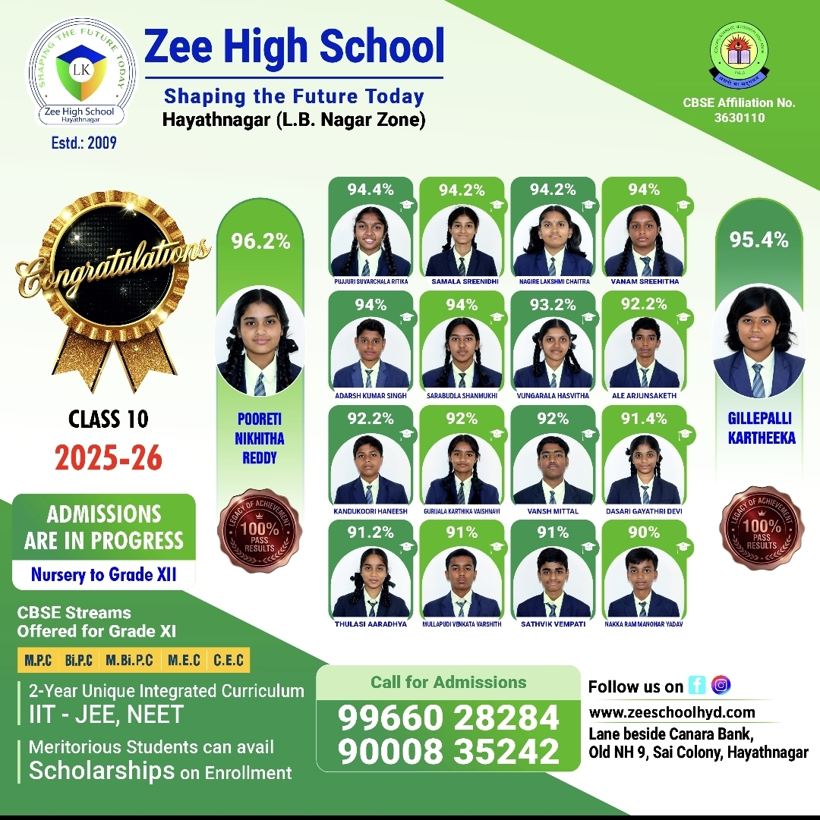

Slide 5
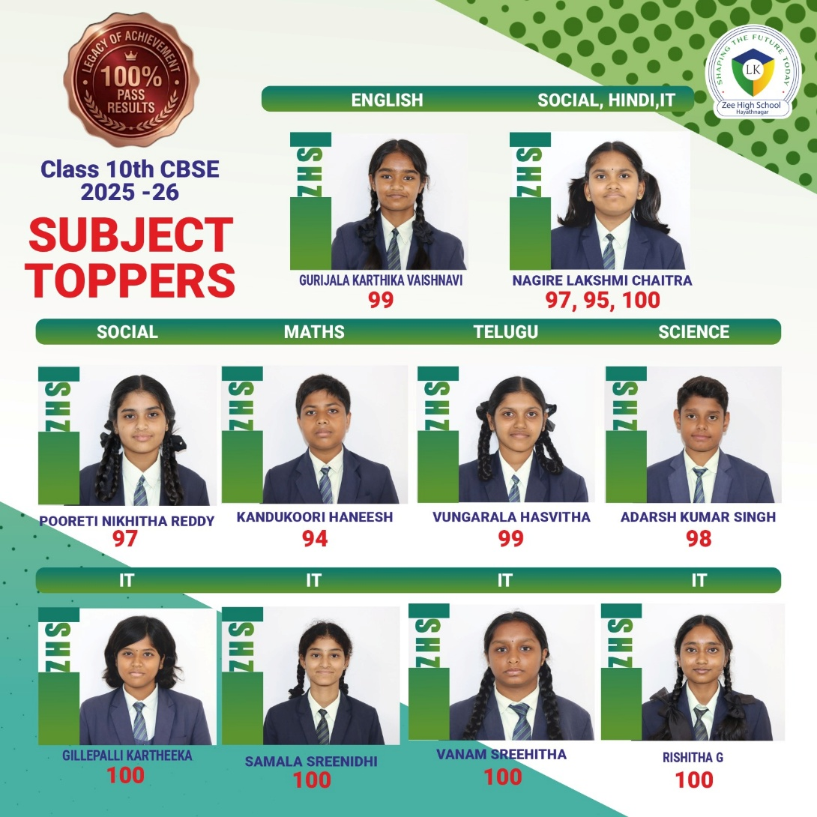

Slide 6
Subject Wise Highest Score
English
99
Mathematics
94
Science
98
Social Science
97
II Lang H/T
99
Information Technology
100

Slide 7
ENGLISH
II LANGUAGE Telugu/Hindi
III LANGUAGE Telugu/Hindi
MATHS
GENERALSCIENCE
SOCIAL SCIENCE
Information Technology
Academics

Slide 8
SUBJECT | CLASS VI
English | Mrs Selvi Mrs Poornima
II Lang. Hindi | Mrs Kausaur Mrs Hajeera
II Lang. Telugu | Mrs Jayalakshmi Mrs Sangeeta Mrs Uma maheshwari
III Lang Hindi | Mrs Kausaur Mrs Hajeera Mrs. Annamma
III Lang Telugu | Mrs Uma Maheshwari Mrs Sangeeta
Math | Mrs Kavitha Mrs Anusha Mrs.Navaneetha
G.Science | Mrs Deepthi Mrs Swathi Mrs Ramya
Social Science | Mrs Vani Mrs Sirisha Mrs. Anjani
IT | Mrs Kalpana

Slide 9
SUBJECT | CLASS VII
English | Mrs Sriveni Mrs Poornima
II Lang. Hindi | Mrs Neetu Thakur Mrs Sarita Roy
II Lang. Telugu | Mrs Padmalata Mrs Madhavi Mrs Jayalakshmi
III Lang Hindi | Mrs Kausaur Mrs Hajeera Mrs.Annamma
III Lang Telugu | Mrs Uma Maheshwari Mrs Sangeeta
Math | Mrs Kavitha Mrs. Navaneetha Mrs Anusha
Physics | Mrs Ramya
Bio/Chemistry | Mrs Swathi Mrs Deepthi
Social Science | Mrs Bhavya Mrs Anjani Mrs Sirisha Mrs Vani
IT | Mrs Kalpana

Slide 10
SUBJECT | CLASS VIII
English | Mrs Selvi Mrs Sriveni
II Lang. Hindi | Mrs Sarita Roy Mrs Neetu Thakur
II Lang. Telugu | Mrs Madhavi Mrs Padmalatha Mrs Jayalakshmi
III Lang Telugu | Mrs Jayalakshmi Mrs Padmalatha
III Lang Hindi | Mrs Sarita Roy Mrs Neetu Thakur Mrs Kausar
Math | Mrs.A.Anusha Mrs. Navaneetha Mr. Srinivas
Physics | Mrs Ramya Mr . Mahesh Mrs Sowmya
Chemistry | Mrs Meghana
Biology | Mrs Madhavi Mrs Swathi Mrs Deepthi
Social Science | Mrs Bhavya Mrs Anjani Mrs Sirisha
IT | Mrs Pallavi Mrs Kalpana

Slide 11
https://www.cbse.gov.in/

Slide 12
Additional Topics
Class | Math | Science
6 | 1) Patterns in Mathematics 2) Number Play | 1) Temparature and its Measurements 2) Beyond Earth 3) Adaptations
7 | 1) Number Play 2) Constructions | 1) Adolescence 2) World of Metals & Non-Metals 3) Earth, Moon and the Sun
8 | 1)Time and Work 2) Construction of Quadrilaterals 3) Visualising Solid Shapes 4) Statistics 5) Playing with Numbers | 1) Invisible Living World-Cell 2) Health the Ultimate Treasure 3) Our Home: Earth, a Unique Life Sustaining Planet 4) Particulate Nature of Matter 5) Amazing World Of Solutes

Slide 13
ADDITIONAL SUBJECT/
SKILL SUBJECT/6th SUBJECT
Skill education equips students with practical skills for specific trades or occupations.
The CBSE empowers students by offering a curriculum focused on life and employability skills, with 19 skill subjects at the secondary level and 39 at the senior secondary level.
This initiative helps students enhance their abilities and explore diverse career opportunities.
It also acts as a backup for a student who underperforms in one of their core subjects, the 6th subject can replace the lowest scoring marks.
https://cbseacademic.nic.in/skill-education.html

Slide 14
SKILL modules offered in middle school
TERM 1
CLASS | TERM 1 | TERM 2
6 | Beauty and Wellness | Food
 | Financial Literacy | Marketing
 | Travel and Tourism | Photography
 | Mass Media | Khadi
7 | Beauty and Wellness | Food
 | Financial Literacy | Marketing
 | Travel and Tourism | Photography
 | Mass Media | Khadi
8 | Food | Food Preservation
 | Financial Literacy | Marketing
 | Travel and Tourism | Satellite
 | Mass Media | Khadi

Slide 15
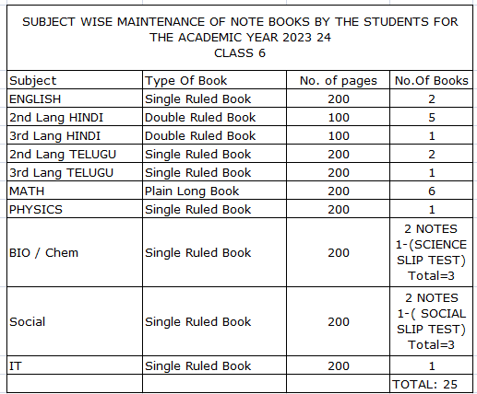
2025-26

Slide 16
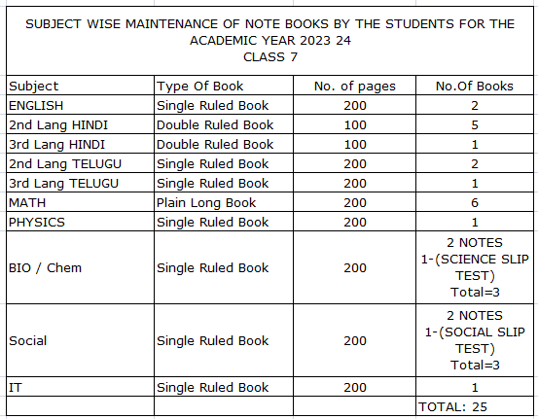
2025-26

Slide 17
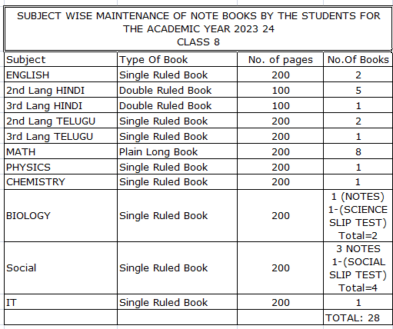
2025-26

Slide 18

ASSESSMENT STRUCTURE
Grade VI -VIII
PT 1 | PT 2 | PT Scale To | Note Book | SEA | Term 1 | TOTAL
25M | 25M | 10 M | 5M | 5M | 80 M | 100 M
PT 3 | PT 4 | PT Scale To | Note Book | SEA | Term 2 | TOTAL
25M | 25M | 10 M | 5M | 5M | 80 M | 100 M
TERM 1 + TERM 2 = 200M SCALE TO = 100 M

Slide 19
Term 1 Exam(80M)
Written Exam for 80 Marks with syllabus coverage as below:
Classes VI,VII,VIII:
Term I syllabus

Slide 20
Term 2 Yearly Exam(80M)
Written Exam for 80 Marks with syllabus coverage as below:
Class VI: 10% of 1st Term covering significant topics + entire syllabus of 2nd Term
Class VII: 20% of 1st Term covering significant topics + entire syllabus of 2nd Term
Class VIII: 30% of 1st Term covering significant topics + entire syllabus of 2nd Term

Slide 21
WEEKLY ASSESSMENT SCHEDULE 2026-27
DAY | Class 6 | Class 7 | Class 8
MONDAY | English | English | English
TUESDAY | science | science | math
WEDNESDAY | SOCIAL | Math | social
THURSDAY | Math | social | science
FRIDAY | II language | Ii Language | Ii language.

Slide 22
Weekly Assessment Schedule
From Monday to Friday between 8.30 am & 9.00 a.m
Schedule with portion will be forwarded every weekend
First 3 weeks of month Subjective paper of 10M
4th week of the month cumulative paper of 20M
Cumulative papers will be dispatched to parents/guardians
Result will be released every fortnight
Check Zee High School Hayathnagar App for the same using the credentials:
Username: Admission Number
Password: DOB of ward

Slide 23
Weekly Intervention Classes
 | Maths | Science | Social
Class 6 | 2 | 1 | 1
Class 7 | 2 | 1 | 1
Class 8 | 2 | 1 | 1

Slide 24
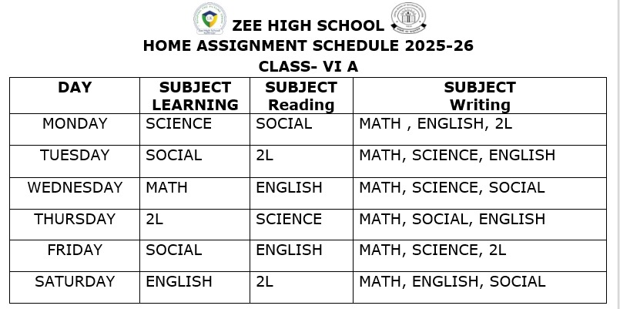
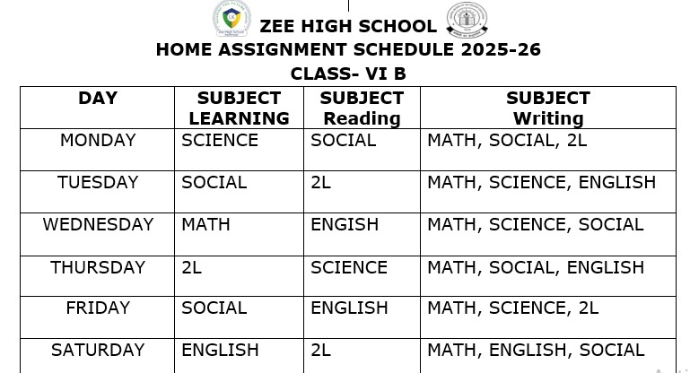
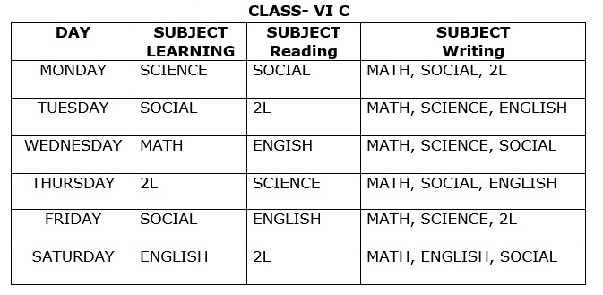
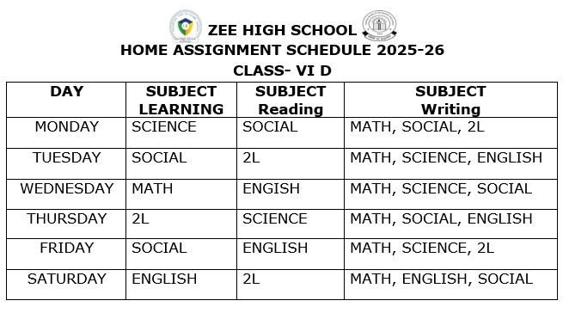
Home assignment Schedule

Slide 25
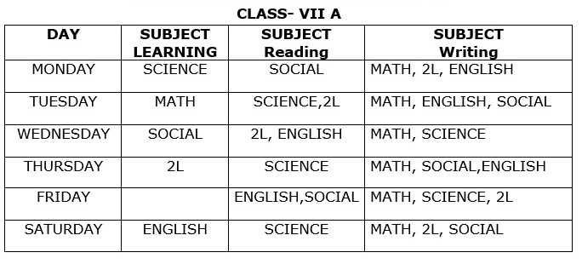
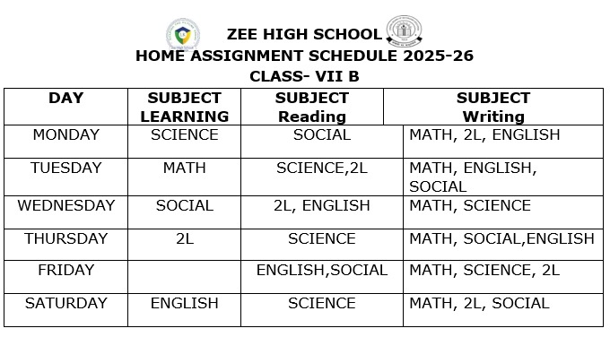
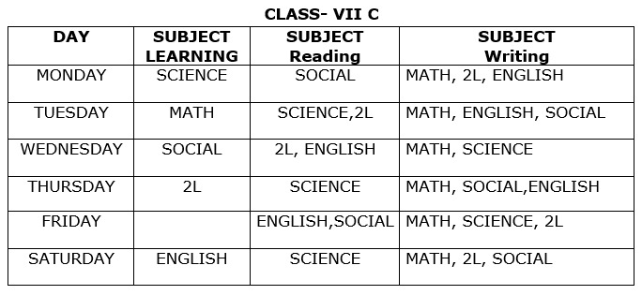
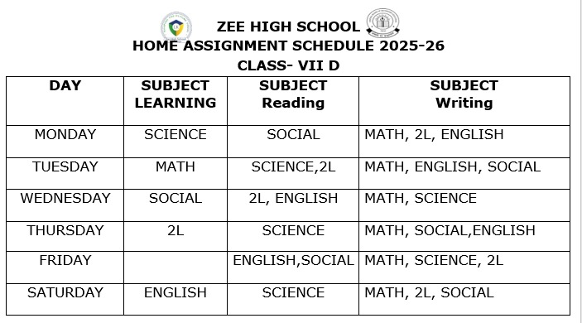
Home assignment Schedule

Slide 26
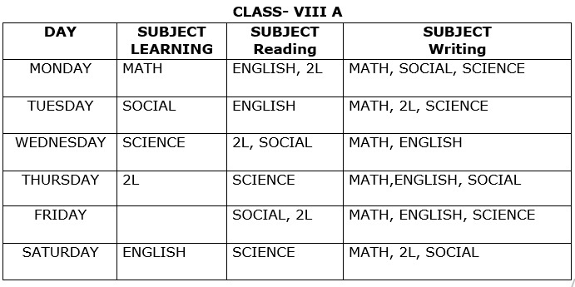
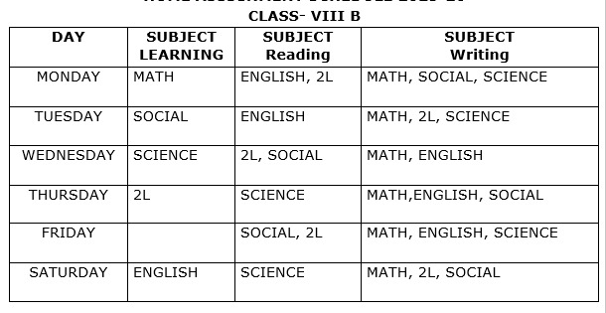
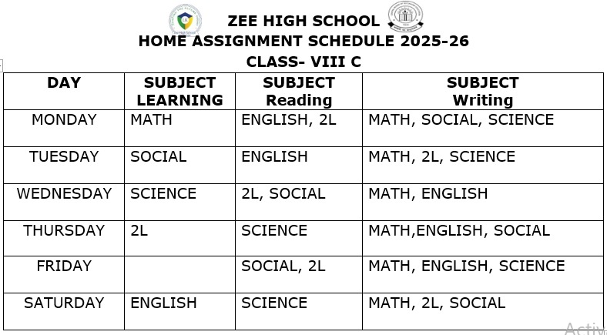
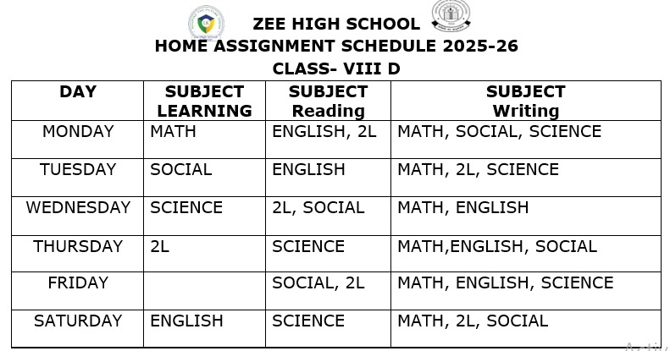
Home assignment Schedule

Slide 27
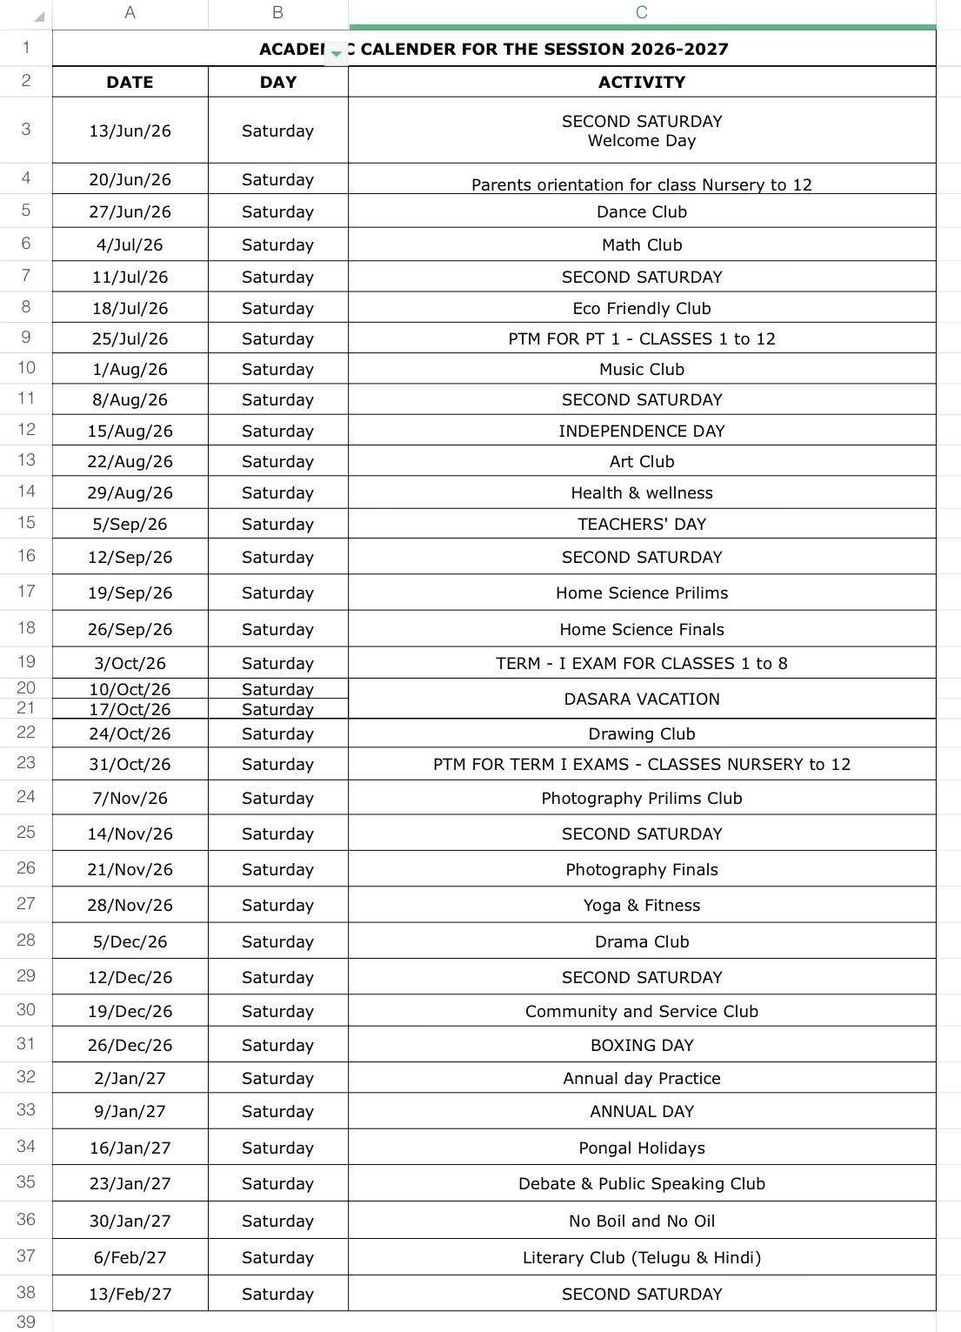
CLUB Activities

Slide 28
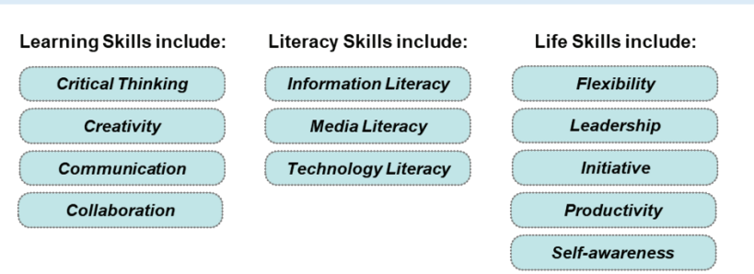
21st Century Skills

Slide 29
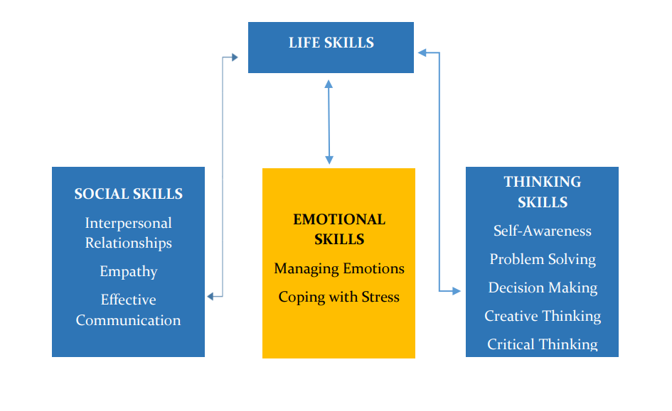
Life Skills

Slide 30
Co –scholastics Activities
Visual arts
Performing arts
Assessed on a 5 point grading scale.

Slide 31
Art Education
Performing Arts
Group C
Performing Arts
Vocal Music
Instrumental Music
Dance
Dramatics
Zumba Dance

Slide 32
Art Education
Visual Arts
Drawing
&
Painting
Craft

Slide 33
Extra Curricular Activities
Physical Education
Group A
Archery
Yoga
Skating
Karate
Group B
Football
Volleyball
Basketball
Cricket
Kho Kho
Badminton

Slide 34


Slide 35

01
05
POETRY
SPELLING
LITERARY CLUB
COMMUNICATION
02
HANDWRITING
READING
03
04

Slide 36
Regularity
Punctuality
Dress Code
Discipline
Assessed on a 5 point grading scale.

Slide 37

School Counsellor
We are dedicated to supporting students' academic, and personal-social development to help them reach their highest potential.
Name: Rajitha Chirra
Phone no:
9573767698

Slide 38
UNIFORM
REGULAR UNIFORM
SPORTS UNIFORM
CORPORATE T SHIRT
Regular School Uniform
School ID Card
Girls Hair Style- Two Plaits tied
up with Black Ribbons
Black School Shoes
Plain Navy Blue Socks
Belt
House colour T-Shirt
Girls – skirt,
Boys – shorts
School ID Card
Black School Shoes
Plain Navy Blue Socks
Girls Hair Style- Two Plaits tied up with black ribbons
On Saturday
Corporate T-shirt on navy blue jeans
Girls Hair Style- Any style
Shoes-Any type

Slide 39
LEVEL | CO-ORDINATOR | CONTACT NUMBERS
VI | NAGA POORNIMA | 8919767840
VII | SRIVENI | 9347823052
VIII | BHAVYA | 9398182919
IX | KONDA MADHURI | 9398568778
X | KAVITHA SRIPATHI | 9347792582
XI&XII | RAGHUNATH RAO | 7730901222

Slide 40
AREA | INCHARGE | CONTACT NUMBERS
TRANSPORT | Mr. PRABHAKAR | 7997131415
ACCOUNTS | Mr. SURESH Mrs KAVITHA Mrs SABITHA | 9010105106
MAINTENANCE | Mr. FAZAL | 9849408877
ADMIN | Mr. SRIDHAR REDDY Mrs. BHAVANI | 9966028284 9000835242
FRONT OFFICE | Mrs MOUNIKA Mrs DEEPIKA | 7730872621
SPORTS DEPT. | Mr. SUDHAKAR | 9963887998

Slide 41
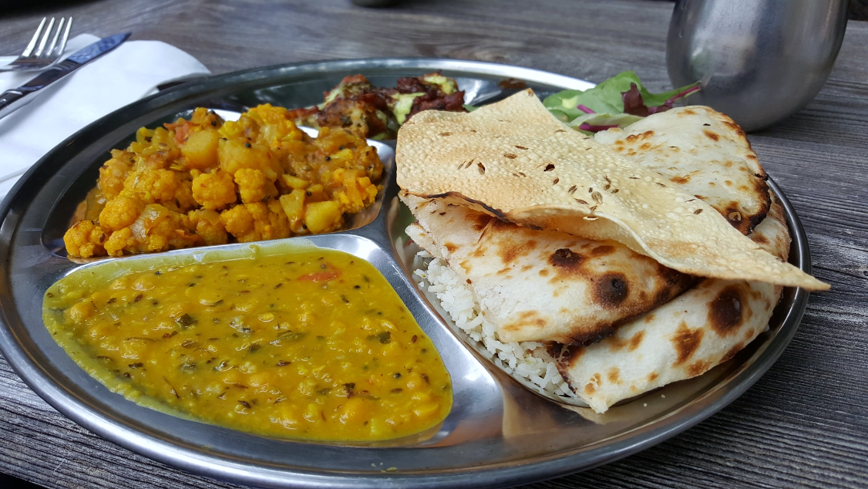
CANTEEN
Contact no: P. Vishnu Goud
9908996195
9398260903

Slide 42
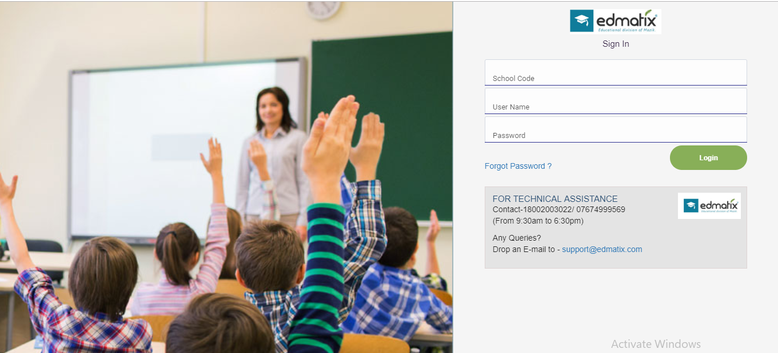
ZEE HIGH SCHool Hayathnagar APP POWERED BY Edmatix
https://itunes.apple.com/in/app/edmatix-parents-app/id1460578434?mt=8

Slide 43
COMMUNICATION
Website
whatsapp
Zee High School Hayathnagar App

Slide 44

Principal - A day with Parents
WEDNESDAY
Between
10 a.m
&
3.00 p.m
For prior appointment
contact
Front Office

Slide 45



“The education of a child involves three major components: Teacher, Student and Parent.”
Student
Teacher
Parent

Slide 46


