Slide 1


Parents’
Orientation Program
2026 -27
classes 9 &10
Zee HIGH SCHOOL,Hayathnagar CAMPUS

Slide 2


Slide 3


Slide 4
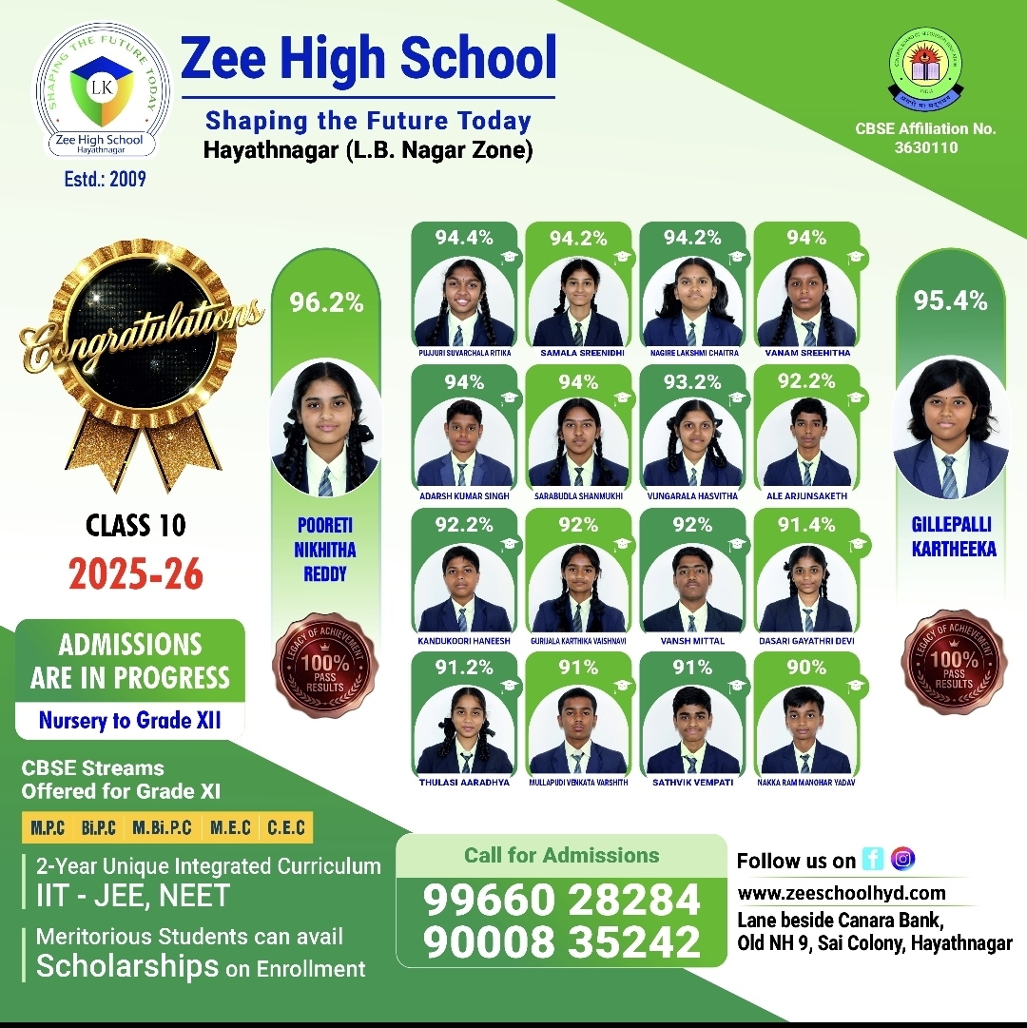

Slide 5
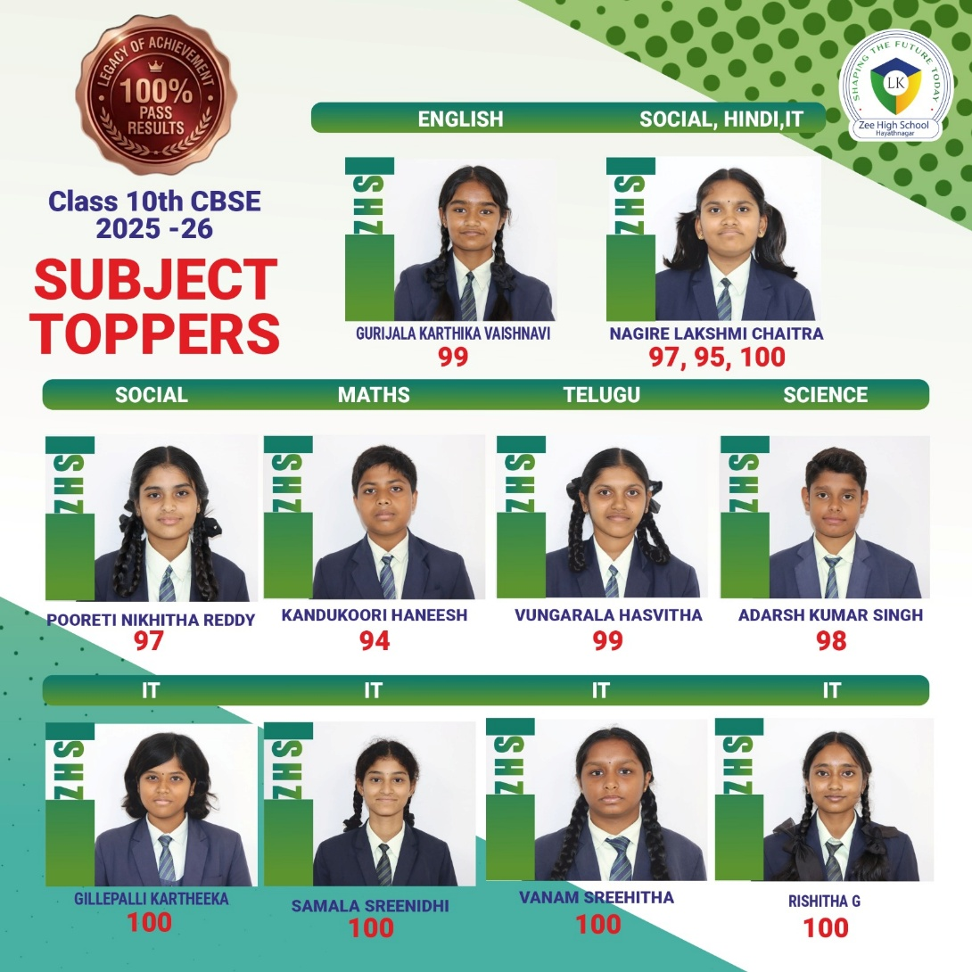

Slide 6


Slide 7
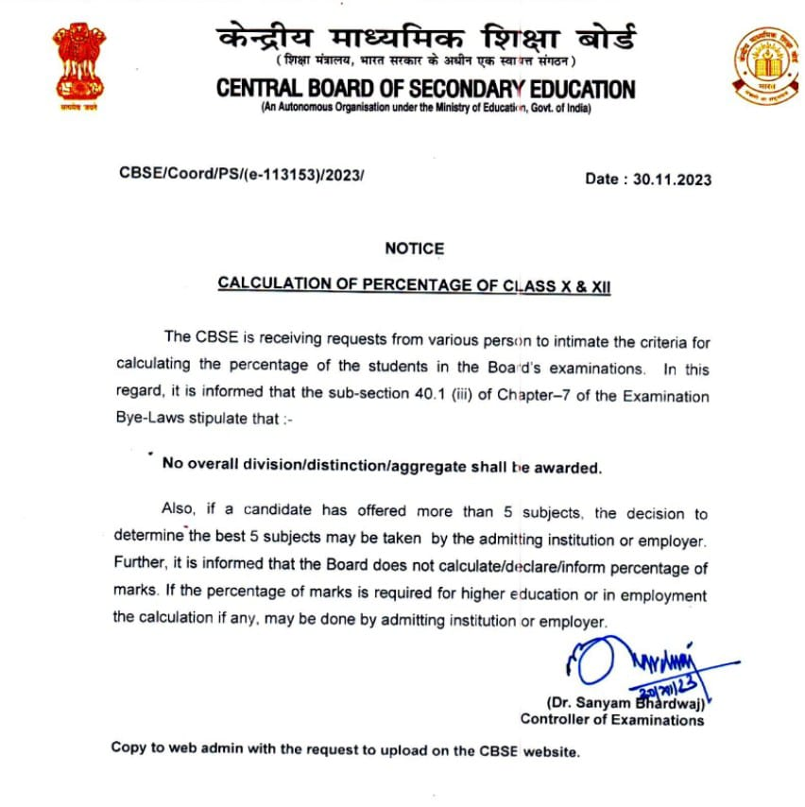

Slide 8
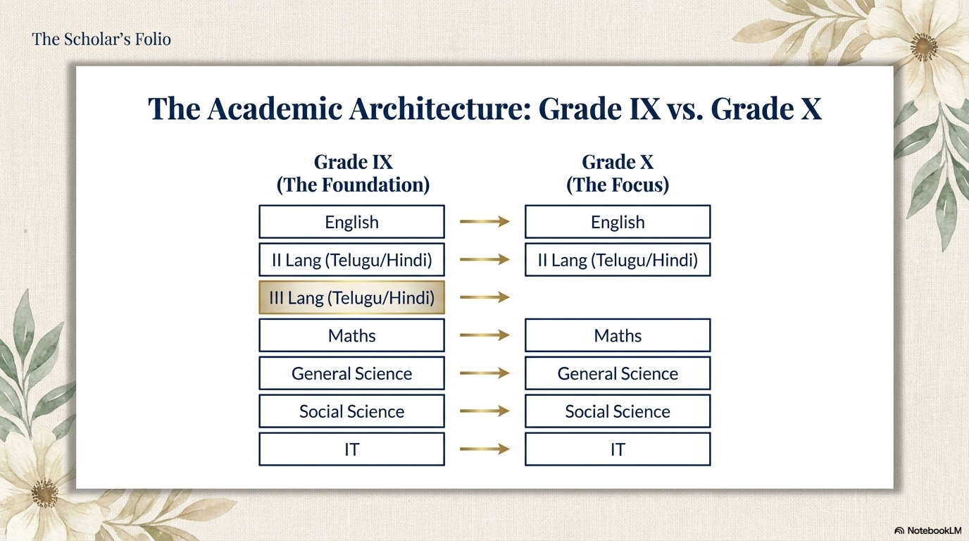

Slide 9
SUBJECT | CLASS IX | CLASS X
English | Mrs Srividya Mrs Selvi | Mrs Mehnaaz Mrs Selvi
II Language Hindi | Mrs Sarita Roy Mrs Nitu Thakur | Mrs Sarita Roy Mrs Nitu Thakur
III Language Hindi | Mrs Sarita Roy Mrs Nitu Thakur | Mrs Sarita Roy Mrs Nitu Thakur
II Language Telugu | Mrs Madhavi Mrs Padmalata | Mrs Madhavi Mrs Padmalata Mrs Jayalakshmi
III Language Telugu | Mrs Madhavi Mrs Padmalata | NIL
Maths | Mrs Kavita Mr Srinivas Mr C.Vinod | Mrs Kavita Mr C.Vinod
Physics | Mr Mahesh Mrs Ramya Mrs Sowmya Lakshmi | Mrs Ramya Mrs Sowmya Lakshmi
Chemistry | Mrs Anitha Mrs Meghana | Mrs Meghana Mrs Anitha
Biology | Mrs Deepthi Reddy Mrs Dhanalakshmi Mrs Madhavi | Mrs Dhanalakshmi Mrs Madhavi
Social Sciences | Mrs Madhuri Mrs Mounika | Mrs Madhuri Mrs Mounika
IT | Mrs Pallavi Mrs Kalpana | Mrs Pallavi

Slide 10
SUBJECT WISE MAINTAINANCE OF NOTE BOOKS BY THE STUDENTS FOR THE ACADEMIC YEAR 2026-27
CLASSES:9,10
SUBJECT | TYPE OF NOTE BOOK | QUANTITY
English | 200 Pages Ruled Book | 3
Hindi | 100 Pages Double Ruled Book | 6
Telugu | 200 Pages Ruled Book | 3
Science | 200 Pages Ruled Book | 4
Social | 200 Pages Ruled Book | 3
IT | 200 Pages Ruled Book | 1
 | TOTAL | 20

Slide 11
https://www.cbse.gov.in/

Slide 12
GRADE IX,X- ENGLISH QUESTION Paper
WEIGHTAGE & design
Section |  | Total Weightage 80
A | Reading Skills | 20
B | Writing Skills with Grammar | 20
C | Literature Textbook and Supplementary Reading Text | 40
Note-The Annual Examination, School / Board Based will be of 80 marks,with a duration of three hours.
Internal Assessment (ASL) for 20 Marks.

Slide 13


Slide 14
CBSE
brings change
in
Class 9th
Math
Two levels
2026-27
Mathematics-NCERT
Mathematics-Advance

Slide 15
GRADE IX -MATH Course WEIGHTAGE
UNITS | NCERT SYLLABUS UNIT NAME | MARKS | ADVANCE SYLLABUS
I | Number Systems | 07 | Coordinate Geometry Sets Logarithms Relations and Functions Combinatorics Exploring some more Progressions
II | Algebra | 20
III | Coordinate Geometry | 04
IV | Geometry | 25
V | Mensuration | 14
VI | Statistics & Probabilty | 10
 | Total | 80 | 25
Note-The School Based TERM 1 & TERM 2 will be of 80 marks with a duration of three hours.
Internal Assessment for 20 Marks.

Slide 16
ZEE HIGH SCHOOL, HAYATHNAGAR
Class : IX Year Plan 2026-27
Sub: Mathematics Name of the sub. Teachers:Kavitha, C.Vinod, Mahesh
S.N | MONTH | NCERT Syllabus | IIT/ Advance Course Syllabus
1 | March | Lines and Angles
2 | April | Triangles – Congruence Theorems
3 | June | Orienting Yourself: The use of Coordinates (Coordinate Geometry) Introduction to Linear Polynomials | Coordinate Geometry
4 | July | The World of Numbers Exploring Algebraic Identities | Sets
5 | August | I’m Up and Down, and Round and Round (Circles) Measuring Space : Perimeter and Area | Logarithms,
6 | September | Revision, Exams
7 | October | The Mathematics of may be : Introduction to Probability Predicting What comes next : Exploring sequences and Progressions | Relations and Functions
8 | November | Linear equations in Two variables Surface Areas and Volumes | Combinatorics
9 | December | Statistics Quadrilaterals Introduction to Euclid’s Geometry | Exploring some more Progressions

Slide 17
CBSE
brings change in board exam
Class 10 Math Board Exam to have
two levels from 2019-20
Mathematics-Standard: For the existing level of examination
Mathematics-Basic: For the easier level

Slide 18
GRADE X -MATH Course WEIGHTAGE
UNITS |  | MARKS
I | Number Systems | 06
II | Algebra | 20
III | Coordinate Geometry | 06
IV | Geometry | 15
V | Trigonometry | 12
VI | Mensuration | 10
VII | Statistics & Probabilty | 11
Total | Total | 80
Note-The Annual Examination, School / Board Based will be of 80 marks with a duration of three hours.
Internal Assessment for 20 Marks.

Slide 19
ZEE HIGH SCHOOL, HAYATHNAGAR
Class : X Year Plan 2026-27
Sub: Mathematics Name of the sub. Teacher: Kavitha, C.Vinod
S.N | MONTH | NCERT Syllabus | IIT Foundation Course Syllabus
1 | March | Real Numbers Polynomials Statistics Probability
2 | April | Pair of Linear Equations in two variables Quadratic Equations
3 | June | Arithmetic Progressions Co-ordinate Geometry | Arithmetic Progressions Co-Ordinate Geometry
4 | July | Triangles | Triangles
5 | August | Circles Areas Related to Circles Surface Areas & Volumes | Circles Areas Related to Circles Surface Areas & Volumes
6 | September | Real Numbers Polynomials Statistics Probability | Real Numbers Polynomials Statistics Probability
7 | October | Trigonometry | Trigonometry
8 | November | Heights and Distances | Heights and Distances
9 | December | Sets | Sets

Slide 20
GRADE IX-SCIENCE Course WEIGHTAGE
UNITS | NCERT SYLLABUS UNIT NAME | MARKS | ADVANCE SYLLABUS
Chemistry | Exploring Mixtures & their Separation Journey inside the Atom, Atomic Foundations of Matter, Earth as a system:Energy Matter & Life | 25 | Structure of Atom Mixtures and their separation Chemical Bonding
Biology | Cell Tissues Reproduction in Plants & Animals Diversity | 30 | Microscope and Microscopy Engineering and Biotechnology
Physics | Motion Force Work Energy Simple Machines Sound | 25 | Measurement-Foundation of Science Understanding Motion Through Experience Newton’s Laws of Motion Geometry of Power- Advance Simple Machines Work and Energy
 | Total | 80 | 25
Note-The School Based TERM 1 & TERM 2 will be of 80 marks with a duration of three hours.
Internal Assessment for 20 Marks.

Slide 21
ZEE HIGH SCHOOL, HAYATHNAGAR
Class : IX Year Plan 2026-27
Sub: Physics Name of the sub. Teacher: Ramya, Mahesh, Sowmya
S.N | MONTH | NCERT Syllabus |  | IIT/Advance Course Syllabus
1 | March
2 | April | Ch.7. Motion
3 | June | Ch.7. Motion
4 | July | Ch.8. Force and Laws of Motion
5 | August | 10. Work and Energy
6 | September | Term- I Revision, Exams
7 | October | 9.Simple Machines 11. Sound
8 | November |  |  | Measurement-Foundation of Science Understanding Motion Through Experience Newton’s Laws of Motion
9 | December |  |  | Geometry of Power- Advance Simple Machines Work and Energy

Slide 22
ZEE HIGH SCHOOL, HAYATHNAGAR
Class : IX Year Plan 2026-27
Sub: Chemistry Name of the sub. Teacher: Meghana, Anitha
S.N | MONTH | NCERT Syllabus |  | IIT/AdvanceCourse Syllabus
1 | March | Exploring Mixtures and their Separations
2 | April | Exploring Mixtures and their Separations
3 | June | Exploring Mixtures and their Separations
4 | July | Journey inside the Atom
5 | August | Atomic Foundations of Matter
6 | September | Revision and Term 1
7 | October | Earth as a system: Energy , Matter & Life Exploration : exploring the World of Secondary Science
8 | November |  |  | Structure of Atom Mixtures and their separation
9 | December |  |  | Chemical Bonding

Slide 23
ZEE HIGH SCHOOL, HAYATHNAGAR
Class : IX Year Plan 2026-27
Sub: Biology Name of the sub. Teacher: Dhanalaxmi, Madhavi
S.N | MONTH | NCERT Syllabus |  | IIT/Advance Course Syllabus
1 | March | Cell: Building block of Life
2 | April | Cell: Building block of Life
3 | June | Cell: Building block of Life
4 | July | Cell:Building block of Life Tissues in Action
5 | August | Tissues in Action Reproduction in Plants & Animals-How Life continues
6 | September | Term- I Revision, Exams
7 | October | Reproduction in Plants & Animals-How Life continues Patterns in Life Diversity and Classification
8 | November |  |  | Microscope and Microscopy
9 | December |  |  | Engineering and Biotechnology

Slide 24
GRADE X-SCIENCE Course
UNITS | UNIT NAME | MARKS
Chemistry | Chemical Reactions & equations Acids, Bases & Salts Metals & Non- Metals Carbon & its Compounds | 25
Biology | Life Process Control & Cordination How Do Organisms Reproduce? Heridity Our Environment | 30
Physics | Electricity Light-Reflection & Refraction Magnetism Human Eye & Colourful World | 25
Total | Total | 80
Note-The Annual Board Examination will be of 80 marks, with a duration of three hours.
Internal Assessment for 20 Marks.

Slide 25
ZEE HIGH SCHOOL, HAYATHNAGAR
Class : X Year Plan 2026-27
Sub: Physics Name of the sub. Teacher:Ramya, Mahesh, Sowmya
S.N | MONTH | Syllabus | IIT Foundation Course Syllabus
1 | March | Ch.11. Electricity
2 | April | Ch.11. Electricity
3 | June | Ch.9. Light Reflection | Ch.9. Light - Reflection
4 | July | Ch.9. Light Refraction | Ch.9. Light. Refraction
5 | August | CH.10. Human Eye: Colourful World | CH.10. Human Eye: Colourful World
6 | September | Term- I Revision
7 | October | CH.10. Human Eye: Colourful World | Ch.11. Electricity
8 | November | Ch.12. Mg Effect of Electric Current | Ch.11. Electricity
9 | December |  | Ch.12. Magnetic Effect of Electric Current

Slide 26
ZEE HIGH SCHOOL, HAYATHNAGAR
Class : X Year Plan 2026-27
Sub: Chemistry Name of the sub. Teacher: Meghana, Anitha
S.N | MONTH | Syllabus | IIT Foundation Course Syllabus
1 | March | Chemical Reactions & Chemical Equations
2 | April | Chemical Reactions & Chemical Equations
3 | June | Chemical Reactions & Chemical Equations | Chemical Reactions & Equations
4 | July | Acids, Bases & Salts | Chemical Reactions & Equations
5 | August | Metals & Non Metals | Acids Bases & Salts
6 | September | Revision , Exams
7 | October | Carbon and its Compounds | Metals & Non Metals
8 | November | Carbon and its Compounds | Metals & Non Metals
9 | December |  | Carbon & Its Compounds

Slide 27
ZEE HIGH SCHOOL, HAYATHNAGAR
Class : X Year Plan 2026-27
Sub: Biology Name of the sub. Teacher :Dhanalaxmi, Madhavi
S.N | MONTH | Syllabus | IIT Foundation Course Syllabus
1 | March | Life Processes: Nutrition
2 | April | Life Processes: Respiratory & Transport System
3 | June | Control and Coordination | Life Processes
4 | July | Control and Coordination, How do Organisms Reproduce | Control and Coordination
5 | August | How do Organisms Reproduce | How do Organisms Reproduce
6 | September | Revision, Exams
7 | October | Heredity | Heridity
8 | November | Heredity Our Environment | Our Environment
9 | December

Slide 28
Social Science
Part 1
Part 2
https://cbseacademic.nic.in/web_material/CurriculumMain27/SecPart1/SocialScience_SecP1IX_2026-27.pdf

Slide 29
GRADE IX- Social SCIENCE Course
PART 1 | PART 2
Understanding Social Science Shaping of the Earth’s Surface Atmosphere & Climate Begining of Civilisation State & Society Democracy Elections Building Blocks in Economics The Price Puzzle | Oceans & Life Life on Earth Building a Resilent India India and the world -I Authourity From Ideas to Startups Smart Ways to manage your finances
Note-The School Based TERM 1 & TERM 2 Examinations will be of 80 marks, with a duration of three hours.
Internal Assessment for 20 Marks.

Slide 30
Vocational Skill Education
Kaushal Vikas
https://cbseacademic.nic.in/web_material/Curriculum27/publication/secondary/Vocational_Education_(Kaushal_Vikas)_book.pdf

Slide 31
GRADE X- Social SCIENCE Course
UNITS | UNIT NAME | MARKS
I | India and the Contemporary World – I | 20
II | Contemporary India – I | 20
III | Democratic Politics - I | 20
IV | Economics | 20
Total | Total | 80
Note-The Annual Board Examination will be of 80 marks, with a duration of three hours.
Internal Assessment for 20 Marks.

Slide 32
ASSESSMENT STRUCTURE
Grade IX
Test/Exam | Maximum Marks | Portfolio | SEA
Periodic Test 1 | 30 Marks | 5M | 5M
Periodic Test 2 | 30 Marks
Periodic Test 3 | 30 Marks
Scale to | 10 Marks
Term 1 | 80 Marks
Term 2 | 80 Marks
NOTE: Diverse Methods of Assessment

Slide 33
ASSESSMENT STRUCTURE
Grade X
Test/Exam | Maximum Marks | Portfolio 5M | SEA 5M
Periodic Test 1 | 30 Marks
Periodic Test 2 | 30 Marks
Periodic Test 3 | 30 Marks
Term 1 | 80 Marks
Pre Board 1 | 80 Marks
Pre Board 2 | 80 Marks
Pre Board 3 | 80 Marks
NOTE: Diverse Methods of Assessment

Slide 34
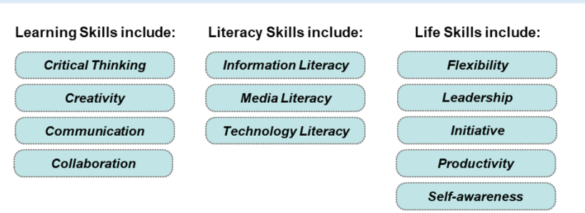
21st Century Skills

Slide 35
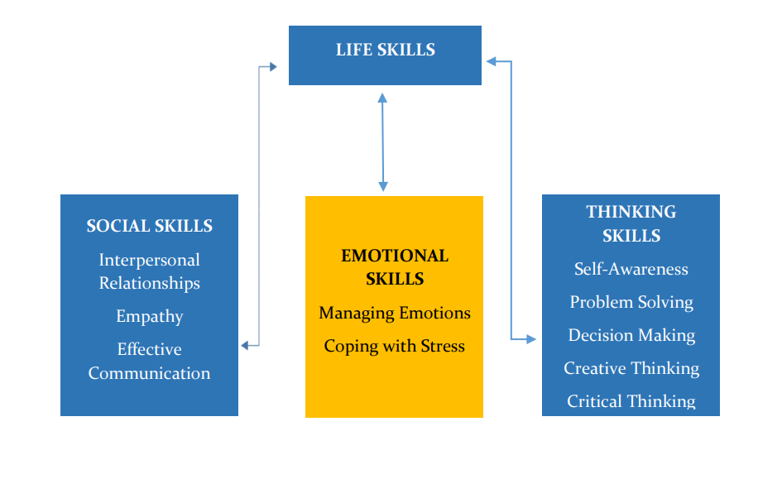
Life Skills

Slide 36
Weekly Test Schedule-IX
Day | Subject
Monday | Math
Tuesday | English
Wednesday | Social
Thursday | 2 Language
Friday | Science

Slide 37
Weekly Test Schedule-X
Day | Subject
Monday | Math
Tuesday | English
Wednesday | Social
Thursday | 2 Language
Friday | Science

Slide 38
Weekly Assessment for classes 9,10
From Monday to Friday between 8.30 am & 9.00 a.m
A 20 M paper including MCQ & Subjective Questions
Schedule with portion will be forwarded every weekend
Result will be released every fortnight
Need to check Zee High School Parent App powered by Edmatix for the same using the credentials
Username: Admission Number
Password: DOB of your ward

Slide 39
CUMULATIVE ASSESSMENT FOR MATH & SCIENCES Of classes 9,10
Will be held on Fourth Friday of a month.
A 60m MCQ Paper including 15 questions each from Math, Physics, Chemistry & Biology
Schedule with portion will be forwarded
Result will be released in a week.
Need to check Zee High School Parent App powered by Edmatix for the same using the credentials
Username: Admission Number
Password: DOB of your ward

Slide 40
Intervention Classes Weekly
 | Social
Class 9 | 2
Class 10 | 2

Slide 41

ZEE HIGH SCHOOL PARENT APP POWERED BY Edmatix
https://itunes.apple.com/in/app/edmatix-parents-app/id1460578434?mt=8
Contact:Bhavani-9000835242

Slide 42
CO SCHOLASTIC ACTIVITY
Physical Education
Group B
Football
Volleyball
Basketball
Cricket
Badminton
Kho Kho
Assessed on a 5 point grading scale.

Slide 43


Slide 44
Regularity
Punctuality
Dress Code
Discipline
A process of
controlling
one's behavior
and actions,
either through
self-motivation
or through teaching
Assessed on a 5 point grading scale.

Slide 45

School Counsellor
We are dedicated to supporting students' academic, and personal-social development to help them reach their highest potential.
Name: Rajitha Chirra
Phone no:
9573767698

Slide 46
UNIFORM
REGULAR UNIFORM
SPORTS UNIFORM
CORPORATE T SHIRT
Regular School Uniform
School ID Card
Girls Hair Style- Two Plaits tied
up with Black Ribbons
Black School Shoes
Plain Navy Blue Socks
Belt
House colour T-Shirt
Girls – skirt,
Boys – shorts
School ID Card
Black School Shoes
Plain Navy Blue Socks
Girls Hair Style- Two Plaits tied up with black ribbons
On Saturday
Corporate T-shirt on navy blue jeans
Girls Hair Style- Any style
Shoes-Any type

Slide 47


Slide 48
LEVEL | CO-ORDINATOR | CONTACT NUMBERS
VI | NAGA POORNIMA | 8919767840
VII | SRIVENI | 9347823052
VIII | BHAVYA | 9398182919
IX | KONDA MADHURI | 9398568778
X | KAVITHA SRIPATHI | 9347792582
XI&XII | RAGHUNATH RAO | 7730901222

Slide 49
AREA | INCHARGE | CONTACT NUMBERS
TRANSPORT | Mr. PRABHAKAR | 7997131415
ACCOUNTS | Mr. SURESH Mrs KAVITHA Mrs SABITHA | 9010105106
MAINTENANCE | Mr. FAZAL | 9849408877
ADMIN | Mr. SRIDHAR REDDY Mrs. BHAVANI | 9966028284 9000835242
FRONT OFFICE | Mrs MOUNIKA Mrs DEEPIKA | 7730872621
SPORTS DEPT. | Mr. SUDHAKAR | 9963887998

Slide 50
COMMUNICATION
Website
whats app
Zee High School Parent App

Slide 51
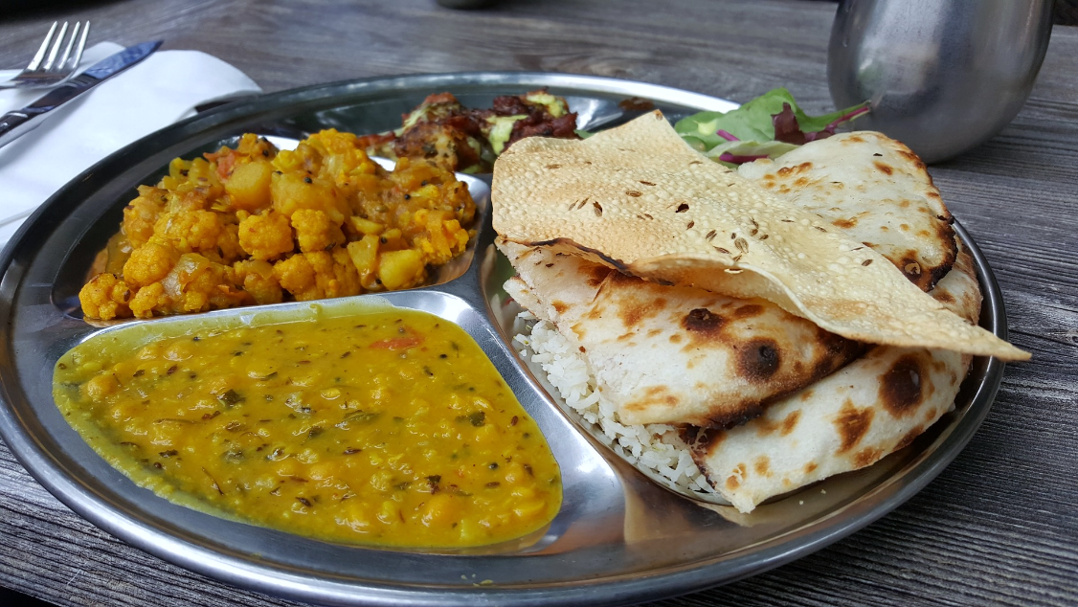
CANTEEN
Contact no: P. Vishnu Goud
9908996195
9398260903

Slide 52

Principal - A day with Parents
WEDNESDAY
Between
10 a.m
&
3.00 p.m
For prior appointment
contact
Front Office

Slide 53



“The education of a child involves three major components: Teacher, Student and Parent.”
Student
Teacher
Parent

Slide 54


